Slide 1
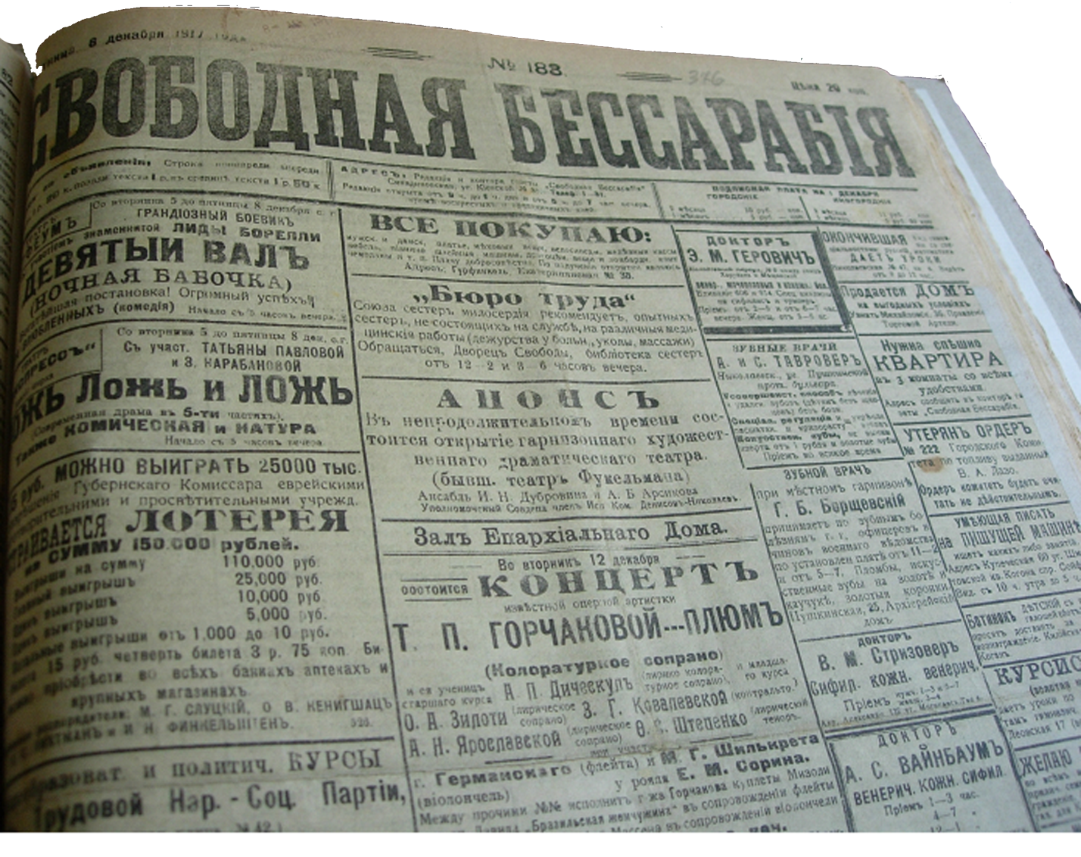
“Bessarabian Jewish entrepreneurs in 1870 – 1917–s”

Slide 2
ALLA CHASTINA (MOLDOVA, KISHINAU)

Slide 3
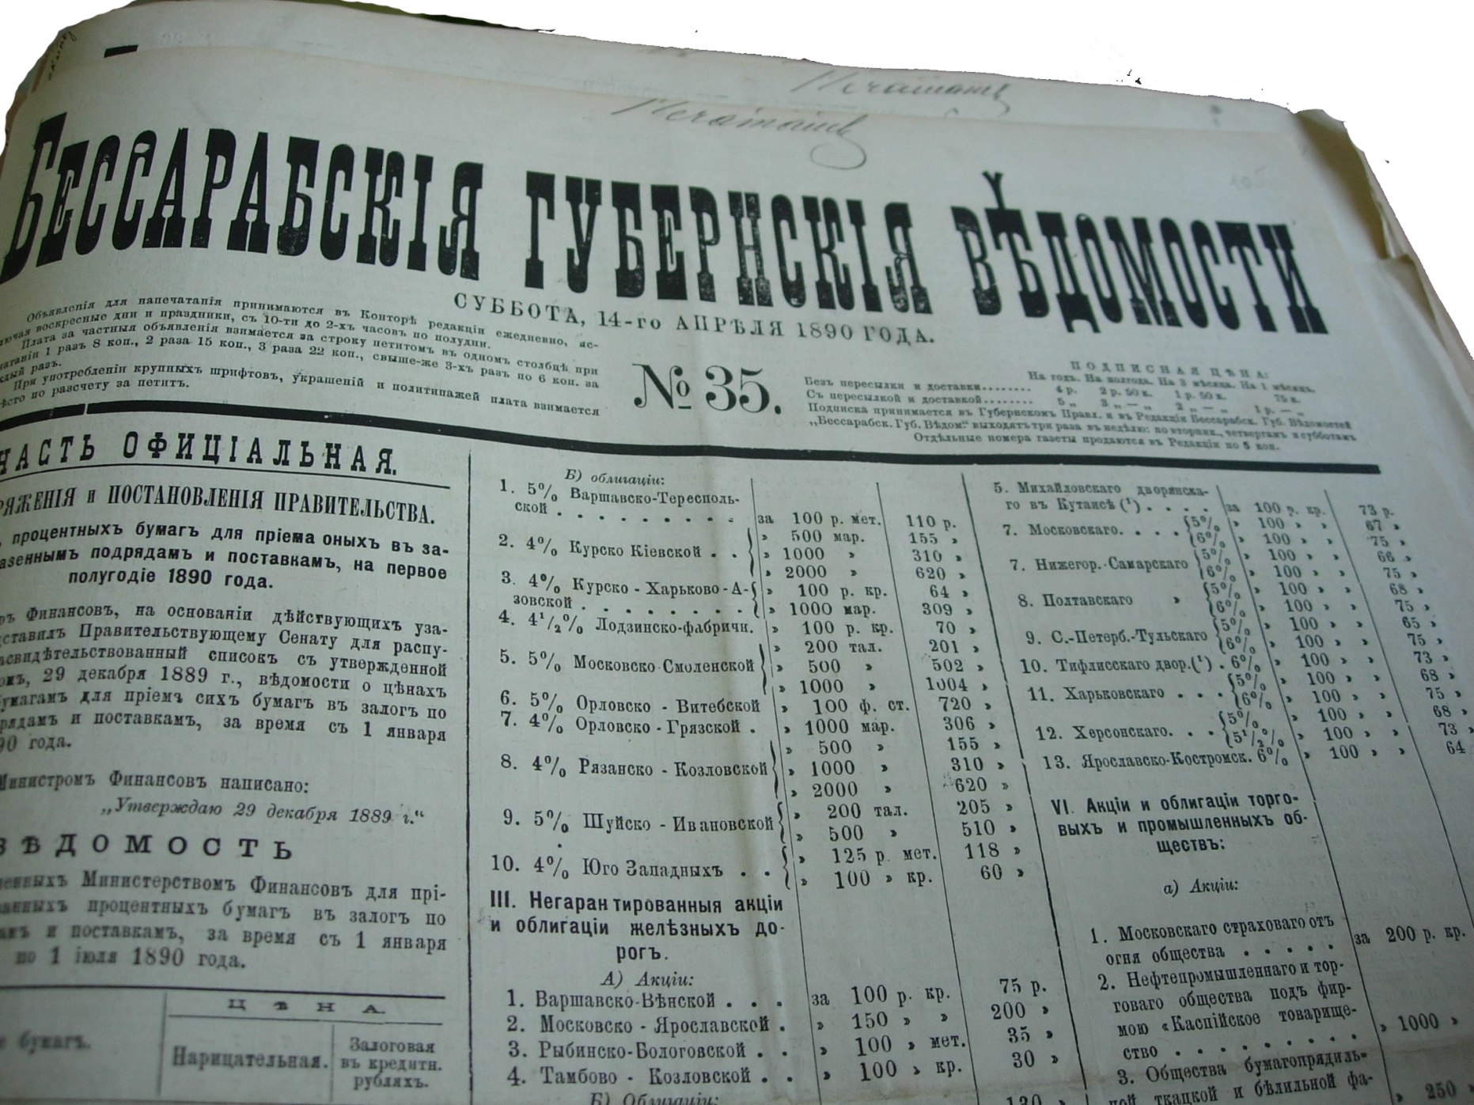
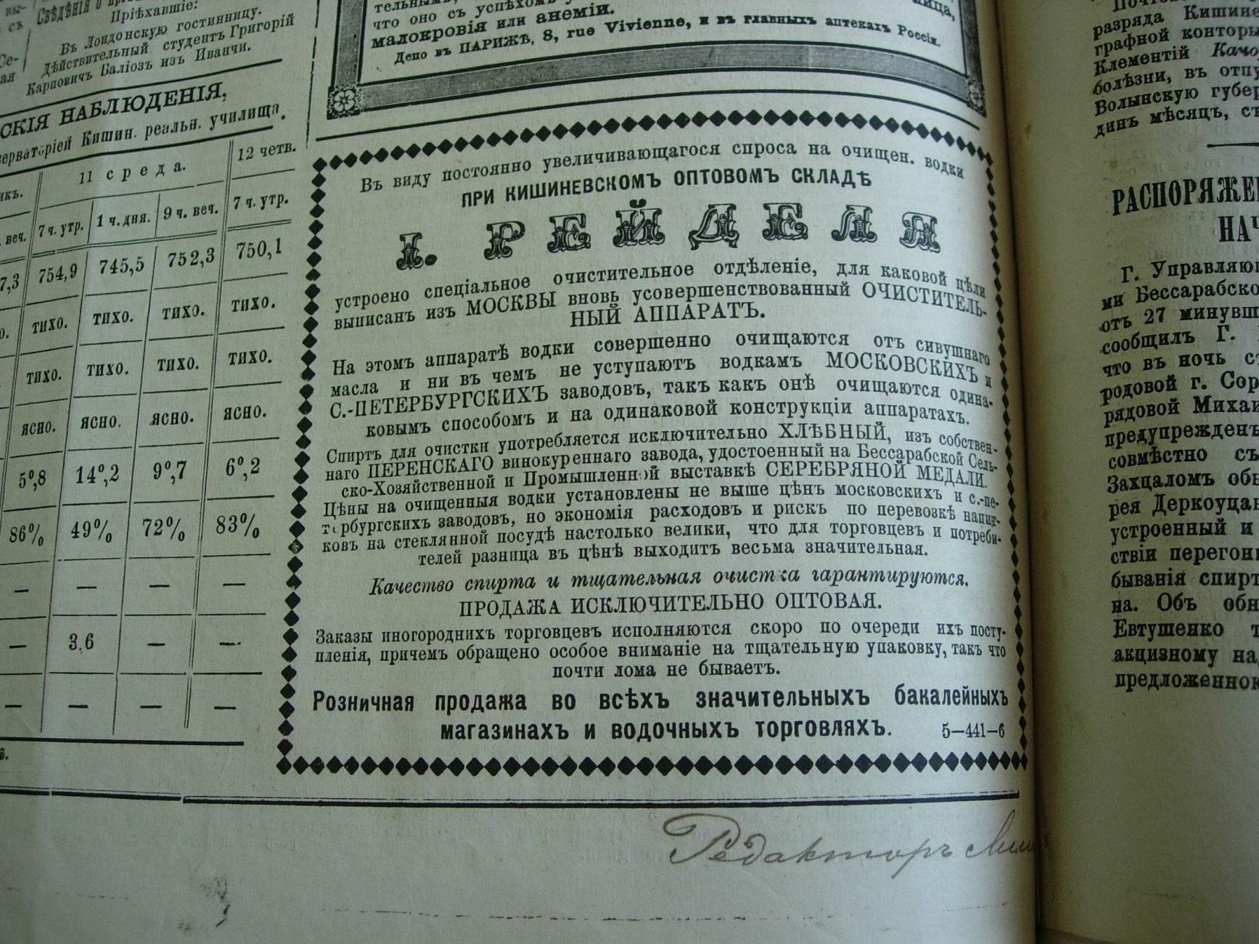
1. Bessarabian Provincial gazette, 1890. About Kishinev fruit and grape vodka distillery of the merchant Eleazar Reidel

Slide 4
2.The newspaper’s advertisement about the Bessarabian steam brewery “Bergshloss” belonged to Jewish entrepreneur Matus Kipervasser.

Slide 5
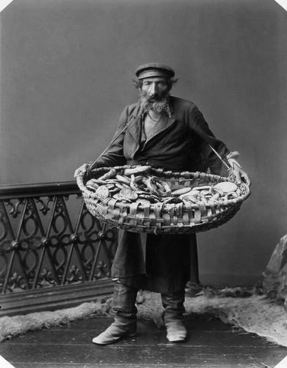
3.The Jew selling the doughnut-shaped bread roll at the market.

Slide 6
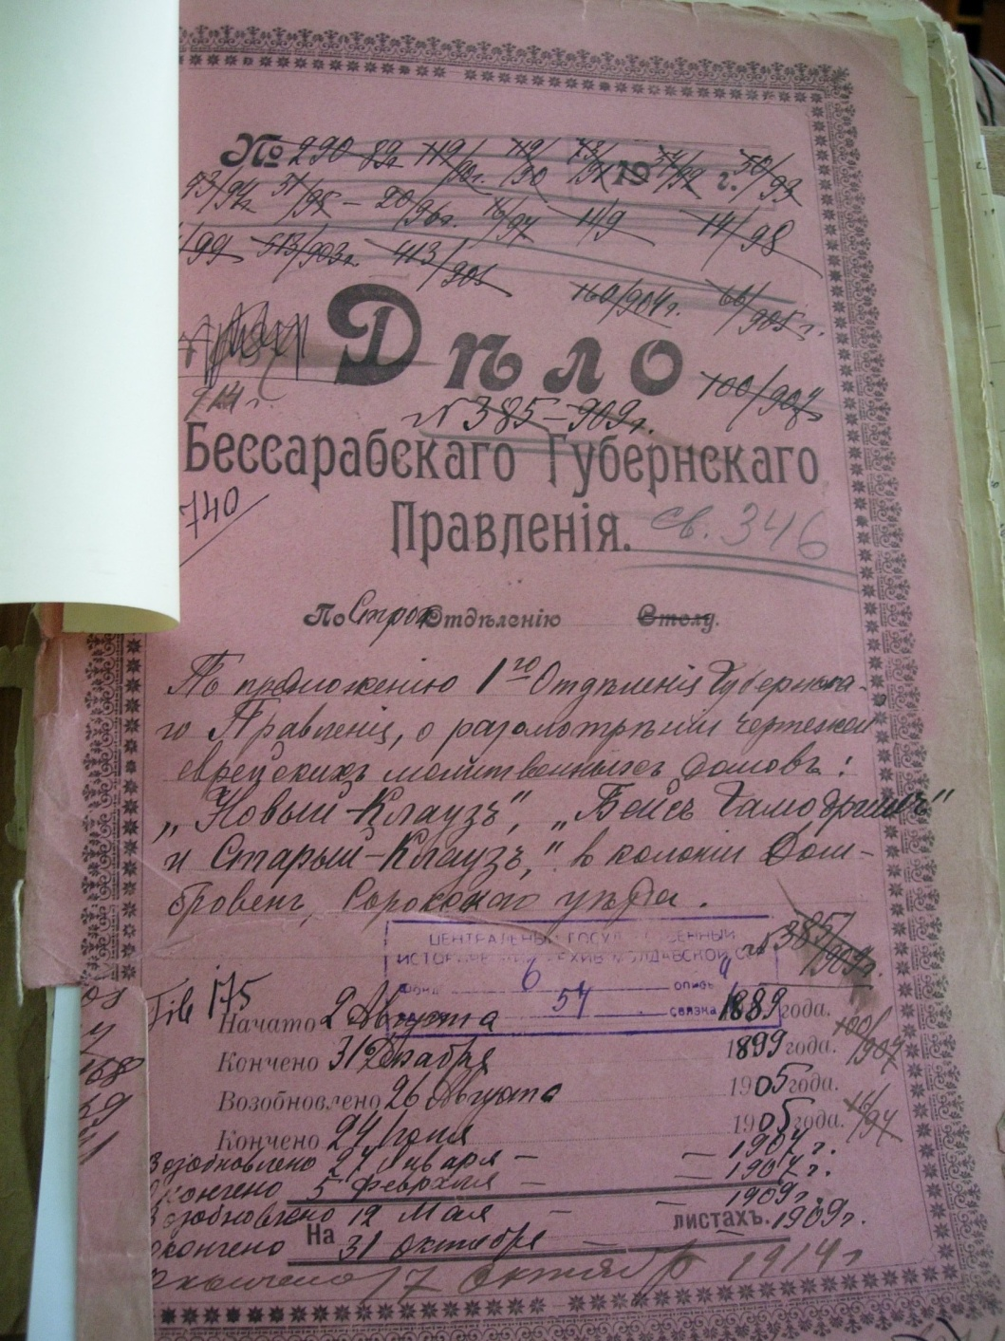
4.The plan of the Jewish prier school “New Klauz” in Soroky for 1899.
(NARM, f.6, inv.4, d.54, p.109)

Slide 7
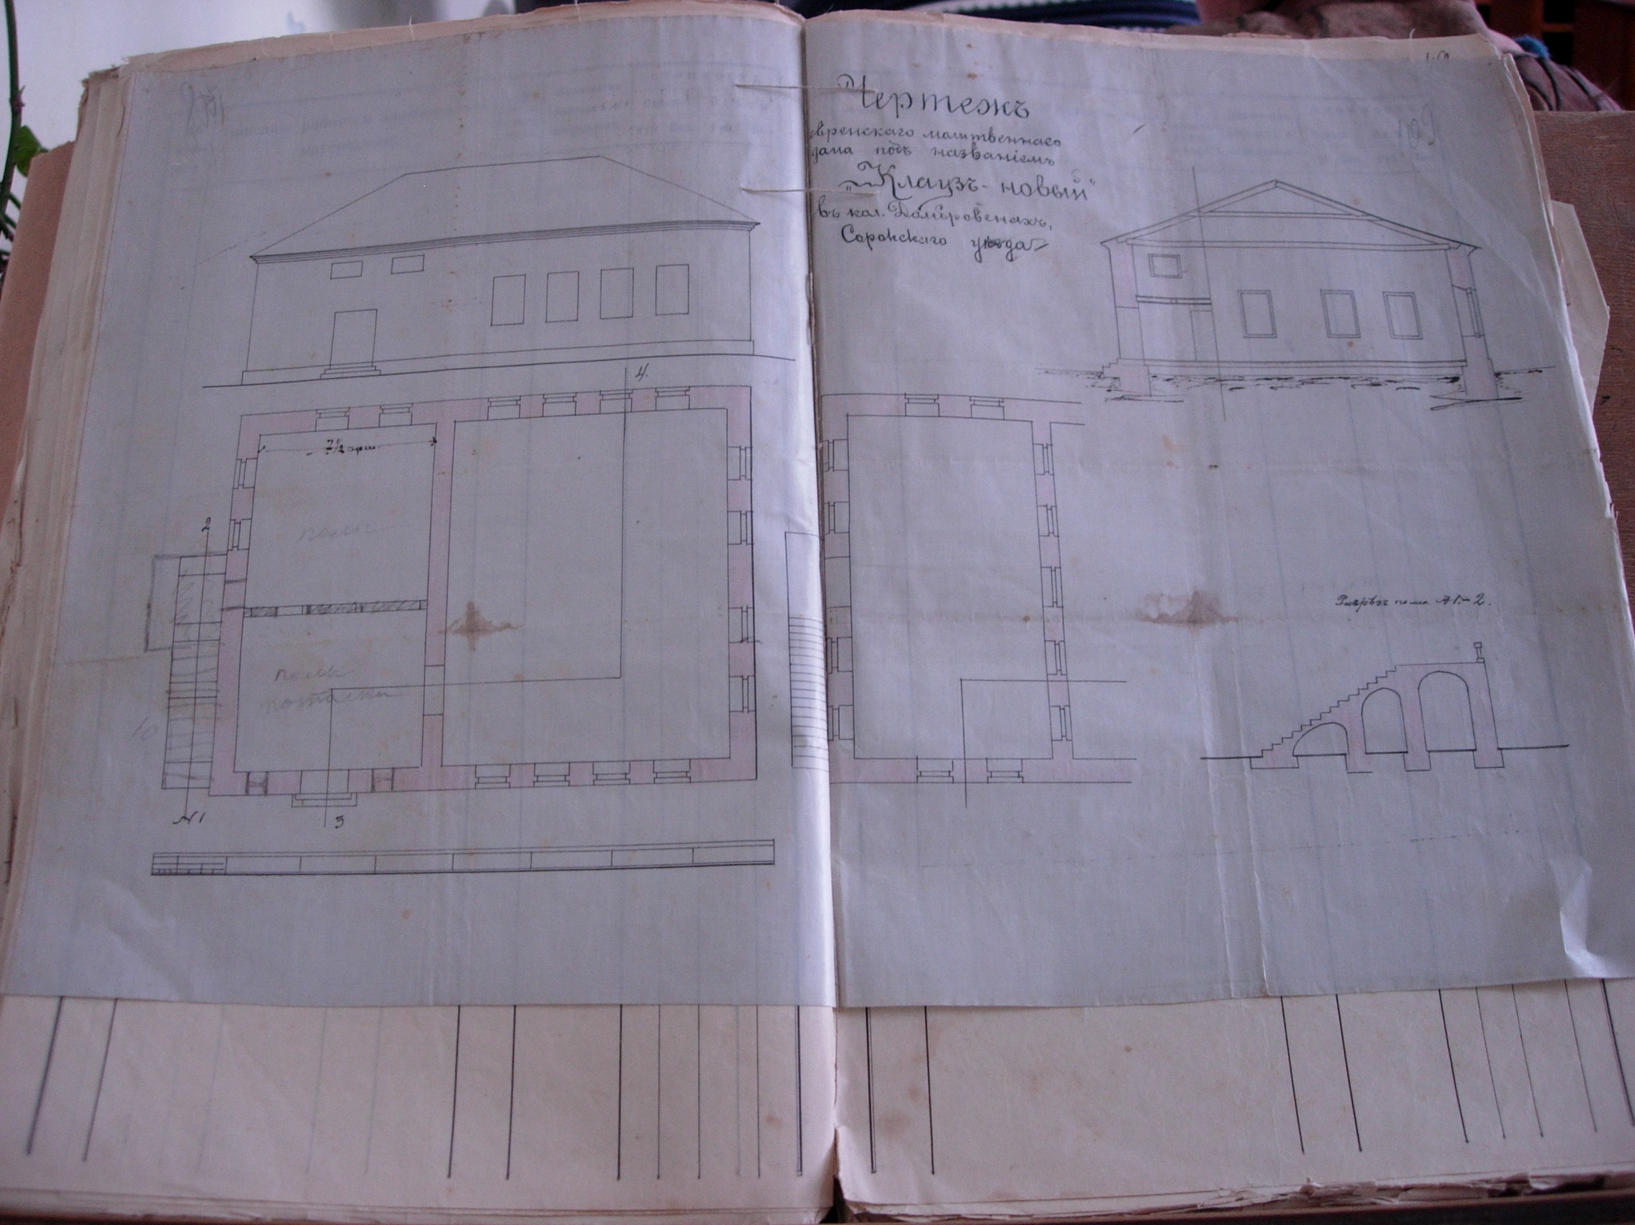

Slide 8
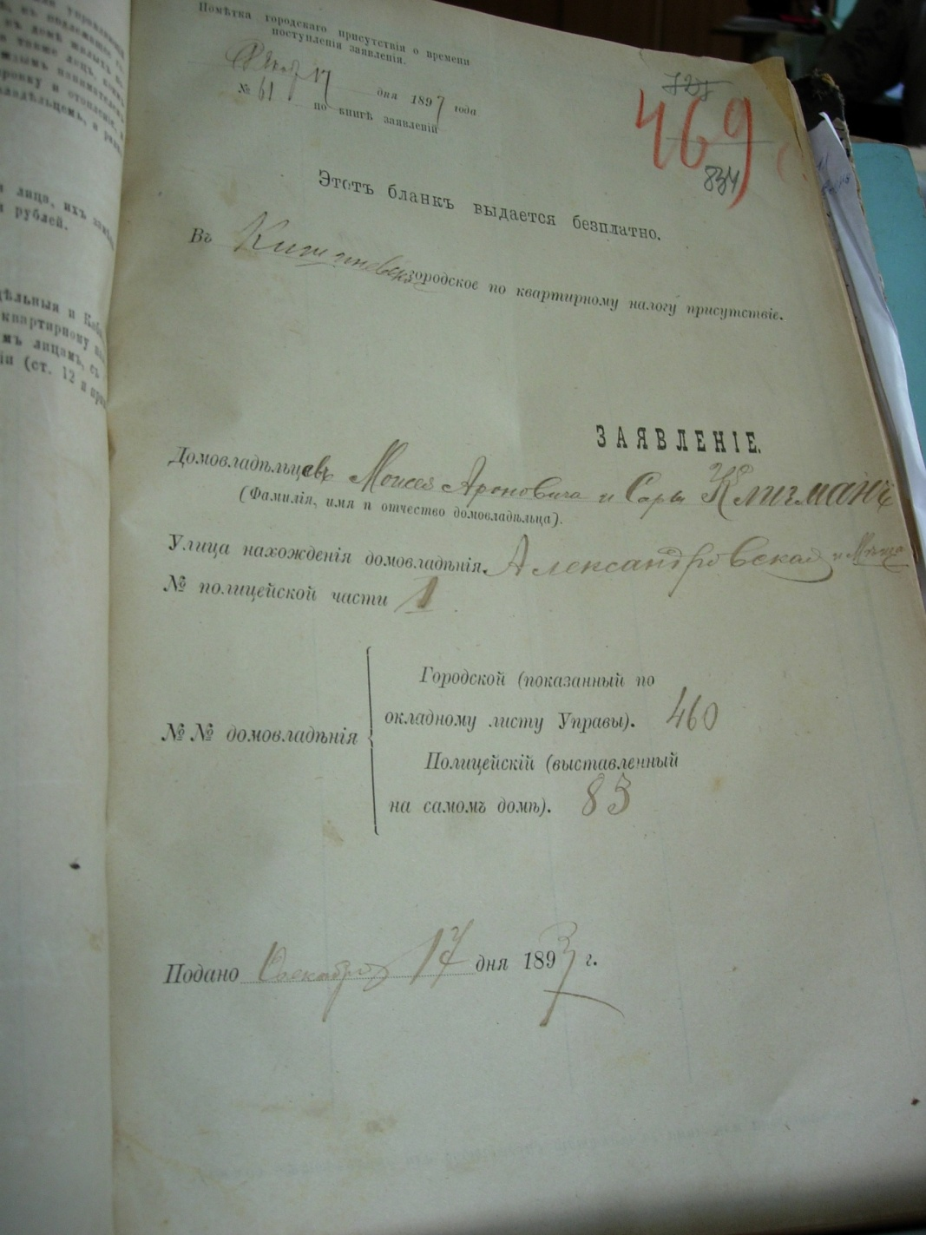
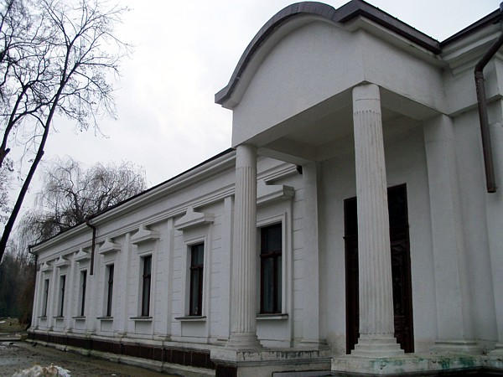
5. Moisey Kligman’s house built for 1896 in Kishinev.
(NARM, f.153, inv.1, d.11, p.834)

Slide 9
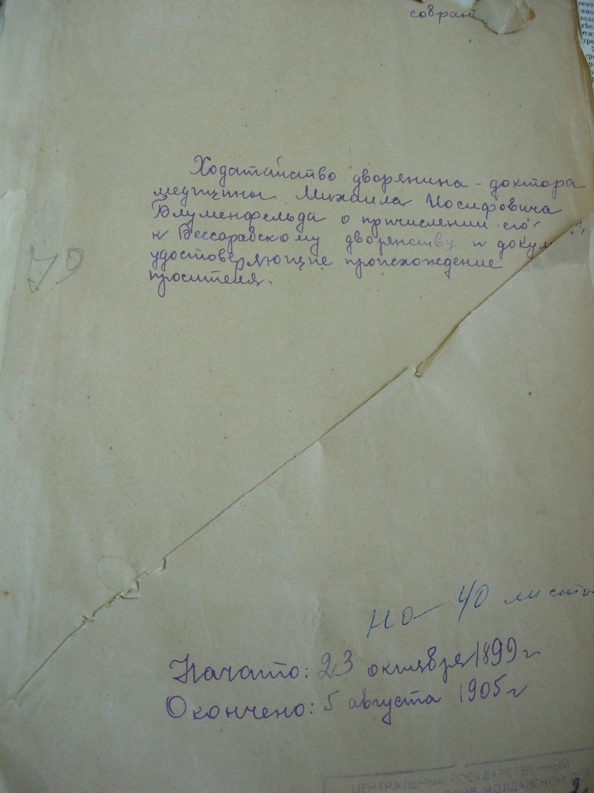
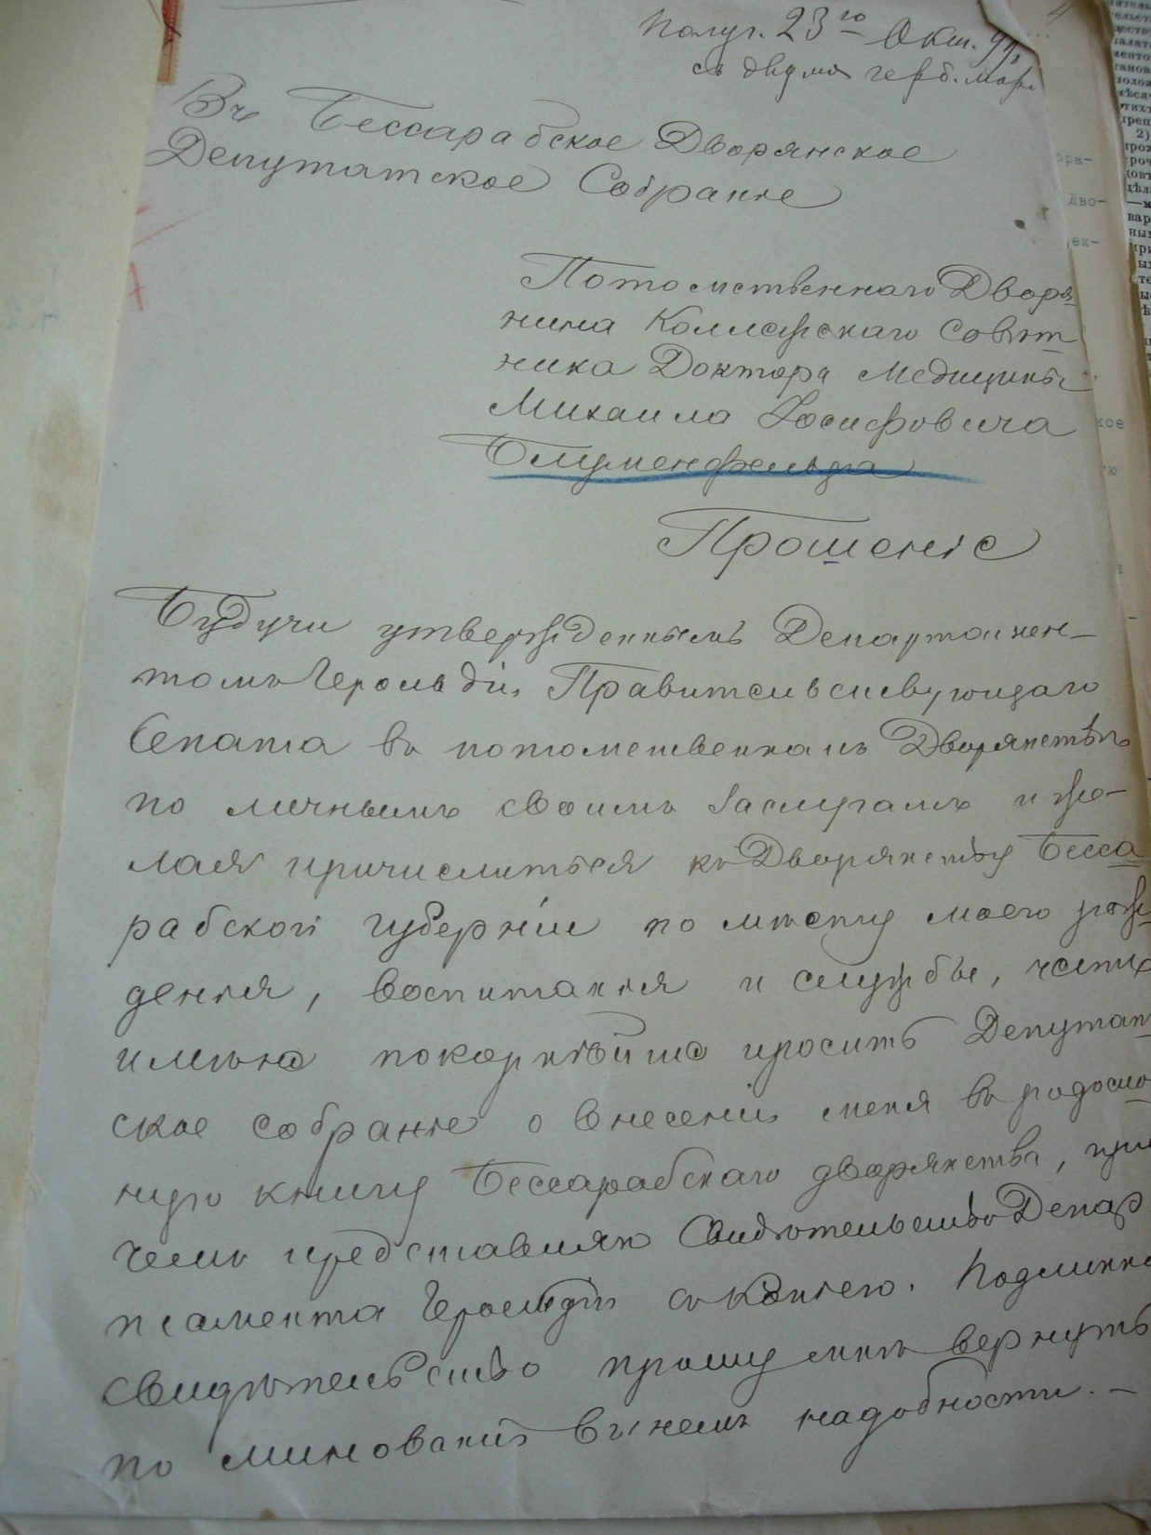
6.The application of doctor Blumenfeld to the Bessarabian Assembly of Nobility for confirming his noble
origin for 1899 - 1905. (NARM, f.88, inv.2, d.6)

Slide 10
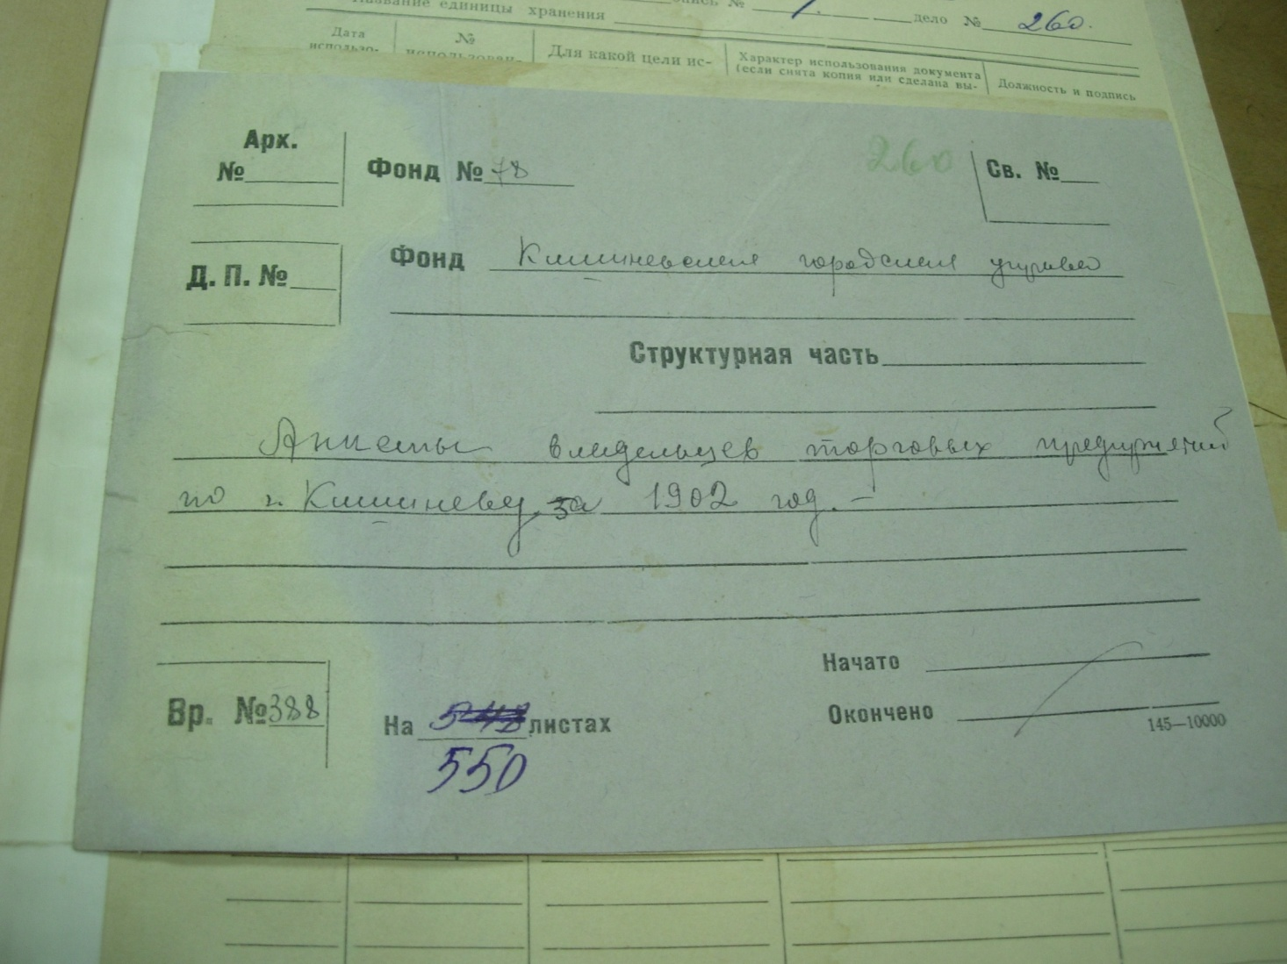
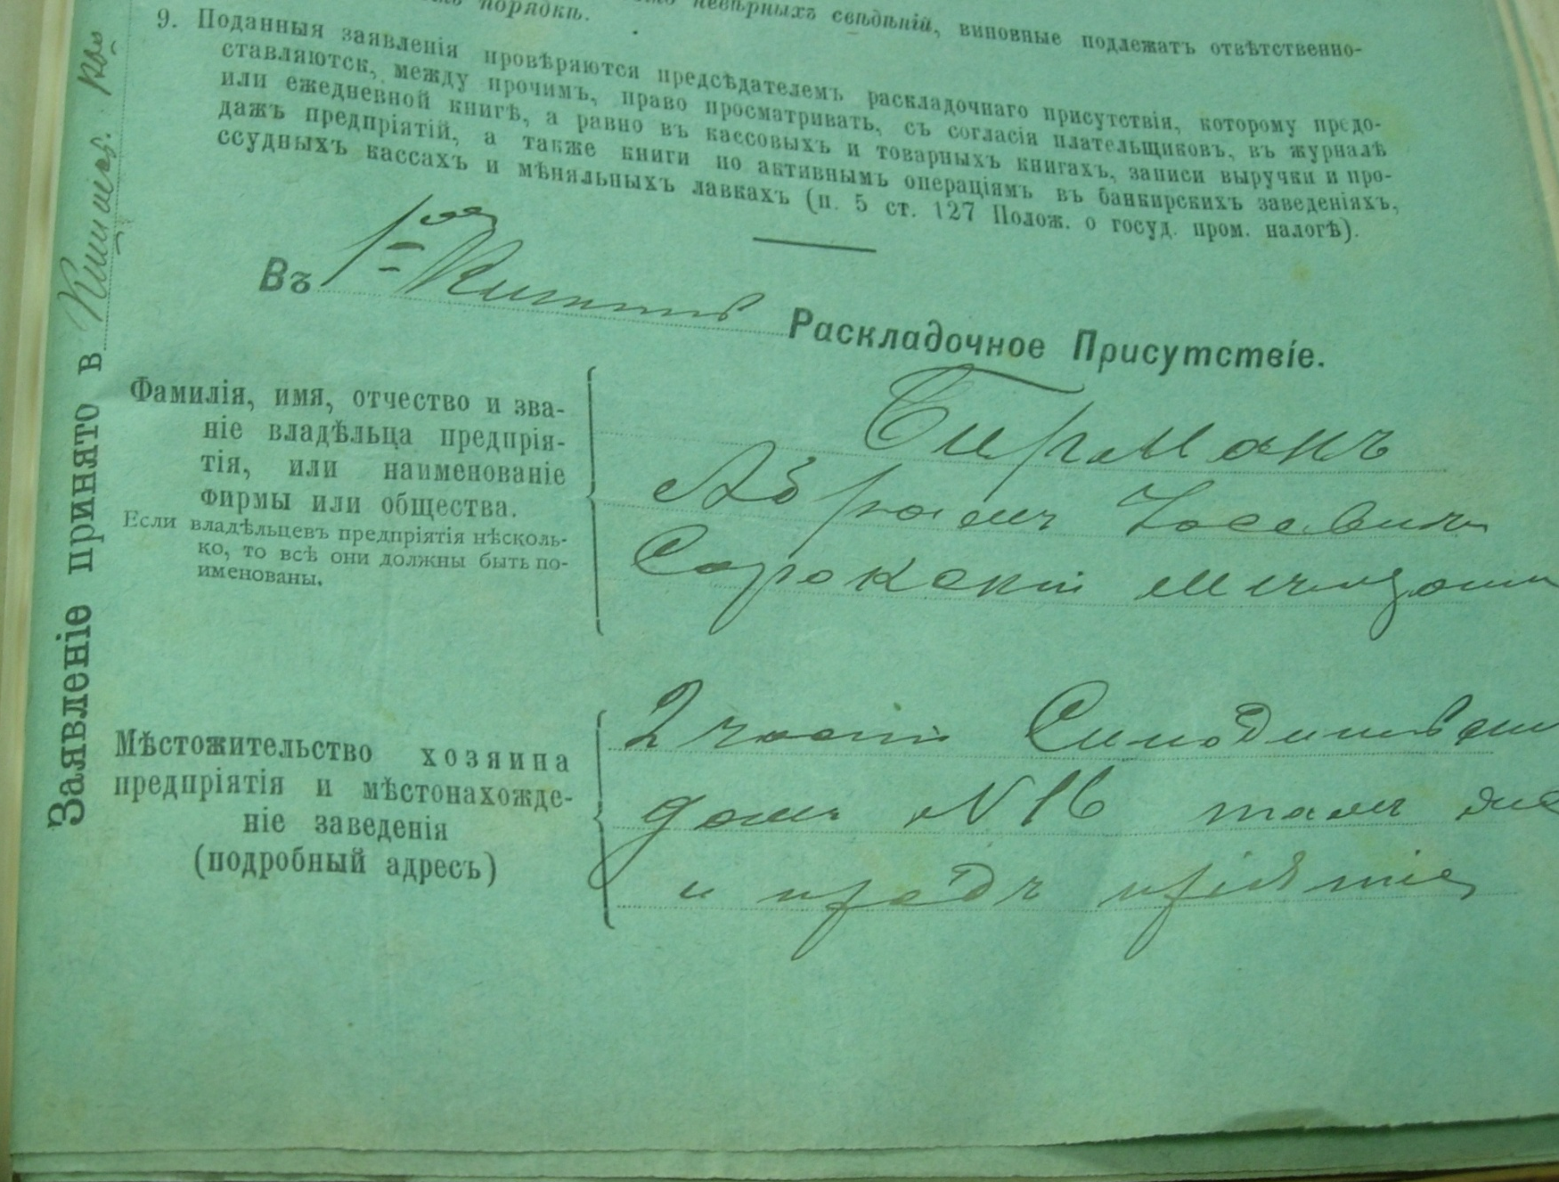
7.From the questionnaire of merchant from Soroky Birman Abram and his factory of sparkling water for 1902. (NARM, f.78, inv.1, d.260, p.237.)

Slide 11
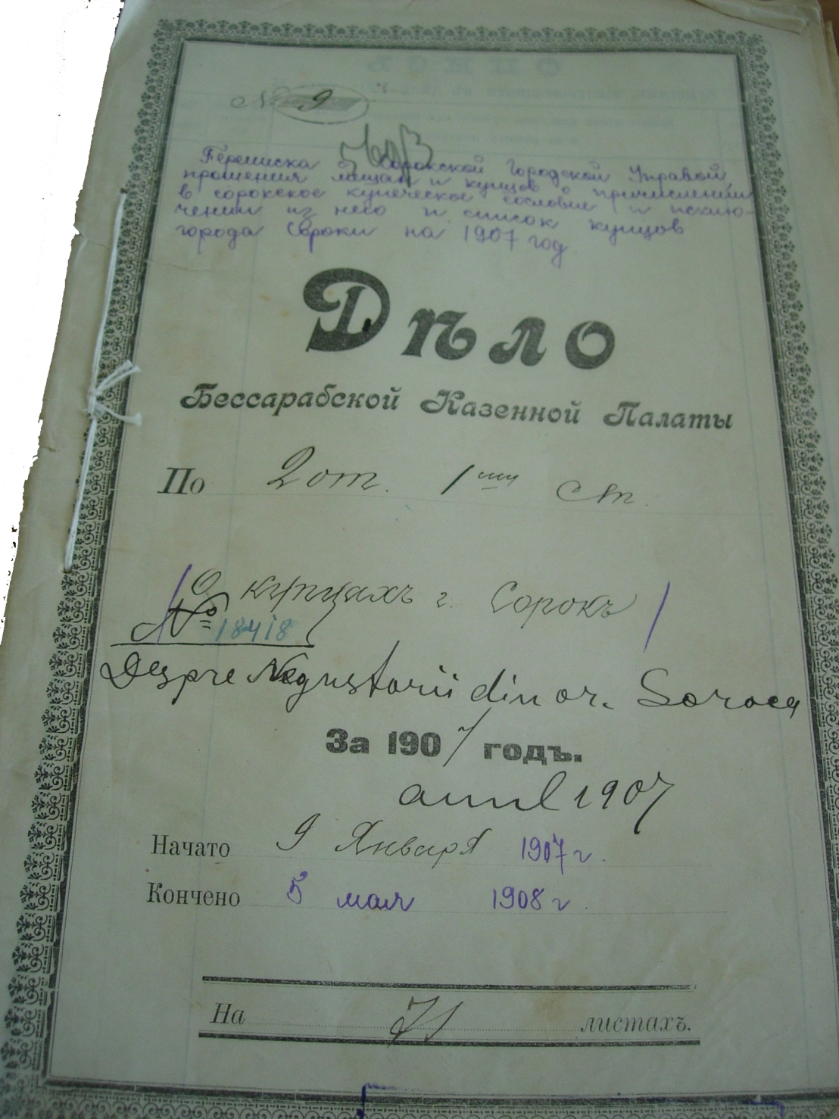
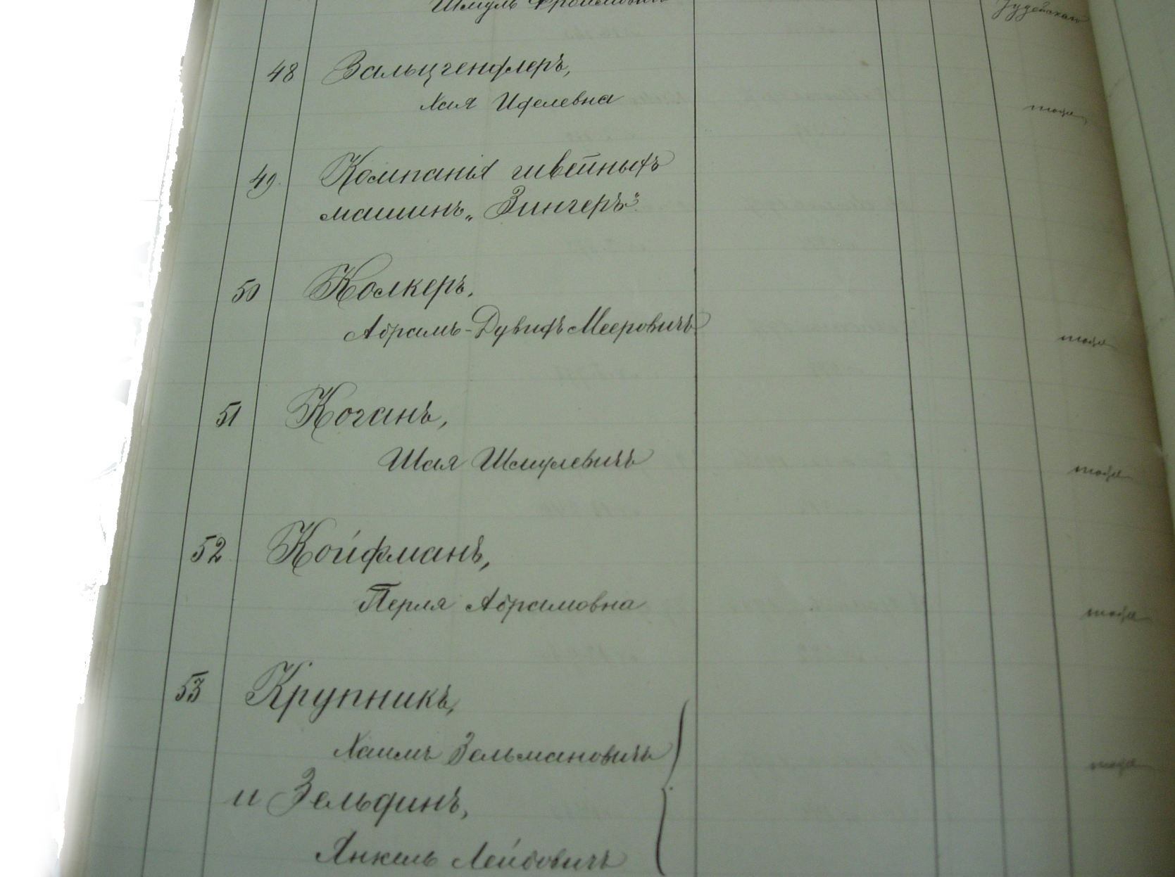
8.From the merchant’s list that declared their capitals on Soroky for 1907-1908 (NARM, f.134, inv.3, d.1206)

Slide 12
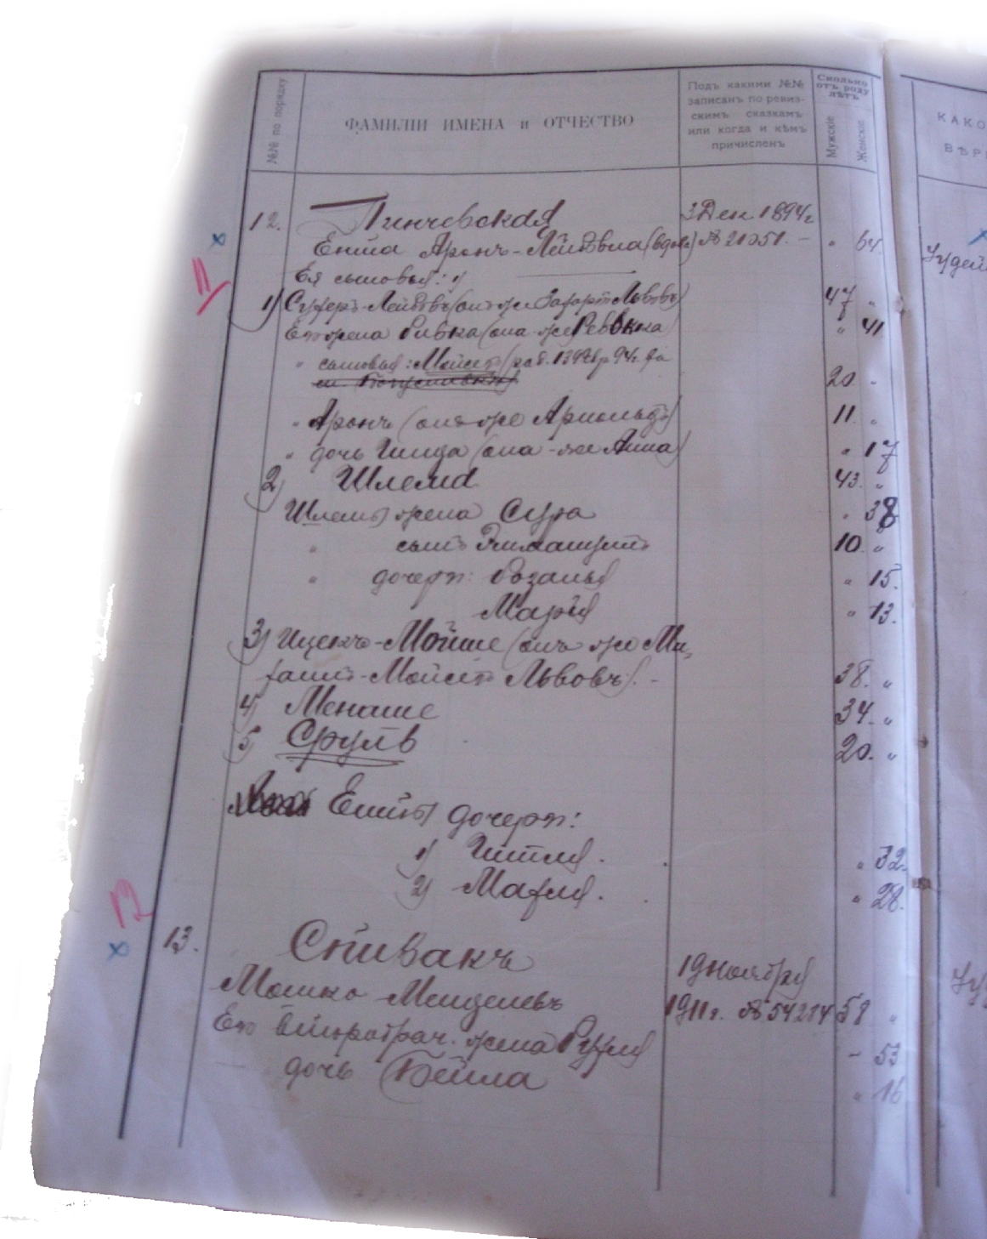
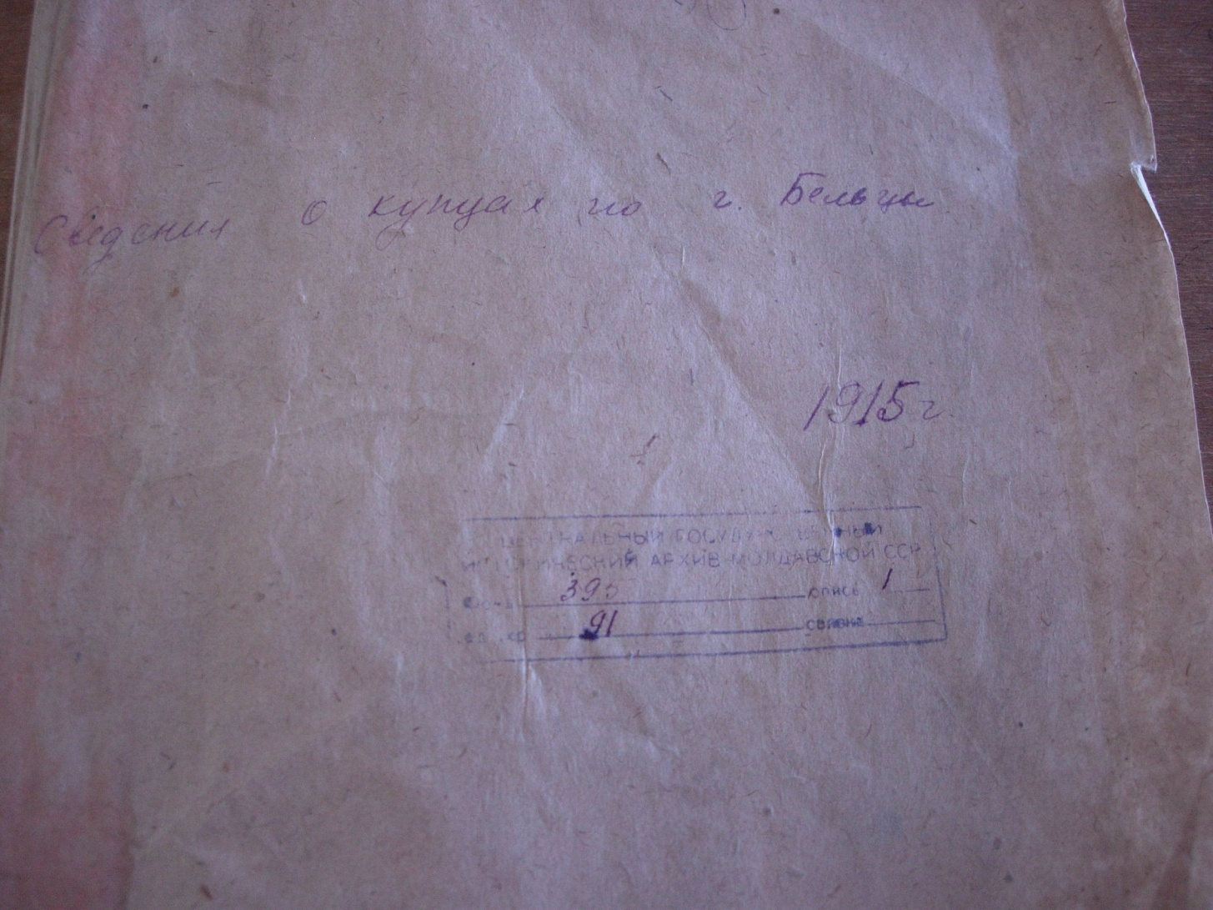
9.From the merchant’s list on Beltsy for 1915: Pinchevsky Enta, Spivac Moshko.
(NARM, f.395, inv.1, d.91)

Slide 13
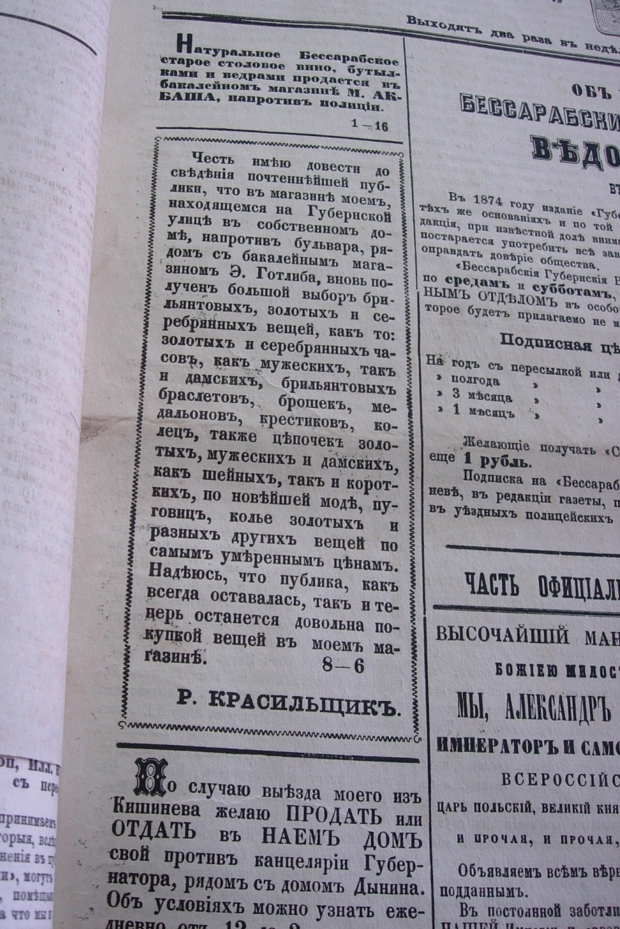
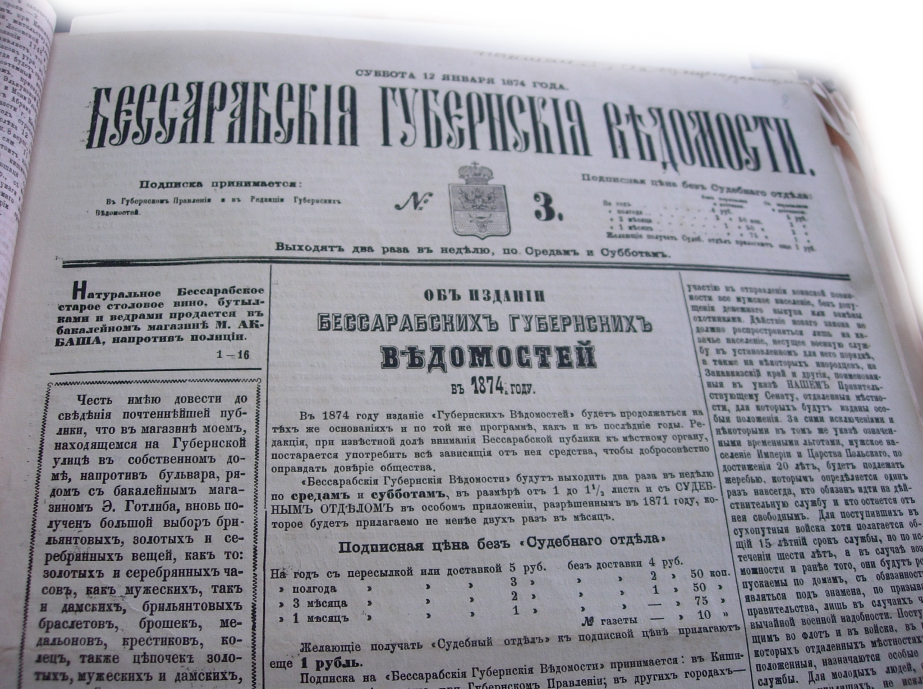
10. Bessarabian Provincial gazette, 1874. The advertisement about the jewellery shop of R. Krasilschik

Slide 14
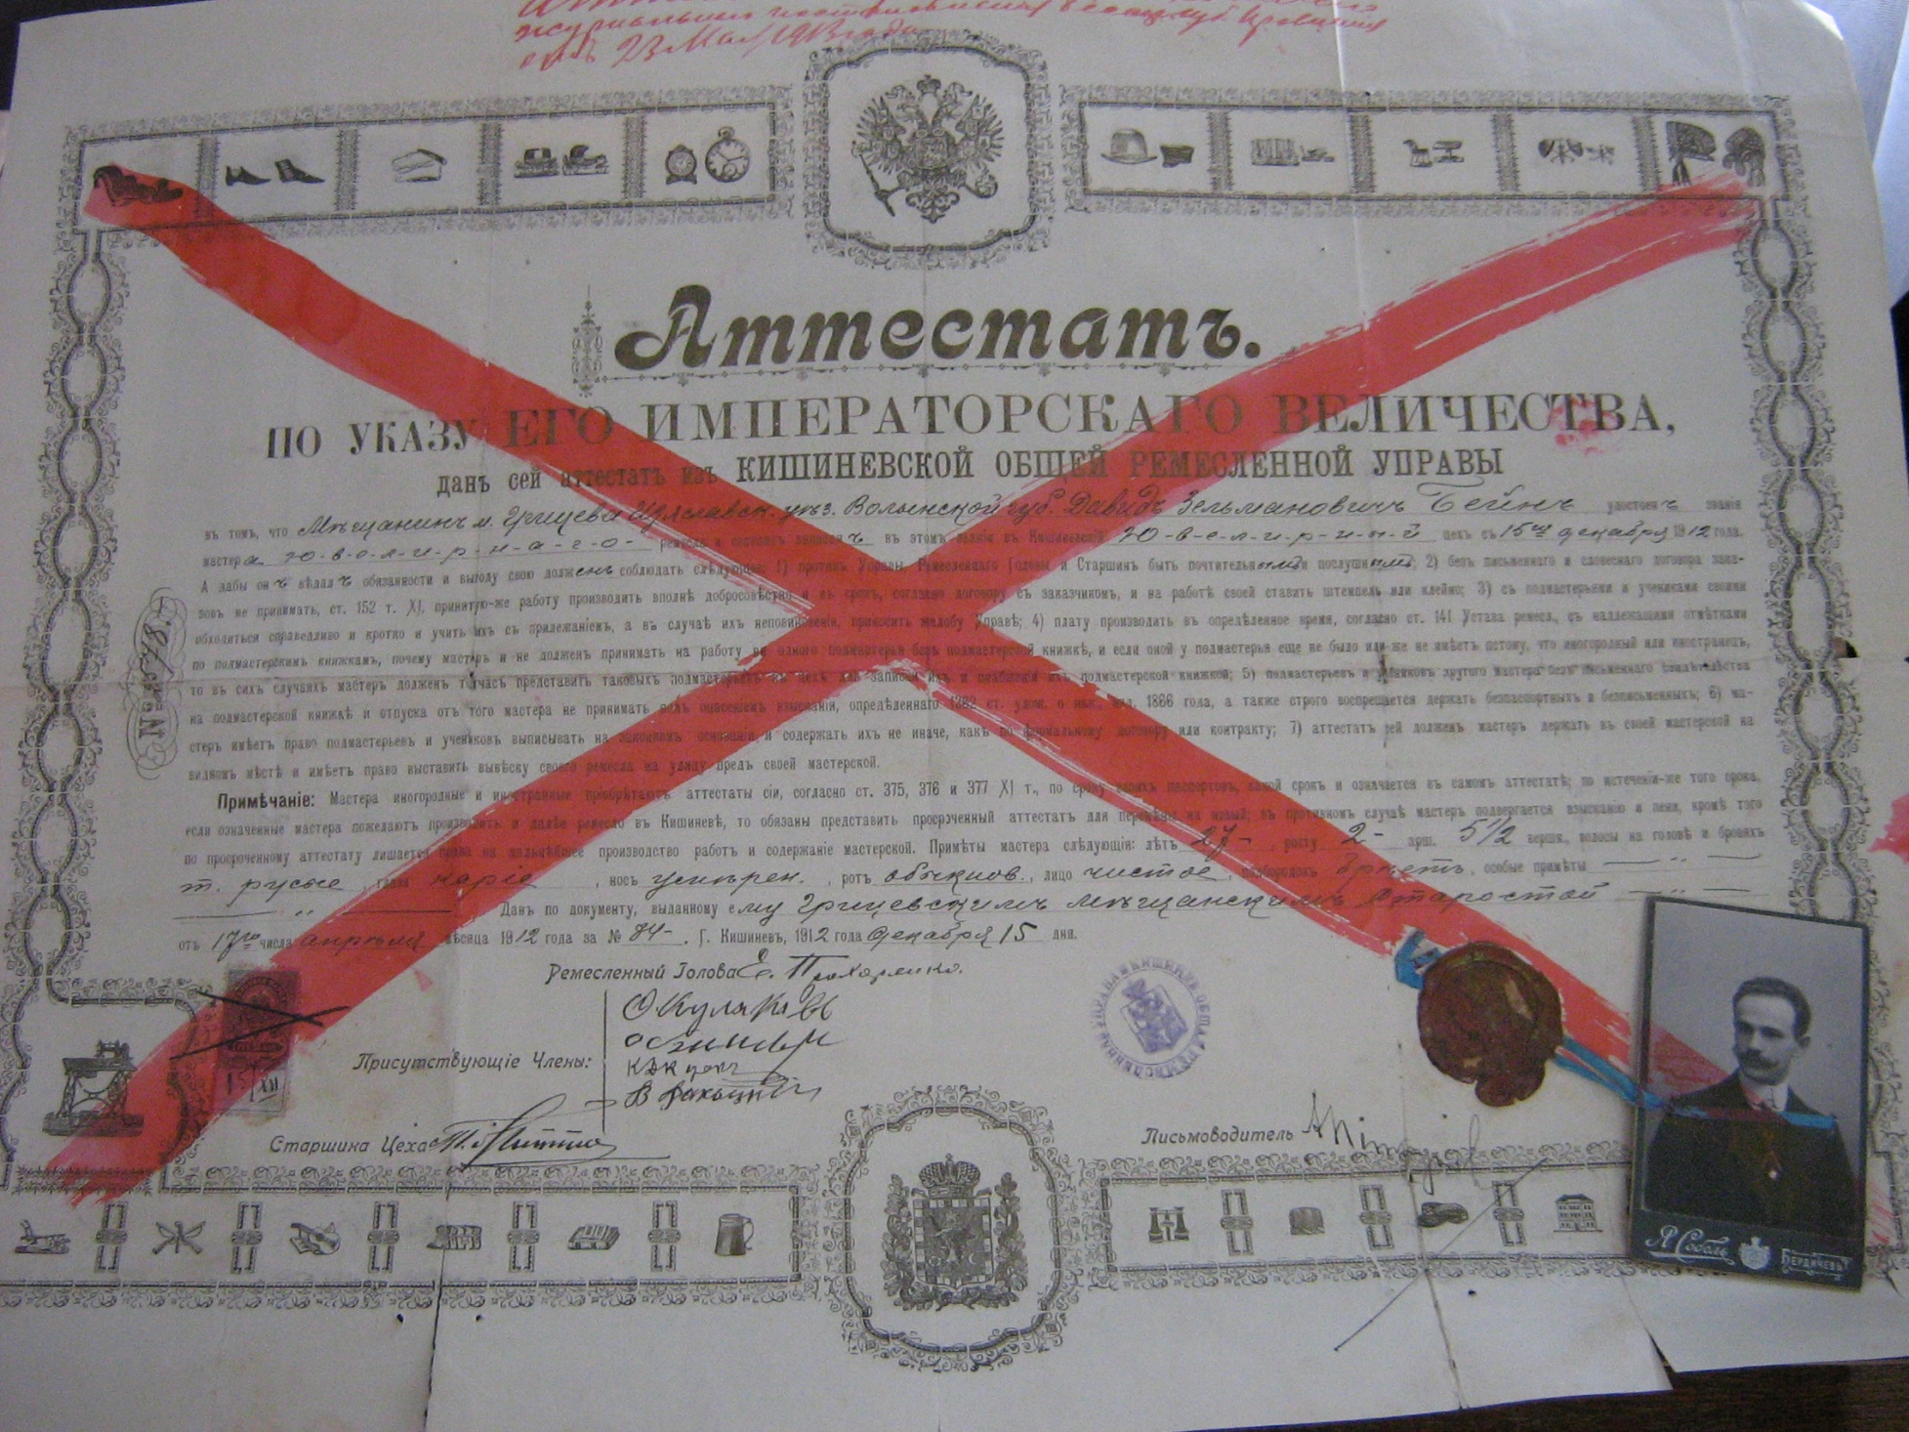
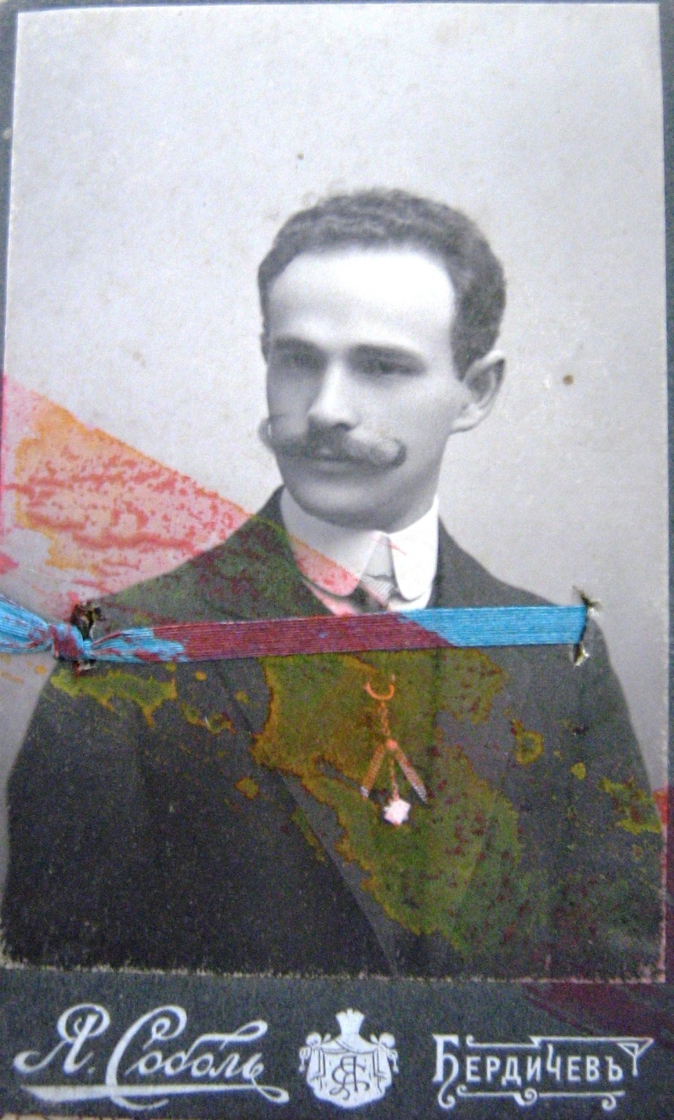
11. Personal documents of Kishinev jeweller David Bein. (NARM, f.6, inv.18, d.866)

Slide 15
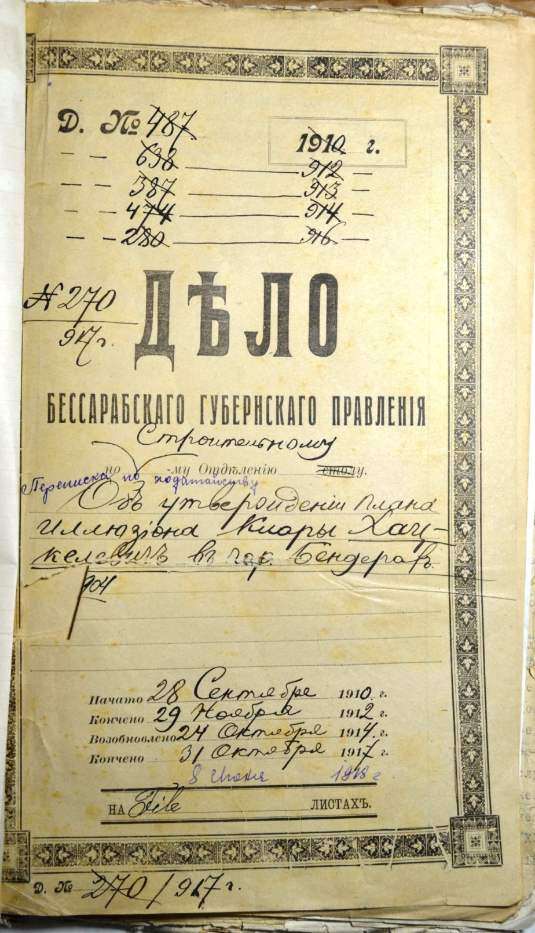
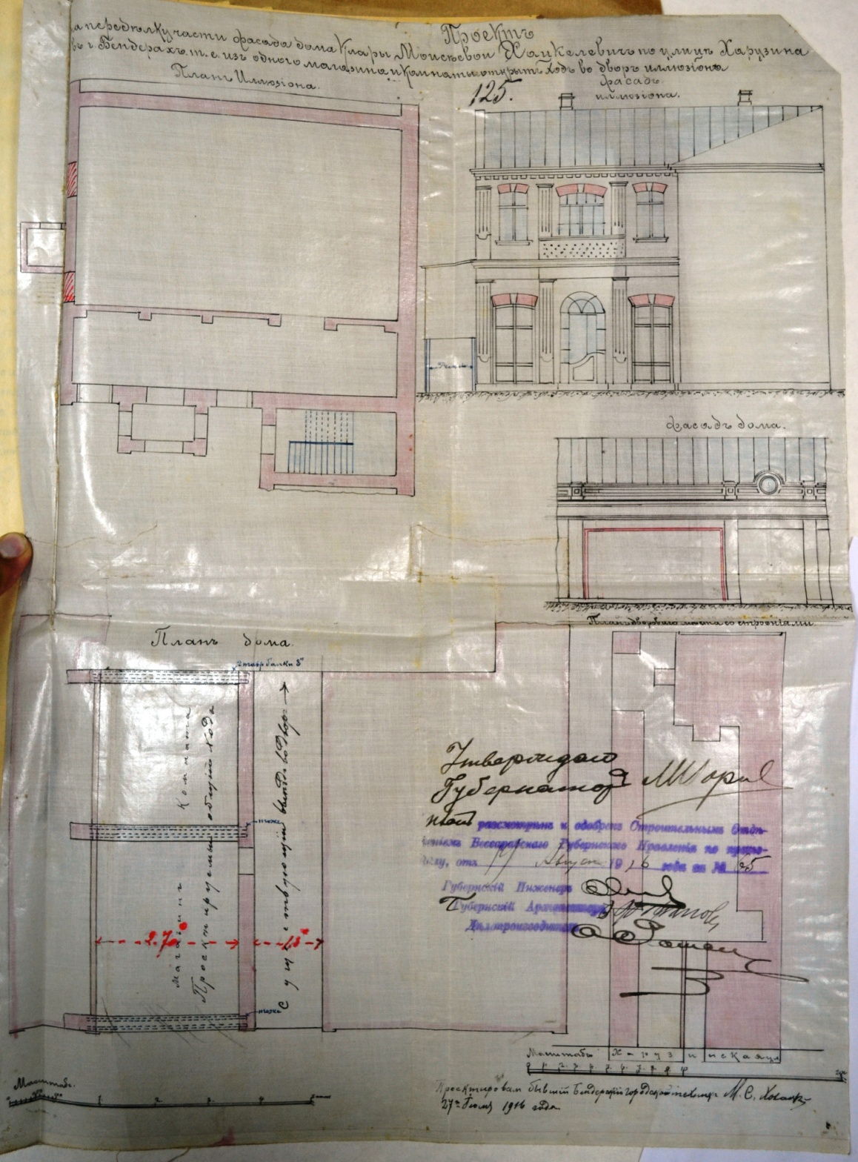
11.The plan of Klara Khatsckilevich’s illusion in Bendery for 1910-1916. (NARM, f.6, inv.4, d.1644, p125)

Slide 16
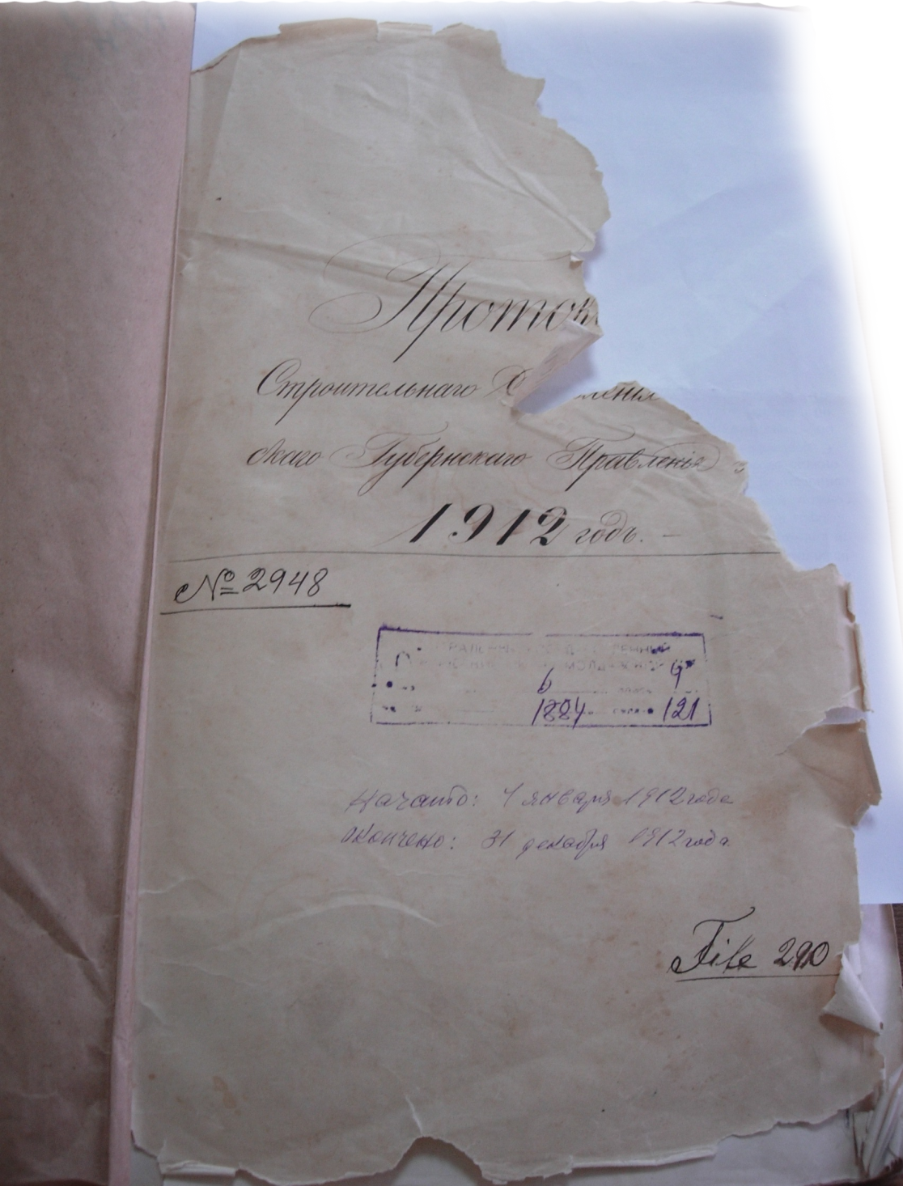
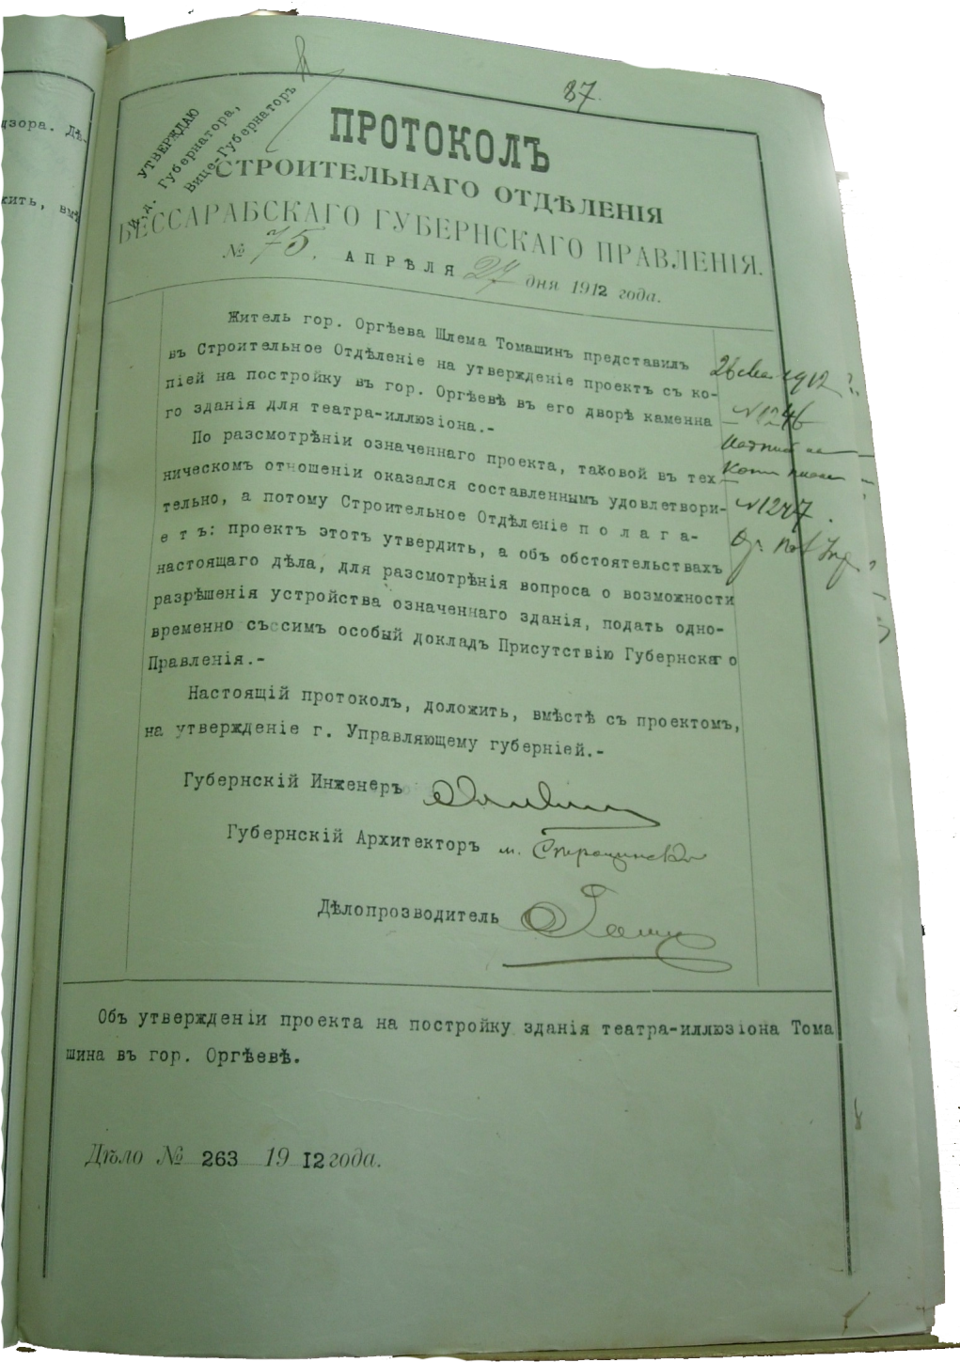
13.The approval of Shlema Tomashin’s design for building the city theatre in Orgeev for 1912. (NARM, f.6, inv.4, d.1884, p.87)

Slide 17
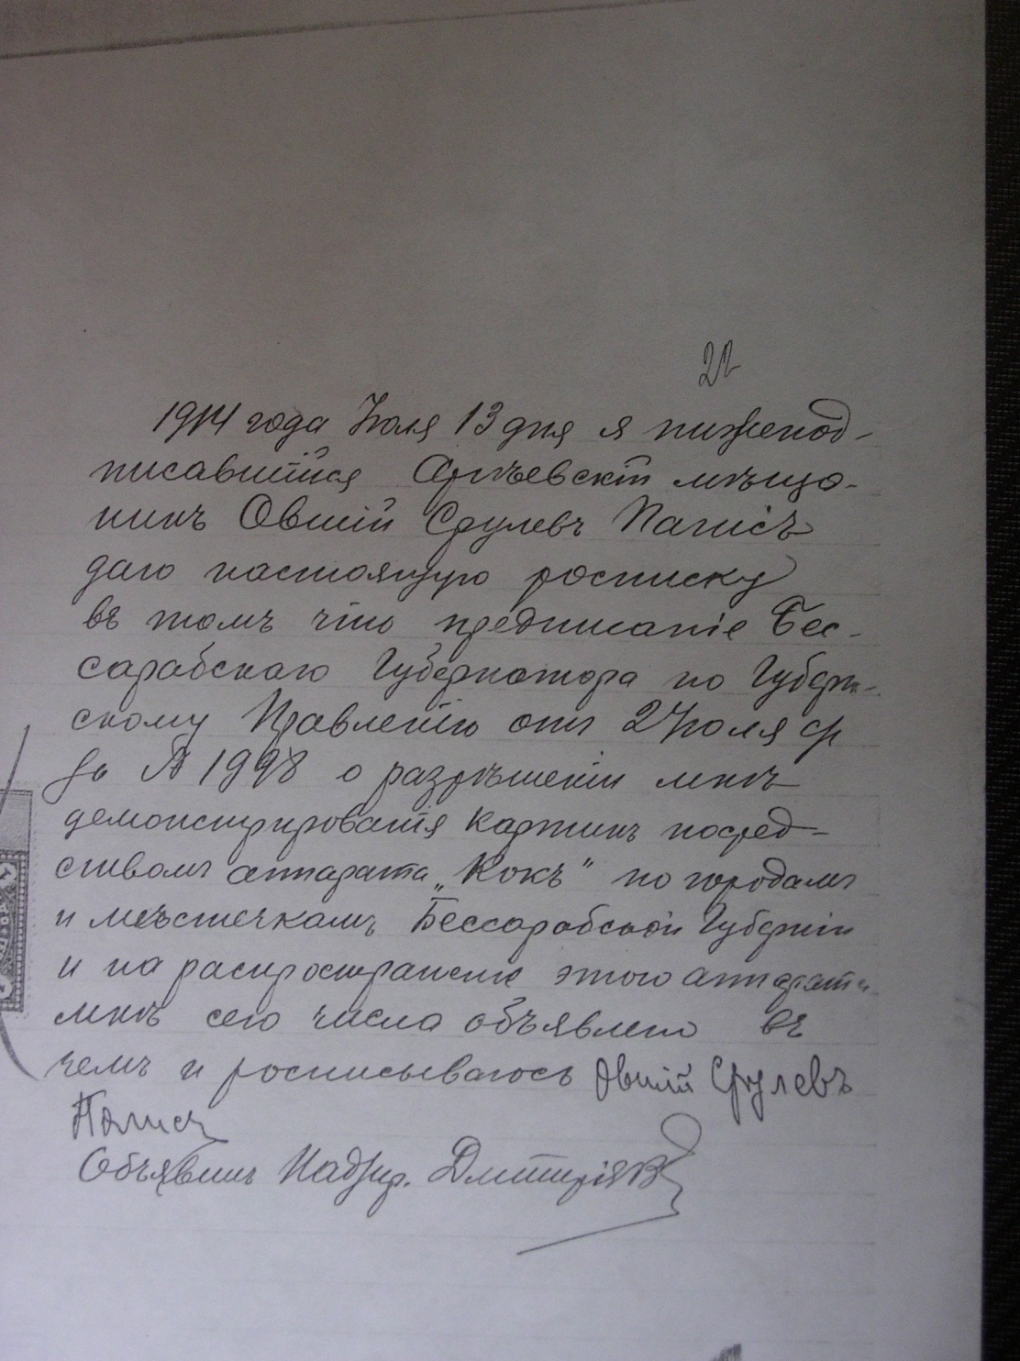
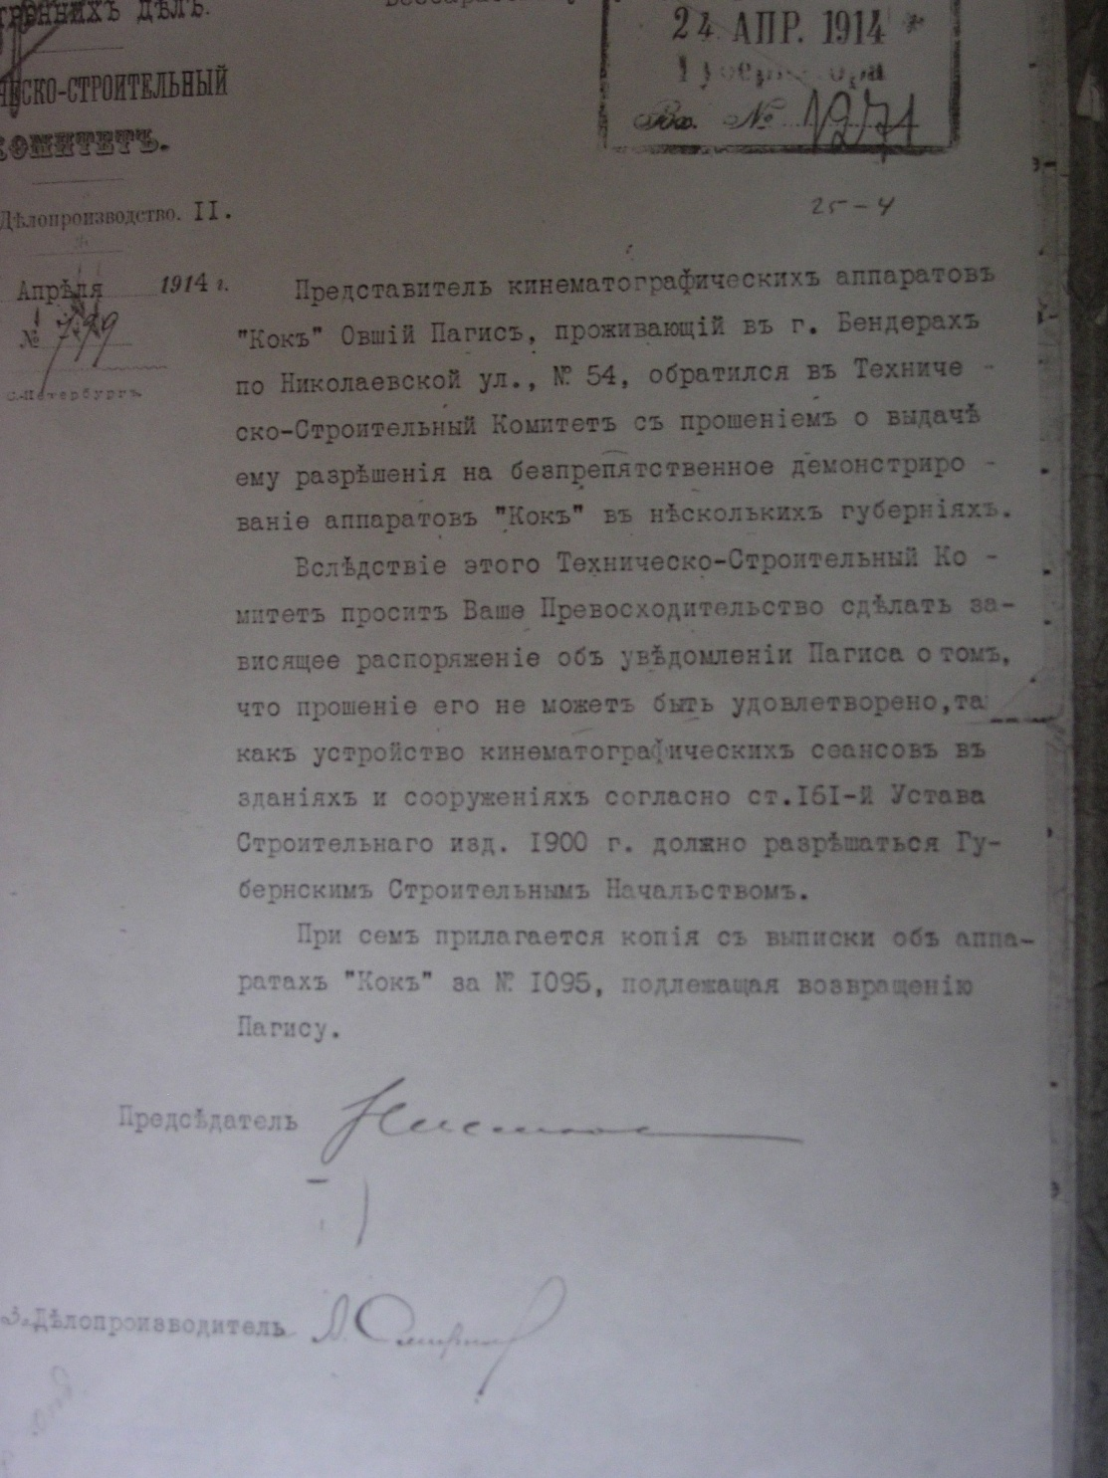
14.The document confirming a development of the cinematograph by Ovshii Paghis in Orgeev for 1913-1917. (NARM, f.6, Inv.4, d. 2300, p.22.

Slide 18
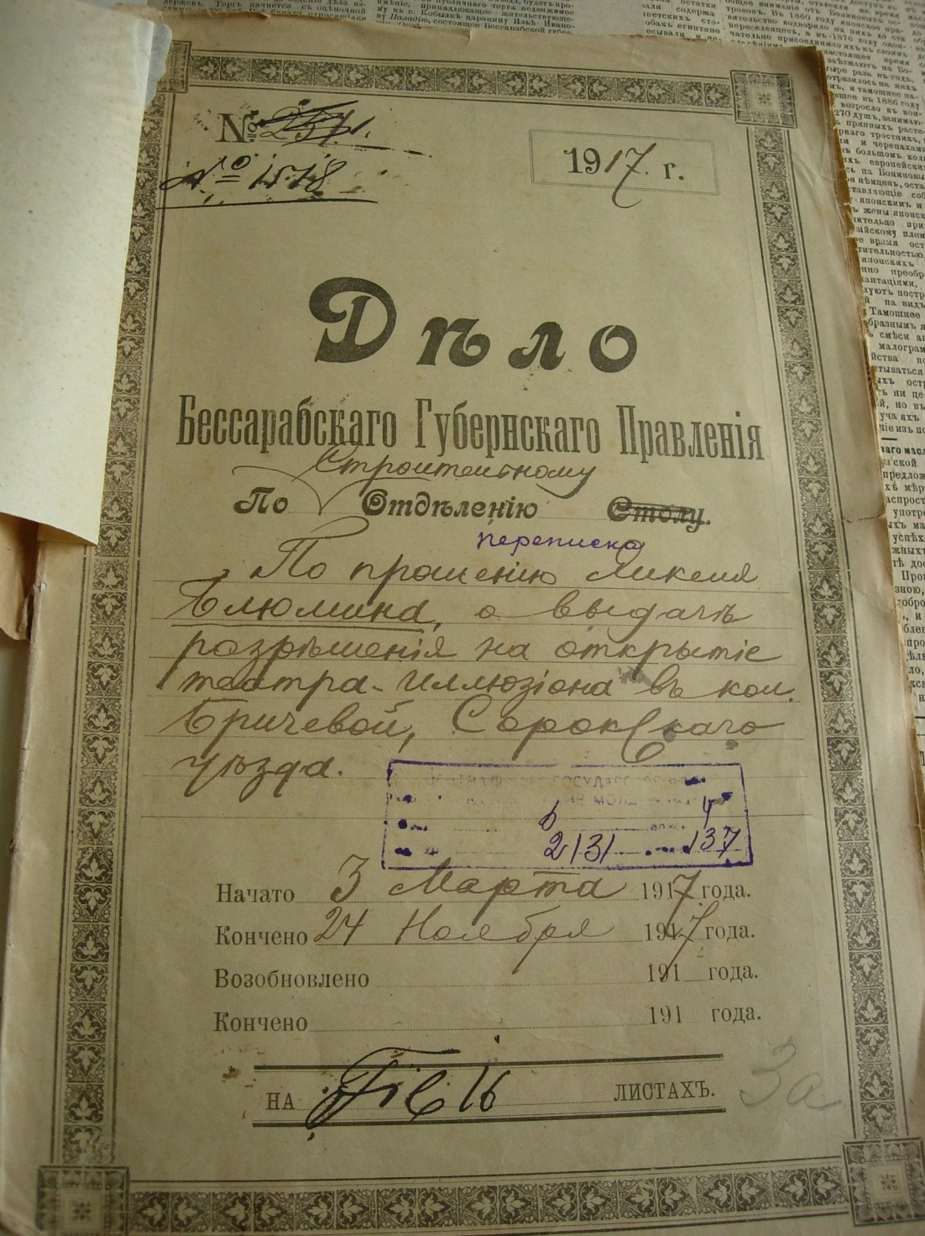
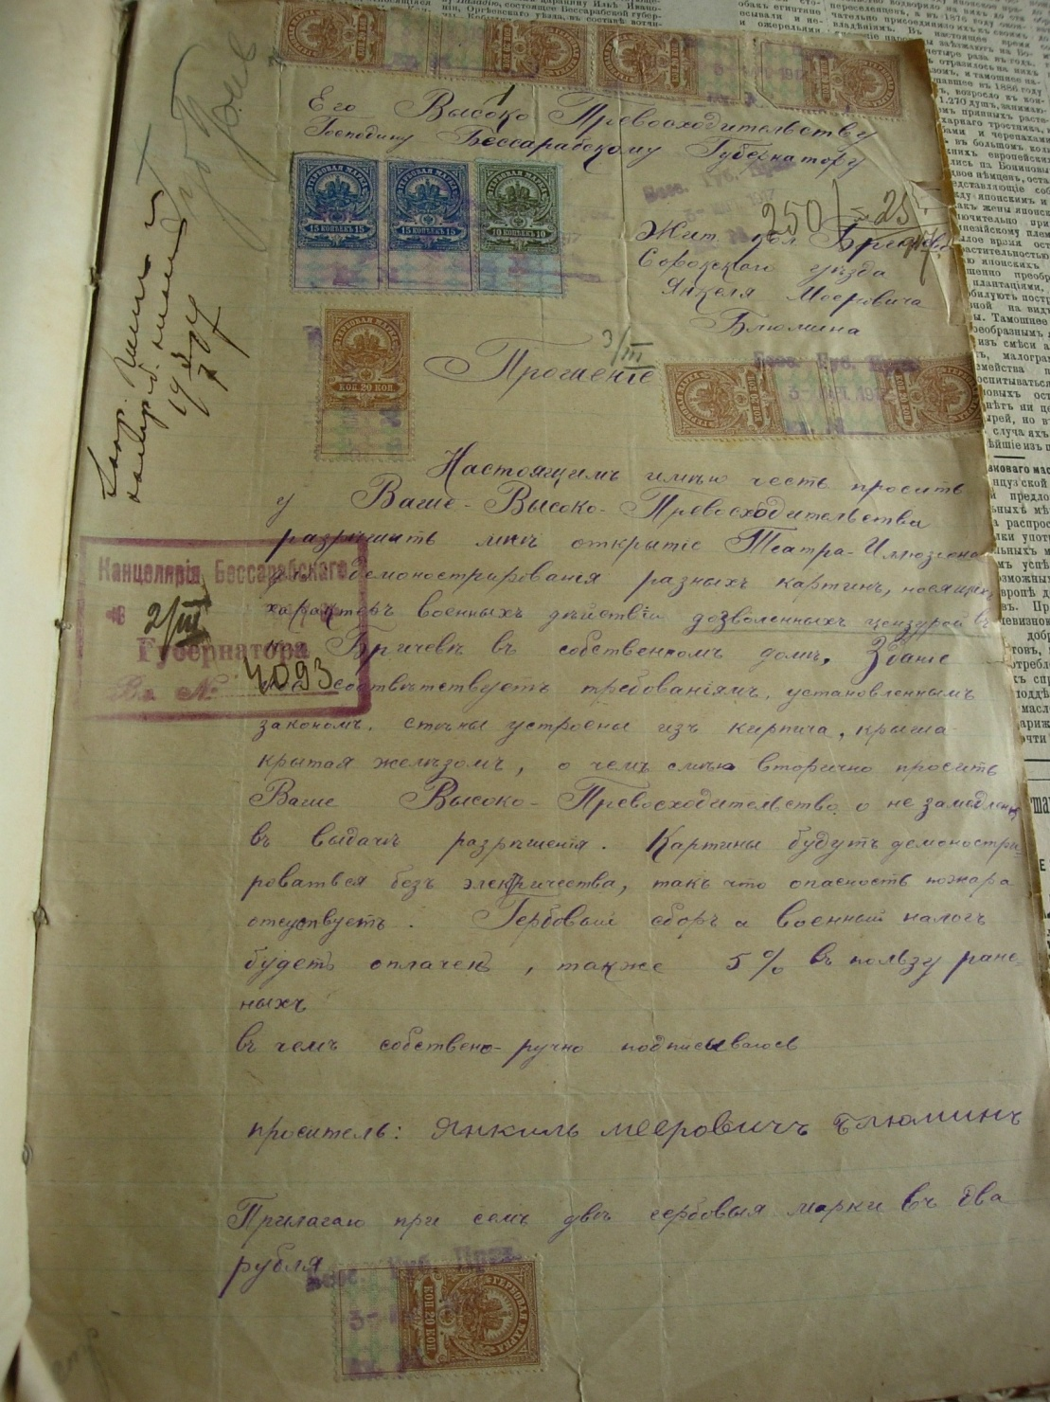
15. The documents relative to opening the illusion for 1917 in colony of Brichevo of Soroky district by Yanckel Blumen (NARM, f.6, inv.4, d.2131, p.25)

Slide 19
КLIОSFЕRА
THE PROJECT
«VOICES FROM THE PAST»
Informational and educational treasures of the National Archive of Moldova

Slide 20
BESSARABIA.
XIX CENTURY
BESSARABIAN
JEWISH
ARCHIVE
BIBLIOGRAPHICAL
INDEX
In three parts
E-publishing house
«KLIOSFERA»
KISHINEV
2014

Slide 21
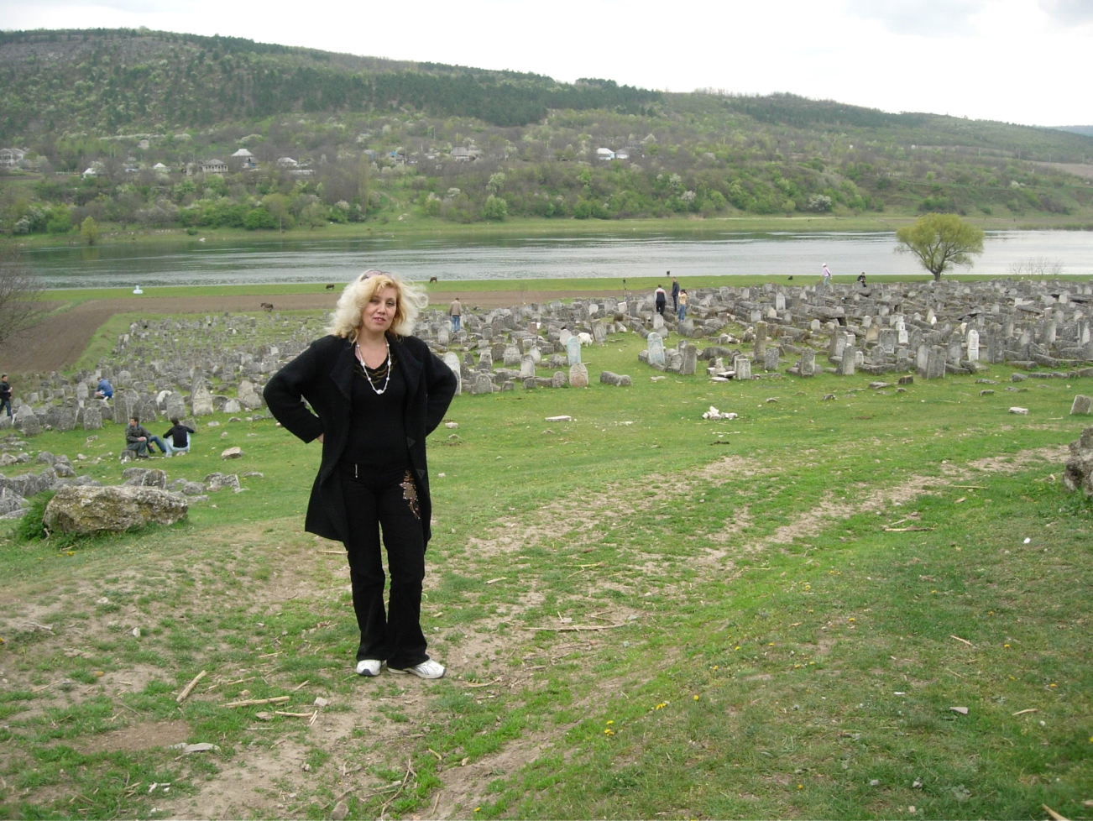
Thanks you for listening!
www.bessarabia.ru chastinalla@gmail.com

