Slide 1
Moldovan Archives:
What information we can find in addition to Vital records and Revision Lists
Yefim A. Kogan
yefimk@verizon.net
JewishGen Bessarabia SIG Leader and Coordinator www.jewishgen.org/Bessarabia
August 6, 2018
Notes:
*

Slide 2
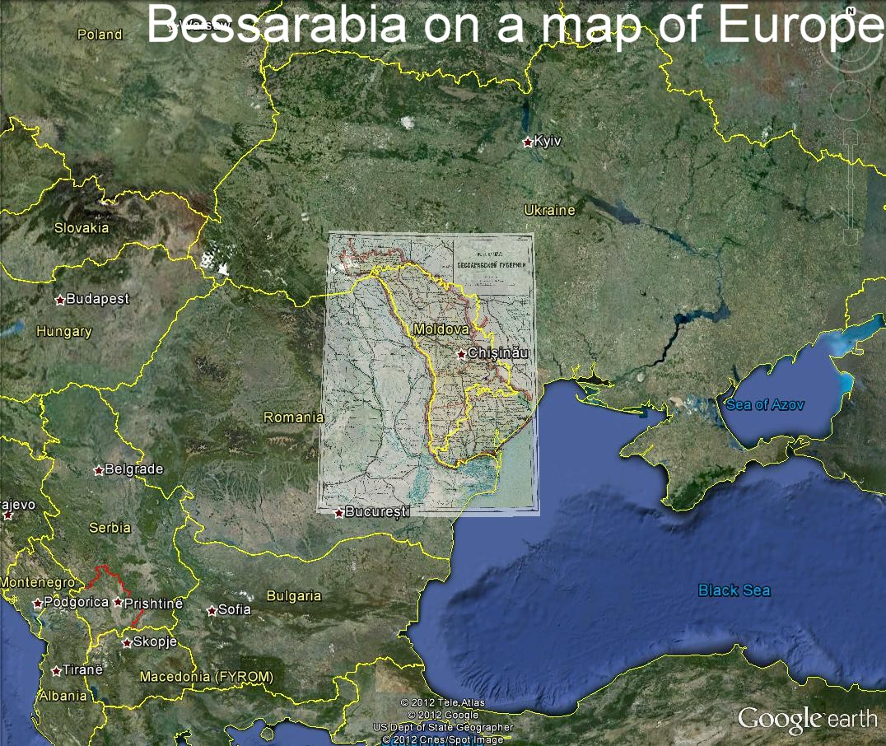

Slide 3
National Archive of Moldova (NARM)
Vital records and Revision Lists
JewishGen Bessarabia SIG was organized in 2011. Before 2011 the only records from National Archive of Moldova (NARM) were Bessarabia Vital Records, including Birth, Marriage, Divorce, Death records. 163,000 records were translated. Also, before 2011, I found Revizskie Skazki – Revisions Lists at the Family History Library in Salt Lake City and we started the Bessarabia Revision List project. By now, we have already translated more than 180,000 records.
All of these records originated at NARM in Kishinev.

Slide 4
National Archive of Moldova (NARM)
Let’s visit the National Archive of Republic of Moldova:
67 Gheorghe Asachi str., Chisinau MD-2028
Public Relations Office
Phone: 0 (373 22) 73 58 27
Fax: 0 (373 22) 72 10 57
E-mail: arhiva.national@gmail.com

Slide 5
National Archive of Moldova (NARM)

Slide 6
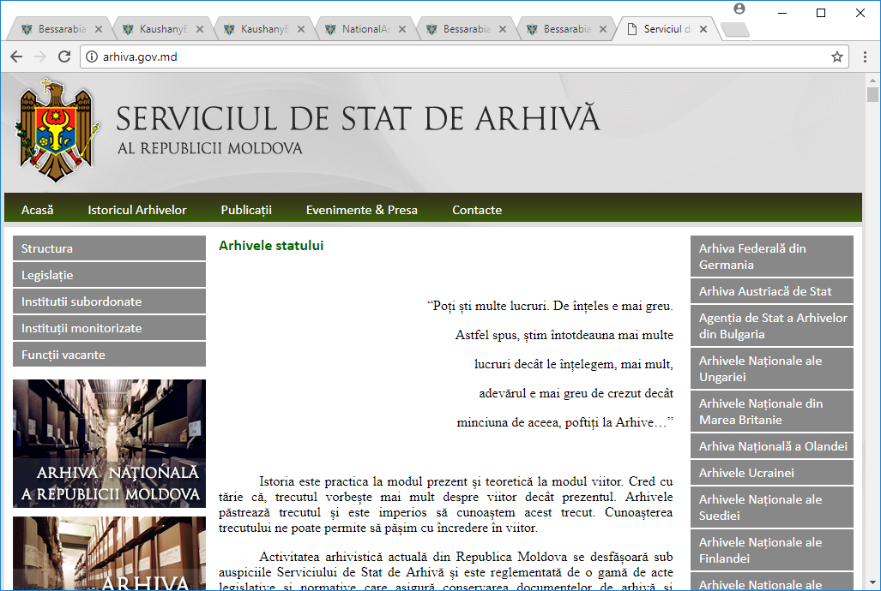
National Archive of Moldova (NARM)

Slide 7
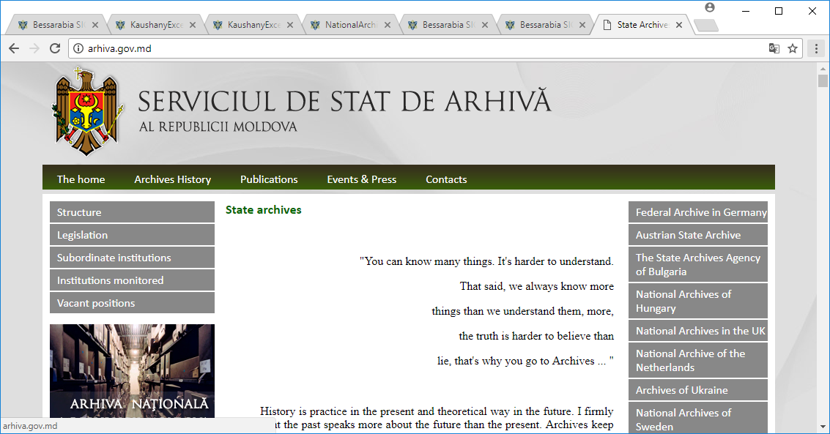
National Archive of Moldova (NARM)

Slide 8
National Archive of Moldova (NARM)
How documents, fonds are structured and identified:
- Фонд – Fond, for example: Fond #134 – for all Revision lists, Jewish and non-Jewish; Fond #769 – Beltsy, Jewish society (Kahal), 1846, etc.
Fond might be huge, like #134 with thousands of cases, or very small with 1-2 case.
- Опись – Inventory – collection of cases.
- Дело – Case/Files. It might be one page or several hundred pages.

Slide 9
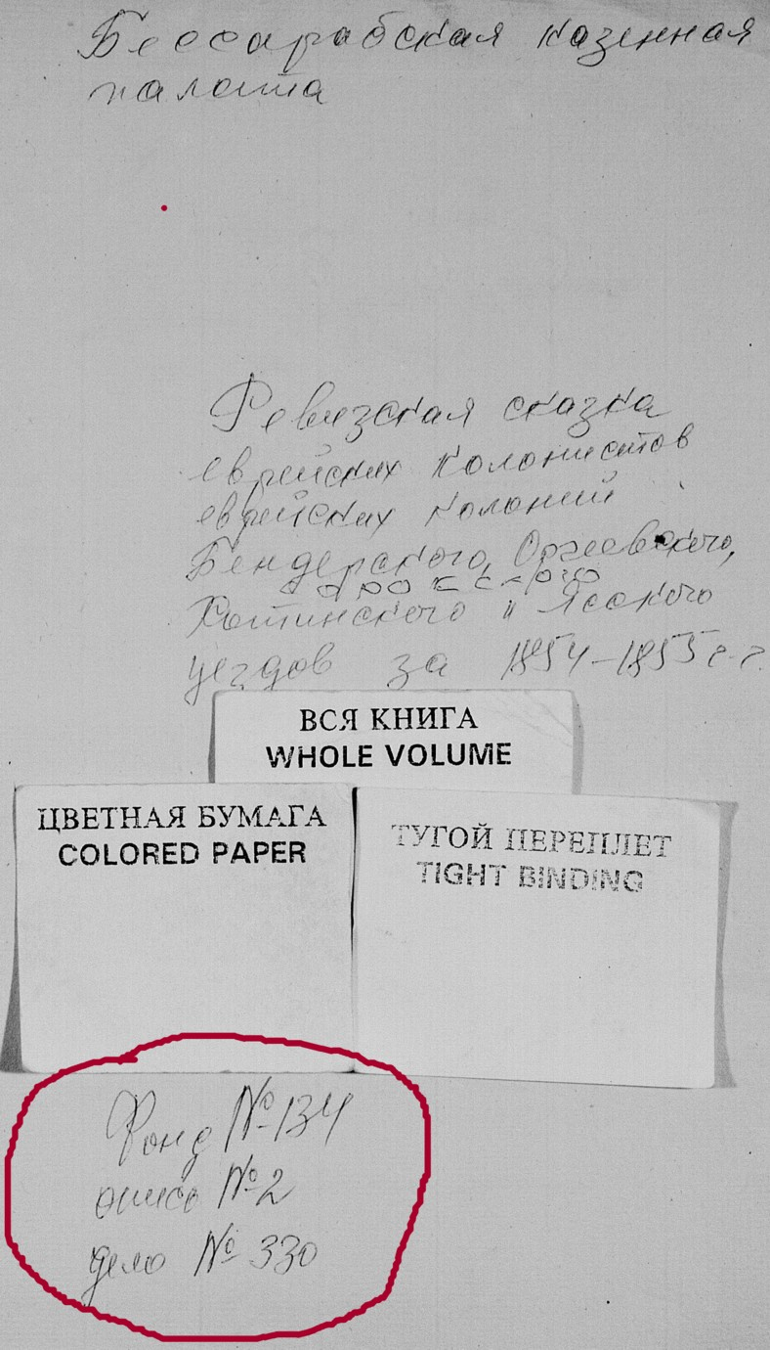
National Archive of Moldova (NARM)
Revision list for Jewish colonists at Jewish colonies Bendery, Orgeev, Khotin and Yassy uezd for 1854-55
Corresponding FHL Microfilm.
Bessarabian Treasury Chamber
Revision List
Fond #134, Inventory #2, Case #330
Years: 1854-1855
Fond #134
Inventory #2
Case #330

Slide 10
National Archive of Moldova (NARM)
Fonds from Archive online:
http://ru.oants.wikia.com/wiki/Национальный_архив_Республики_Молдова
Fond #2
http://ru.oants.wikia.com/wiki/%D0%A4%D0%BE%D0%BD%D0%B4_2
Inventory #6703
https://www.familysearch.org/ark:/61903/3:1:3QS7-99QM-VH9J?mode=g&cc=1985804
Some of the fonds are connected to FHL records. This is a new feature at the connection between NARM and FHL.

Slide 11
National Archive of Moldova (NARM)
Jewish records – records about individuals or Jewish institutions
There are many sources telling us about Jewish material at the Archives:
Researchers from Moldova;
Family Search (Salt Lake City);
Miriam Weiner’s research, book and collection;
Internet resources

Slide 12
National Archive of Moldova (NARM)
Researchers from Moldova:
In 2012 at the Jewish Genealogical conference in Paris, Bessarabia SIG invited a guest speaker from Kishinev, Alla Chastina. One of her presentations was: Archival Documents Relating to Jewish Roots in Moldova (former Bessarabia).
You can read her presentation at Bessarabia SIG website: https://www.jewishgen.org/Bessarabia/files/conferences/2012/Alla%20Chastina%20Moldova.pdf

Slide 13
National Archive of Moldova (NARM)
Researchers from Moldova:
Project “Voice from the Past”, is under way in Republic of Moldova, most likely, it is administered by Academy of Science. This project is similar to what was done in St. Petersburg and Moscow, where several books were published on Jewish Material in these archives. See publications below. Sample for the materials on one shteitl Kaushany:
https://www.jewishgen.org/bessarabia/files/projects/34NationalArchiveMoldova/KaushanyExcerpt.pdf

Slide 14
National Archive of Moldova (NARM)
NARM archive Fonds with Jewish material
There are many fonds in NARM with Jewish collections. Here are several samples of such funds:
Fond 116 Faleshty, Jewish Kahal 1842-6, file 6
Fond 200 Kishinev Jewish Hospital 1890-1920, file 228
Fond 1201 Soroki, One year Talmud-Tora 1818, file 1
Fond 768 Kagul, Society to help poor Jews 1907, file 1

Slide 15
National Archive of Moldova (NARM)
Categories of Jewish fonds
Here are some of the categories of fonds we are able to find:
Jewish census Jews moved abroad Jewish pogroms
Jewish schools Jewish taxes Synagogues
Land documents Court documents Interrogation documents
Jews who illegally crossed the border between USSR and Romania (1930s),
and many more

Slide 16
National Archive of Moldova (NARM)
Family History Library (Salt Lake City) digitized millions of records in Moldova, and will go back to the Moldova Archives to copy more records. Here are a few examples what FHL is planning to get (maybe they already did it):
NEW ADDITIONS OF METRICAL BOOKS 1
fond 211/ opis 5 with 1480 files
1911-1914
Estimate 20m – 100 000 images
JEWISH CHISINAU HOSPITAL records 1
Fond 200/ 228 files
1890-1920
Estimate 3m – 15 000 images

Slide 17
National Archive of Moldova (NARM)
Miriam Weiner’s Archival Material.
Miriam W. donated material on Bessarabia/Moldova to Bessarabia SIG, and after careful research of many documents she obtained during her multiple visits to Moldova, our group created a database of all records/documents related to a person or many people. In addition to our regular records, we found a number of new to us documents, which exist at NARM (National Archive of Moldova Republic). Among them I want to mention several:
List of Zionists in different towns of Moldova
Confirmation of Sale of Property
Resettlement of Bessarabia Jews form bordered by 50 miles
List of Jews in Tiraspol Ghetto, and more

Slide 18
National Archive of Moldova (NARM)
Miriam Weiner’s Archival Material.
In addition to the people’s database, we found Archival inventories for
some of the Fonds with details of what they have.
Our goal is to combine Miriam’s information with data we got from
National Archive of Moldova and FHL and with translating of it to get a
full list of fonds with Jewish material. For example:
Fond 1201 Soroki, One-year Jewish school “Talmud-Tora”, 1918, file 1
Fond 403 List of recruited to the army, 1864-1917, 11 files, 35,000 img
Fond 153 Kishinev city register by houses, including family members,1894-1919, 5,000 images

Slide 19
National Archive of Moldova (NARM)
Personal experience with contacting NARM
I tried to order a set of Land Documents from town of Kaushany at NARM.
It was about 10 years ago…
Here is how I got that set… <only oral story>
I hope that now, in 2018 we will get records easier.…

Slide 20
National Archive of Moldova (NARM)
Publications:
1. Jewish Documentary Sources in Saint Petersburg Archives : A Guide [V. 1]: Federal archives, Ed. and comp. by A. Ivanov, M. Kupovetskii, A. Lokshin; Saint Peresburg, MIR, 2011
2. Jewish Documentary Sources in Saint Petersburg Archives : A Guide [V. 2]: Regional archives, Ed. and comp. by A. Ivanov, M. Kupovetskii; Saint Peresburg, MIR, 2013
3. Genrikh Markovich Deich, Arkhivnye dokumenty po istorii evreev v Rossii v XIX–nachale XX vv: Putevoditel’ / A Research Guide to Materials on the History of Russian Jewry, 19th and Early 20th Centuries in Selected Archives of the Former Soviet Union, ed. Benjamin Nathans (Moscow and Pittsburgh, 1994).
4. Alla Chastina presentation, 2013 https://www.jewishgen.org/bessarabia/files/projects/34NationalArchiveMoldova/NationalArchiveMoldova1.pdf
5. Archive section at the Bessarabia SIG website: https://www.jewishgen.org/bessarabia/TPL_Base.asp?id=23
6. Miriam Weiner, Jewish Roots in Ukraine and Moldova (JRU&M), YIVO, 1999 http://www.rtrfoundation.org/uk1.shtml

Slide 21
Internet resources on Jewish Bessarabia
Bessarabia SIG website: www.jewishgen.org/bessarabia
Aaron Shneer Gallery: http://picasaweb.google.com/106995678358404531836
Jewish News portal : www.dorledor.info (Russian)
My town Kishinev: http://oldchisinau.com/ (Russian)
Centrul Istoric al Chisinaului: http://www.monument.sit.md/ (Romanian)
Jewish Memory: http://www.jewishmemory.md/eng/ (English, Russian)
All about Bessarabia: http://www.bessarabia.ru/ (English, Russian)
Jewish Encyclopedia: http://www.jewishencyclopedia.com/articles/3185-bessarabia
Historical Maps of Moldova: http://commons.wikimedia.org/wiki/Category:Maps_of_the_history_of_Moldova
Jewish Cemeteries of Kishinev and Orgeev: http://www.pavetex.md/
Bessarabian Jews: http://en.wikipedia.org/wiki/Category:Bessarabian_Jews
Preserving Jewish memory Centropa: http://www.centropa.org/
Bessarabian Maps: http://www.wwii-photos-maps.com/bessarabianmaps/index.html
Memorial: http://www.obd-memorial.ru/html/index.html (Russian)
Memory Book: http://www.nekropol.com/Holokost.htm (Russian)

Slide 22
National Archive of Moldova (NARM)
Questions?

