Slide 1
JewishGen Bessarabia Special Interest
Group Meeting
Yefim A. Kogan
yefimk@Verizon.net
JewishGen Bessarabia SIG Leader and Coordinator www.jewishgen.org/Bessarabia
August 6, 2018
Notes:
*

Slide 2
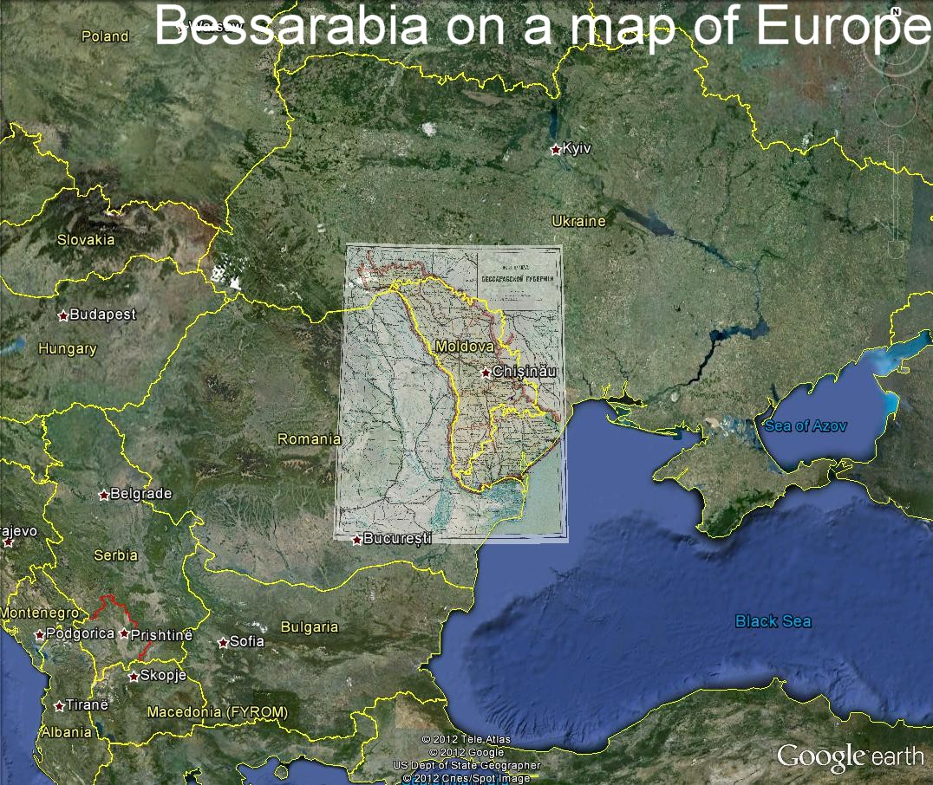

Slide 3
Bessarabia SIG Meeting
The meeting is open to anyone with roots or interest in the region Historically known as Bessarabia, an area now comprising the Republic of Moldova and parts of Ukraine. At the end of the 19th century and before the Wars, Bessarabia had significant Jewish presence. The Bessarabia SIG was organized at the end of 2011 to help people in their Bessarabian genealogical research.
We also include an area which is known as the Transnistria Republic, a breakaway region from the Republic of Moldova.

Slide 4
Bessarabia SIG Meeting
Our Bessarabia SIG Discussion group has 840 members from about 25 countries.
Bessarabian/Moldavian Jewish Roots Facebook Group
This group was established 4 years ago, on June 2, 2014. It has become a great dynamic addition to JewishGen Bessarabia SIG with discussions about culture, traditions, and food of Bessarabian Jews. Today the group accounts for 2,250 members who live all around the world. The language barrier is solved easily thanks to the auto translation feature that Facebook offers to its users. Thus, group members post questions in English, Portuguese, Spanish, Hebrew, and Russian and everyone is able to understand and respond in their native language.

Slide 5
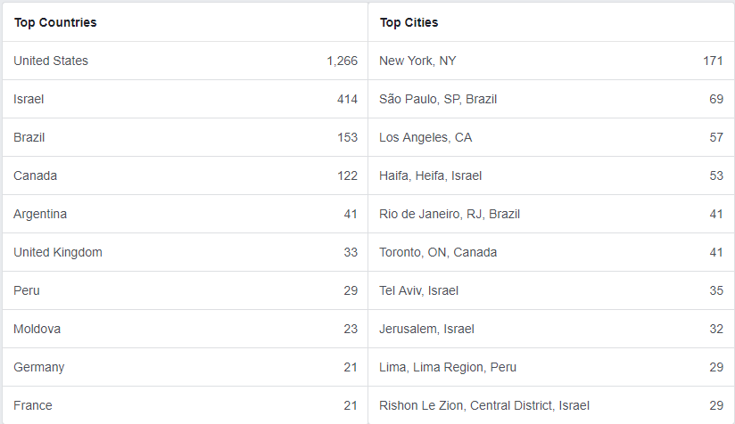
Bessarabian/Moldavian Jewish Roots Facebook Group

Slide 6
Progress report. Project completed from August 2017 to July 2018
1. Cemetery Projects
- Arcyz Jewish Cemetery - completed;
- Beltsy Jewish Cemetery - Phase 5 of the cemetery completed;
- Rashkov Jewish Cemetery - completed;
- Rashkov Old Jewish Cemetery - completed;
- Ataki Jewish Cemetery - completed, but there is a section need more work (2019)
- Akkerman Jewish Cemetery - completed;
- Vadul Rashkov Jewish Cemetery - Phase 1, half of the cemetery was completed;
- Novoselitsa Jewish Cemetery - completed;

Slide 7
Progress report. Project completed from August 2017 to July 2018. Cemetery projects
- Brichany Jewish Cemetery – in progress of Clearing paths, cleaning stones project. Half is done, and the rest will be completed this year. There are going to be additional 1,500 records/images of the tombstones;
- Ataki, Kiliya, Lipkani - next cemeteries to clear paths, cleaning, additional photographing.
If you have photos from the cemeteries in Bessarabia/Moldova, even a few photos, please consider to share with Bessarabia SIG.
Our plan is to complete most of the cemeteries in the region in 2 years. After that we might go to some cemeteries second time, where sections of the cemeteries could not be accessed.
WHAT TO DO WITH CEMETERIES which do not exist anymore?! But we know their locations… and possible even know some people who were buried there…
I think we should write all available information about such cemeteries to JOWBR and Bessarabia SIG and make it available for everyone!

Slide 8
Progress report. Project completed from August 2017 to July 2018. Cemetery projects
If you have photos from the cemeteries in Bessarabia/Moldova, even a few photos, please consider to share with Bessarabia SIG. We may post your photos at JOWBR ( as we did already with photo from …)
Our plan is to complete most of the cemeteries in the region in 2 years. After that we might go to some cemeteries second time, where sections of the cemeteries could not be accessed.
WHAT TO DO WITH CEMETERIES which do not exist anymore?! But we know their locations… and possible even know some people who were buried there…
I think we should write all available information about such cemeteries to JOWBR and Bessarabia SIG!

Slide 9
Progress report. Project completed from August 2017 to July 2018.
2. Revision List Project
- December, 2017 - added 11,947 records
- June, 2018 - added 11,485 records
** added 23,432 records this year! Total of 180,000+ records translated.
Records are uploaded to JewishGen, but the Introductory pages are not updated yet.
3. Vital Records Project
163,000 records translated. There are many sets of records waiting to be translated
Need translators and also Project Leader to take care of the whole process. We have now one Project Leader for Bendery district - Ariel Parkansky, and I am asking our members to become a Project Leader for other districts. The ideal Project Leader have Russian or/and Hebrew language.
3,000 Birth records for Kishinev were added this year.

Slide 10
Progress report. Project completed from August 2017 to July 2018
4. Famous People:
Several categories of Jews were added to the list: Religious Leaders, Scientists
If you know some people who are not on these lists, but should be, submit information to the Project Leader.
5. Create more KehilaLink Website for Bessarabian towns and shteitlakh, and periodically update existing websites
Only one website was completed this year for the town of Ungheni, Beltsy district.
There have now 21 KehilaLinks websites and 6 are in progress
We need to bring this number to at least 100! Websites. Imagine there is no websites for towns of Soroki, Lipkani, Otaki, Markuleshti and many more! We need people to collect information, and there are technically knowledgeable members who can help to put it all on website.

Slide 11
Progress report. Project completed from August 2017 to July 2018
6. Yizkor Books Translations:
Bendery Yizkor Book is completed in 2017, but it was published by JewishGen this year.
Kishinev Yizkor Book – completed, and soon be published.
We started working on Bessarabia Yizkor Book: The Jews in Bessarabia; Between the World Wars 1914-1940
Many Yizkor Books are waiting to be translated. You can browse the list of Yizkor Books and find once of interest. In many Yizkor Books only Table of Contents was translated. There are a number of Bessarabia Yizkor Books with vast information on our ancestors, with photos, family stories, etc.

Slide 12
Progress report. Project completed from August 2017 to July 2018
Upgraded the Bessarabia SIG website. The website was updated, and now it is not just a static website, but we have a place to add some smaller databases, images, articles, etc. Visit us at www.jewishgen.org/bessarabia
8. Miriam’s Weiner Archival collection.
The new database were introduced, and almost 1,000 records submitted to our Bessarabia SIG Name database. The most important of this archival material, that we know what type of records is available, and in most cases where to find these records.

Slide 13
New Project for next year and beyond
Cemetery photographing, translation projects:
Vadul-Rashkov, Phase 2
Beltsy, Phase 6
Kishinev Jewish Cemetery, Phase 2
Several cemeteries in Transnistria
Klishkivtsy, two Jewish cemeteries
Reni Jewish Cemetery
Cemetery clearing paths, cleaning project:
Brichany (finish it)
Ataki
Lipkany
Gancheshty
Kiliya

Slide 14
New Project for next year and beyond
Acquire different types of records from Moldovan Archive as well as from Saint Petersburg and Moscow Archives: student records, synagogue records, court records, etc. Possible to get some records from FHL, Salt Lake City
Revision Lists
Vital Records
Educational Records
Deportation records
Land documents
others

Slide 15
Good ideas from Alan Levitt, from the Leadership group, moderator for Bessarabia SIG Discussion group (Alan asked these questions at the last year conference and we did not get any response)
1) asked for success stories from our members - how has our SIG helped? We know that there are success stories, but you need to tell us about them. Please submit your success stories to us.
2) We may want to undertake a survey of our members, not only to better understand where they live, but also what are their general interests, what would they like our SIG to focus on, other than just the data/research aspects? Need a person or two to help Alan Levitt with the survey.

Slide 16
Internet resources on Jewish Bessarabia
Bessarabia SIG website: www.jewishgen.org/bessarabia
Aaron Shneer Gallery: http://picasaweb.google.com/106995678358404531836
Jewish News portal : www.dorledor.info (Russian)
My town Kishinev: http://oldchisinau.com/ (Russian)
Centrul Istoric al Chisinaului: http://www.monument.sit.md/ (Romanian)
Jewish Memory: http://www.jewishmemory.md/eng/ (English, Russian)
All about Bessarabia: http://www.bessarabia.ru/ (English, Russian)
Jewish Encyclopedia: http://www.jewishencyclopedia.com/articles/3185-bessarabia
Historical Maps of Moldova: http://commons.wikimedia.org/wiki/Category:Maps_of_the_history_of_Moldova
Jewish Cemeteries of Kishinev and Orgeev: http://www.pavetex.md/
Bessarabian Jews: http://en.wikipedia.org/wiki/Category:Bessarabian_Jews
Preserving Jewish memory Centropa: http://www.centropa.org/
Bessarabian Maps: http://www.wwii-photos-maps.com/bessarabianmaps/index.html
Memorial: http://www.obd-memorial.ru/html/index.html (Russian)
Memory Book: http://www.nekropol.com/Holokost.htm (Russian)

Slide 17
Bessarabia SIG Meeting
Questions?

