Slide 1
Jewish Shtetl in Moldova without Jews:
How the Jewish Past can be remembered
Serghei Daniliuc,
Reseacher, Local Historian, Resident of Kaushany, Moldova
Yefim A. Kogan, MJLS
JewishGen Bessarabia SIG Leader and Coordinator
August 8, 2018

Slide 2
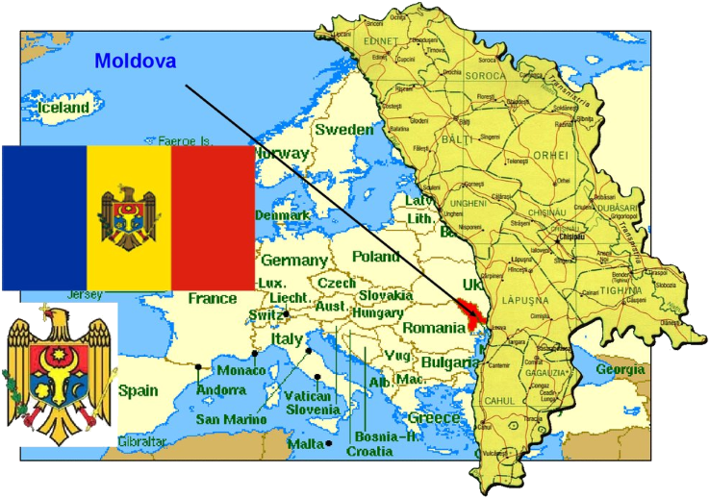
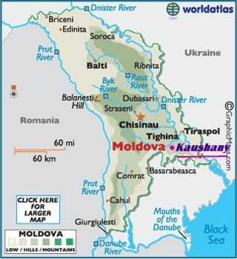
Kaushany is a small town in South-Eastern Moldova. Despite its size Kaushany has a very rich history, a long history of ups and downs, of multiculturalism that lack many larger towns in North-Western Black Sea coastal area

Slide 3
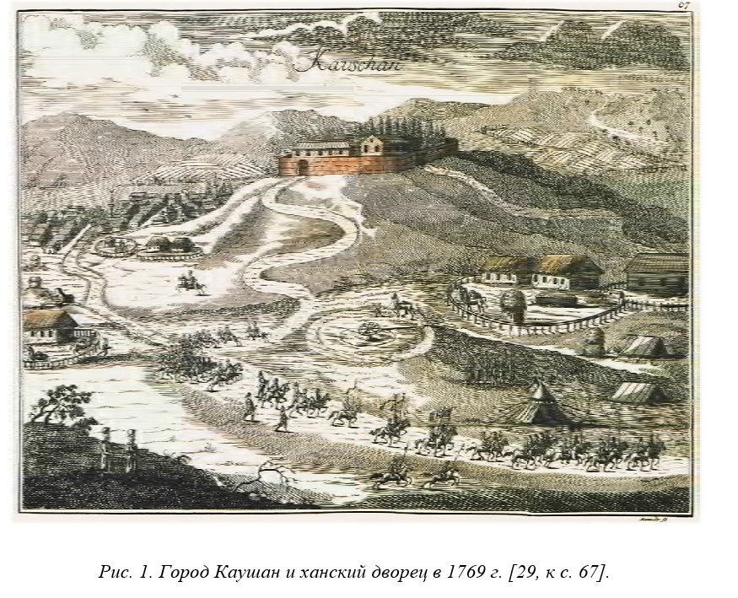
Kaushany became ‘the capital’ of Crimean Tatars in 17 century. ‘…it has become a tradition among crimean khans to have a personal residence in Budjac (South of Bessarabia).

Slide 4
Jews in Kaushany
We know from different travelers that Jews lived in Kaushany at the beginning of 18 century (1720s) and most likely 100 years before that. The oldest synagogue was built in 1700s.

Slide 5
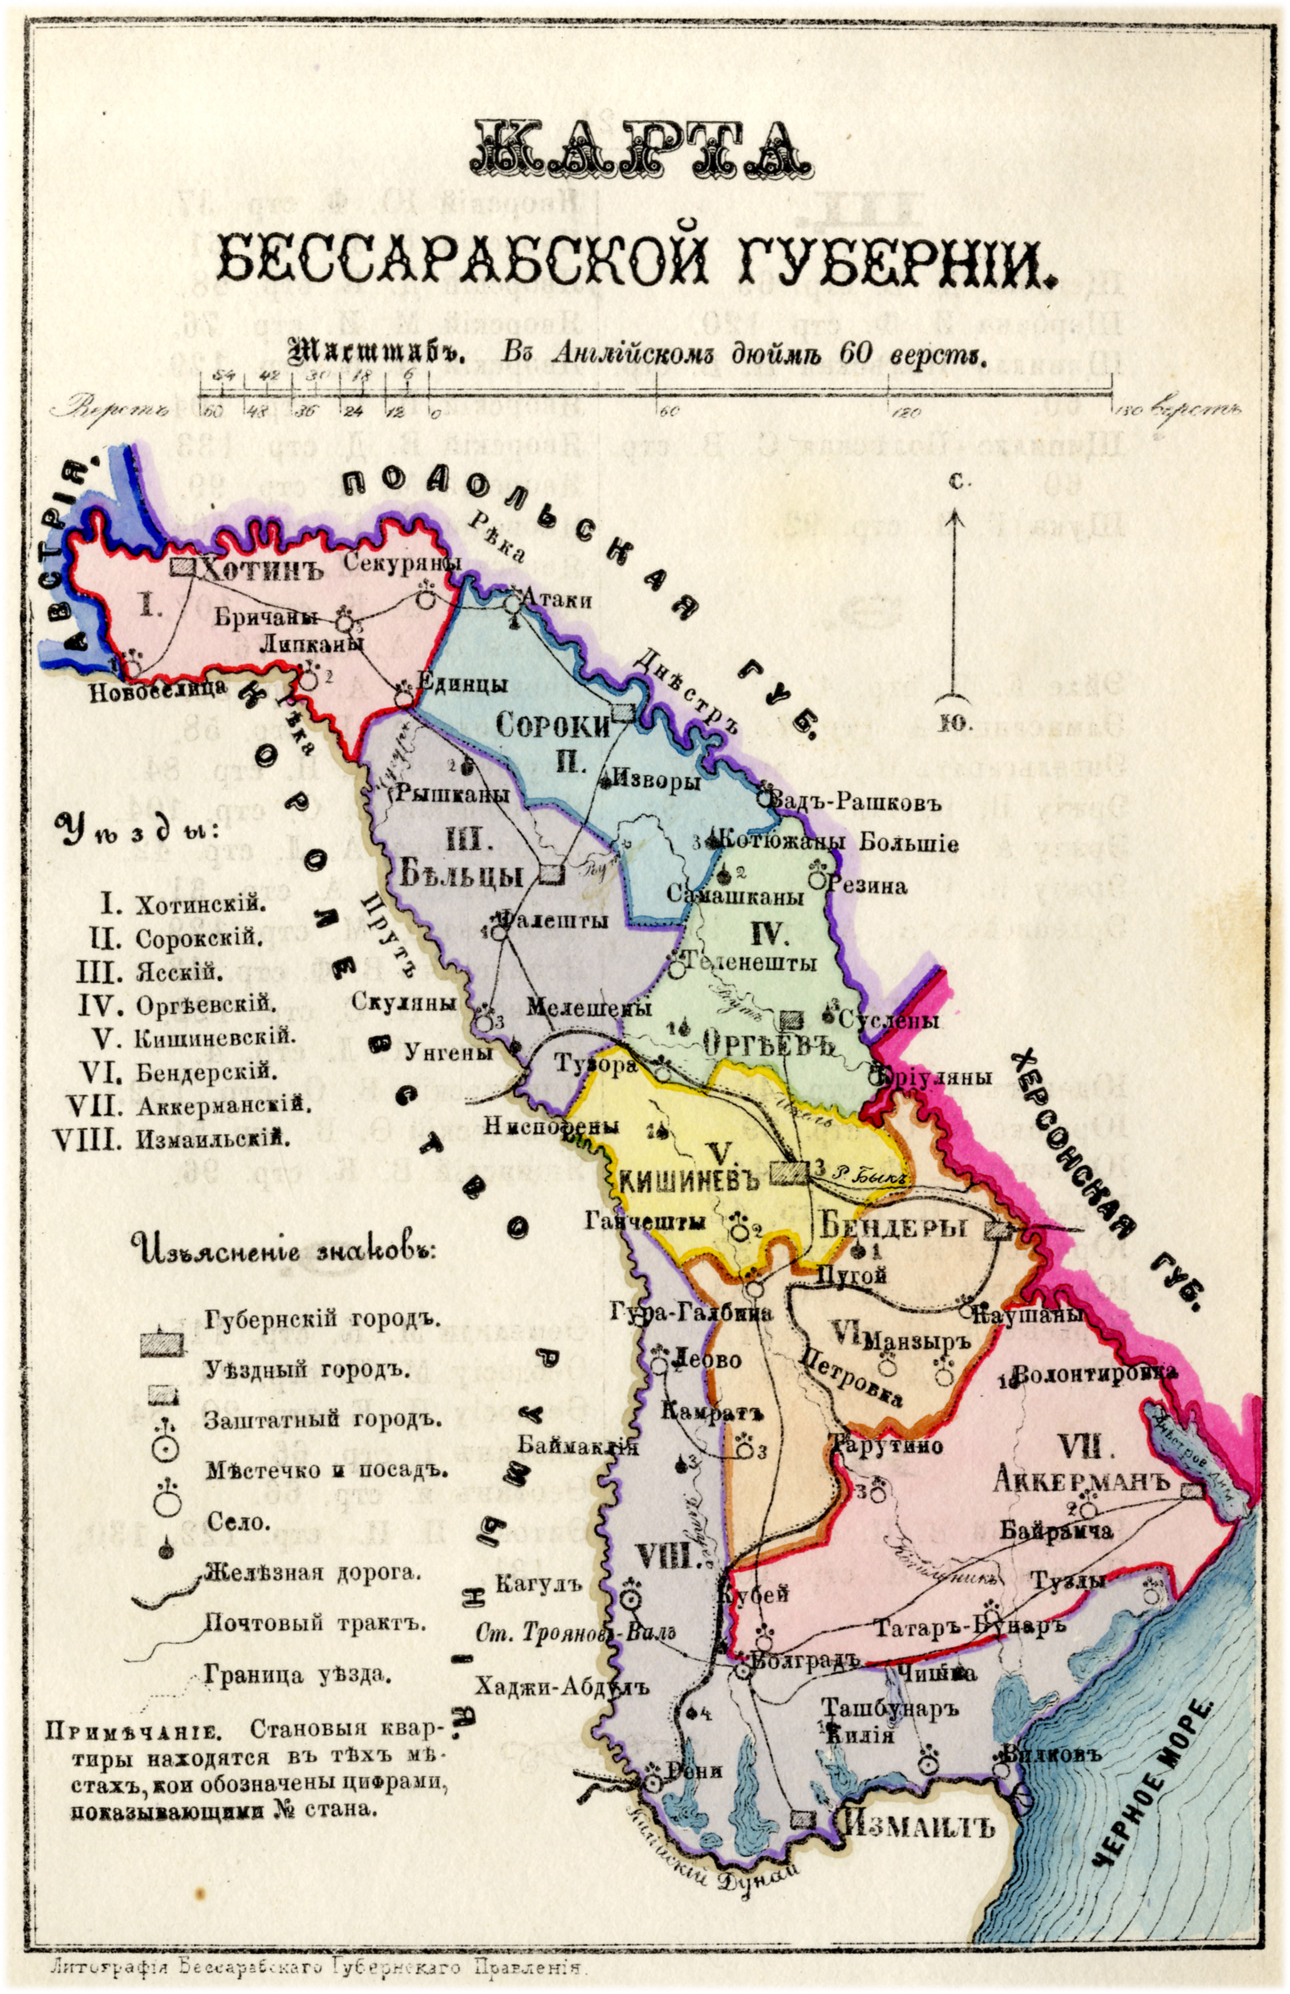
In 1812, Bessarabia became a part of the Russian Empire.
By 1817, 53 Jewish families lived in Kaushany. The community increased with a large Jewish immigration into Bessarabia in the 19th century.
In 1853 80 families of Jewish farmers were granted landholdings by the state, and were reclassified as "state farmers."

Slide 6
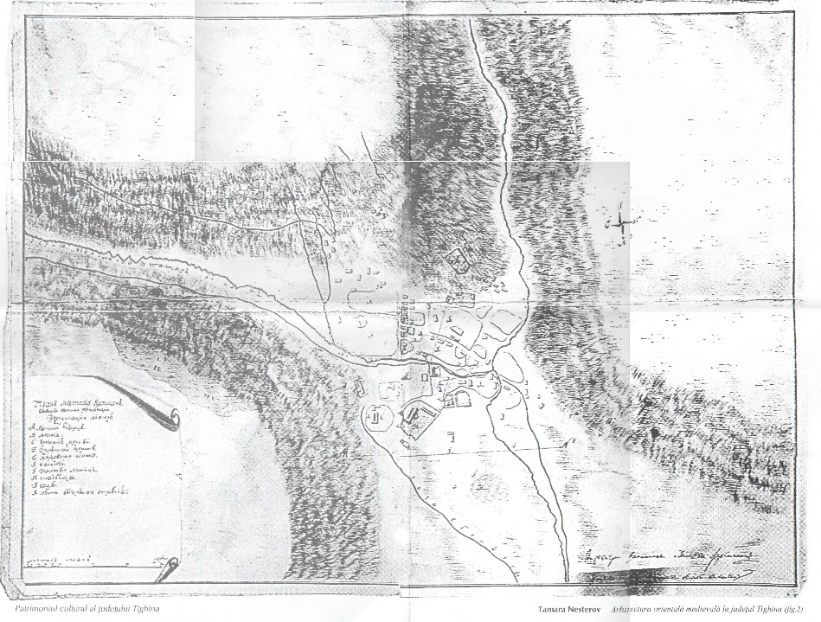
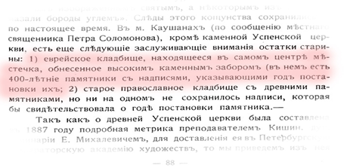
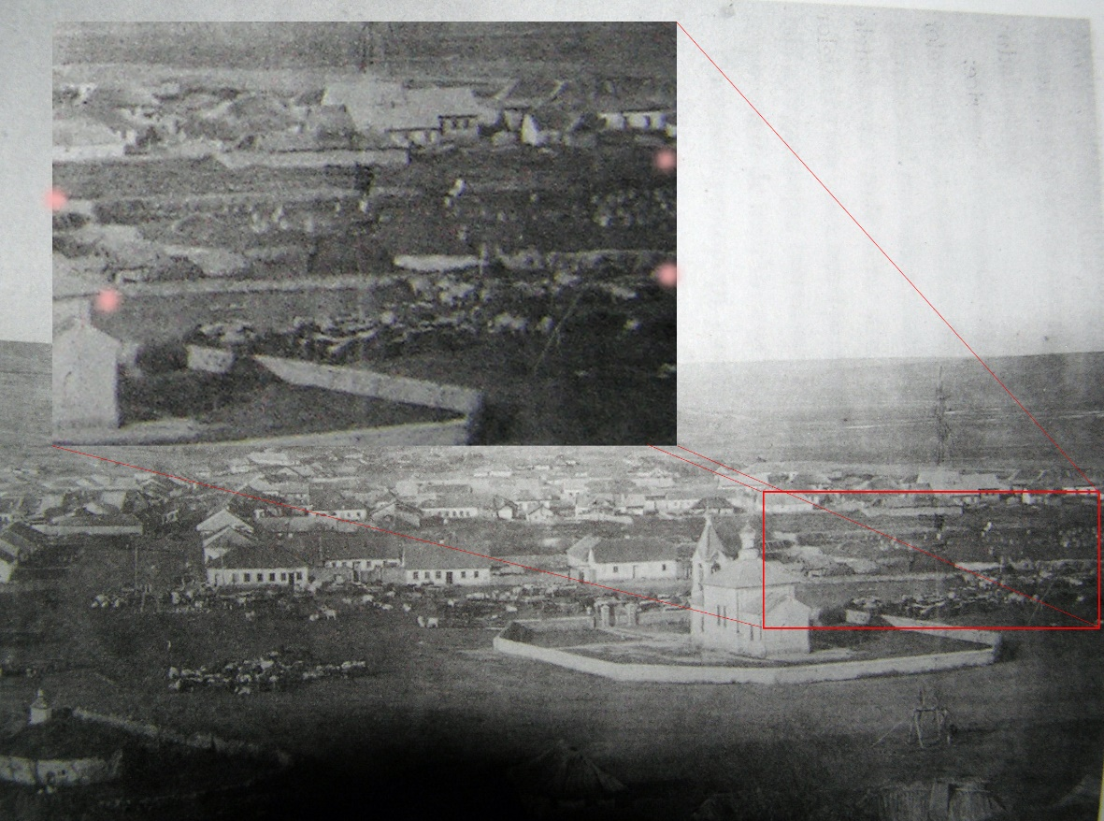
Jewish Cemeteries – an important discovery
The old cemetery was located in the middle of the town and there’s nothing left of it today. I was able to find some mentions of its existence. Also it can be seen on a late 19th century photo. There is a document written in 1910, with a quote about old Jewish Cemetery in Kaushany, with some stones 400 years old

Slide 7
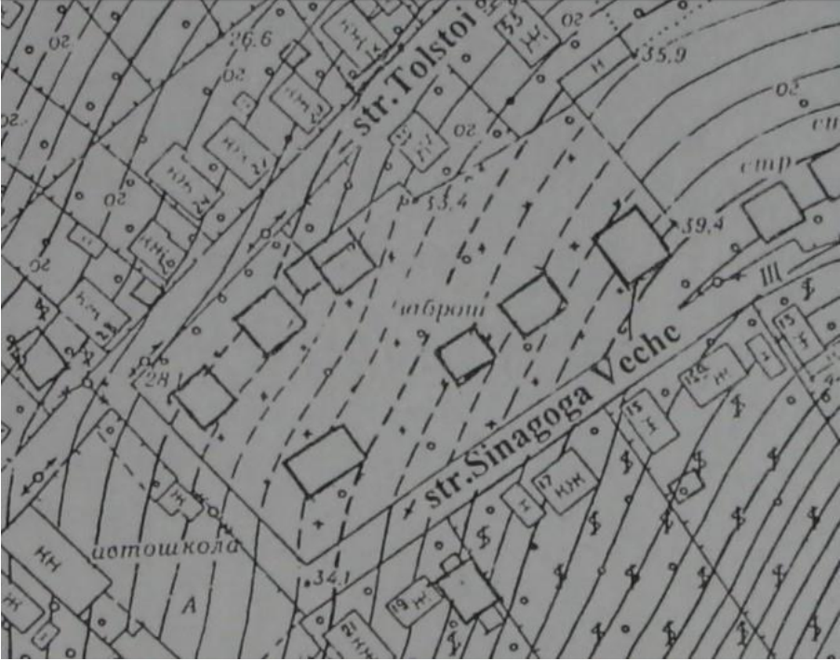
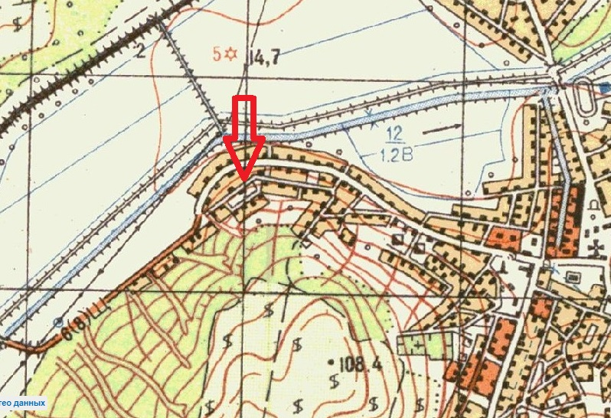
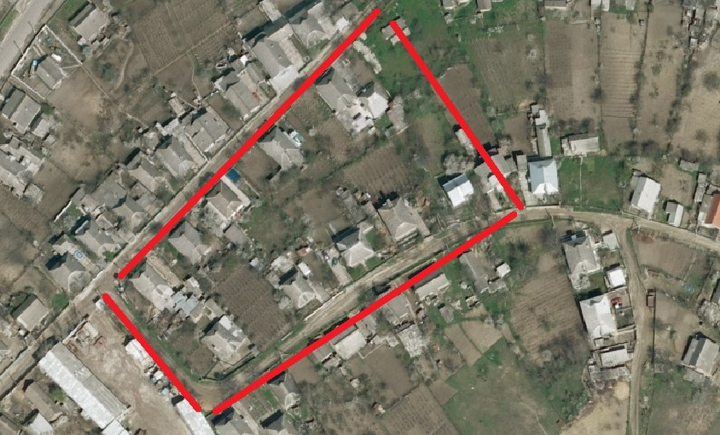
The second new cemetery was located in another part of the town and apparently was newer than the first one. We can see its location on this topographic plan of late 1980s

Slide 8
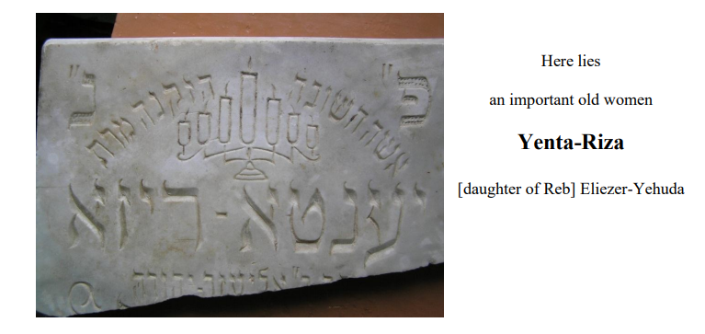
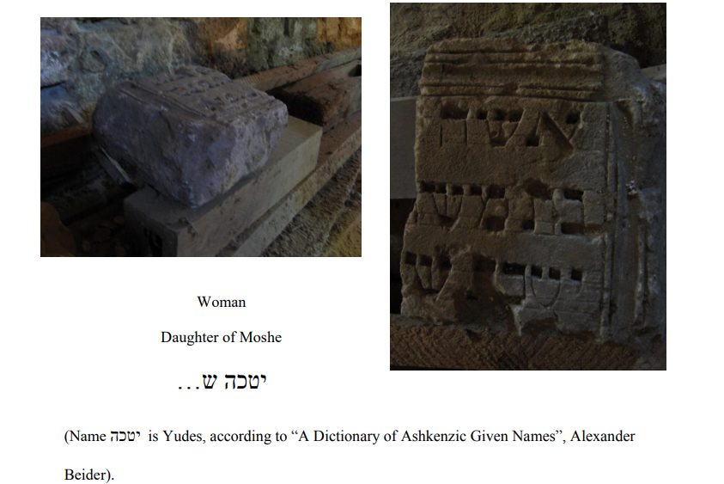
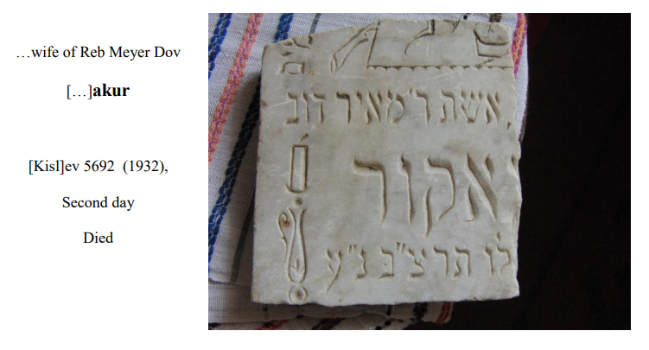

Slide 9
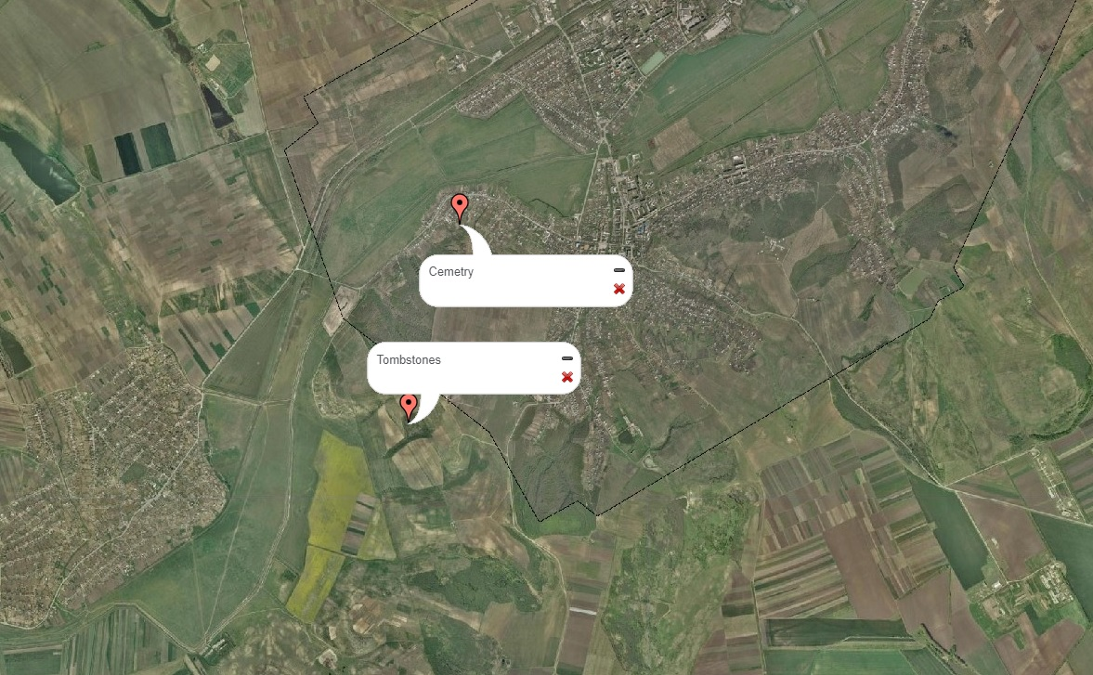
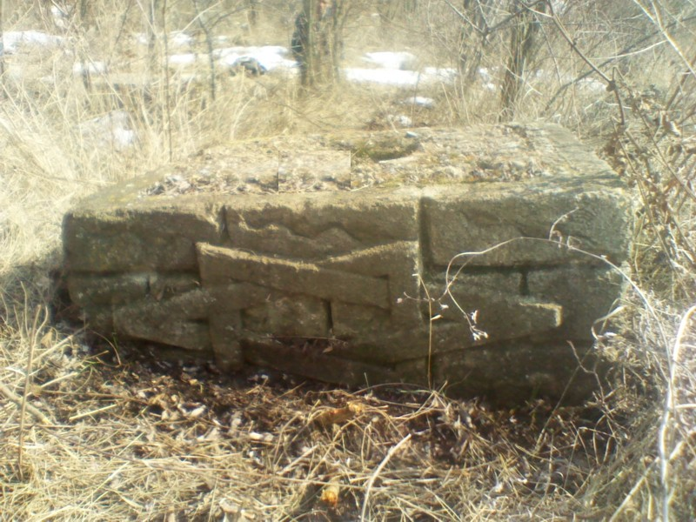
After exploring nearby forests and ravines, several traces were found. First, a gravestone with the star of David was found in 2012
A stone found not far from Kaushant in a wooded area by Serghey D. in 2012

Slide 10
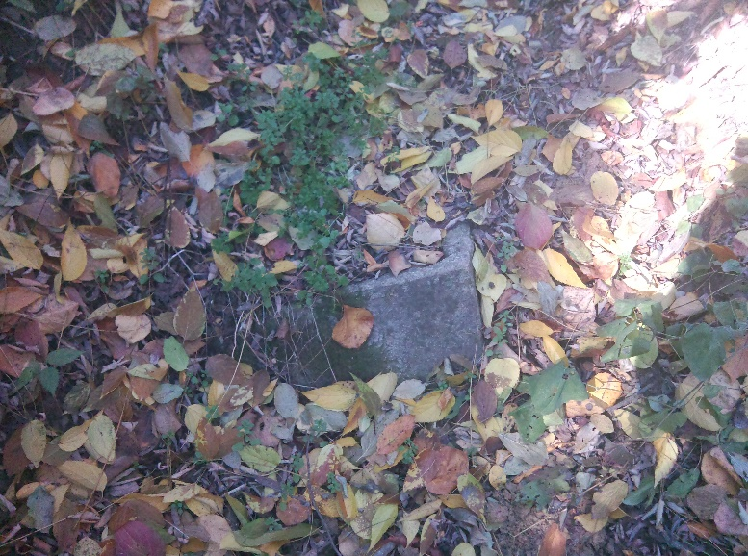
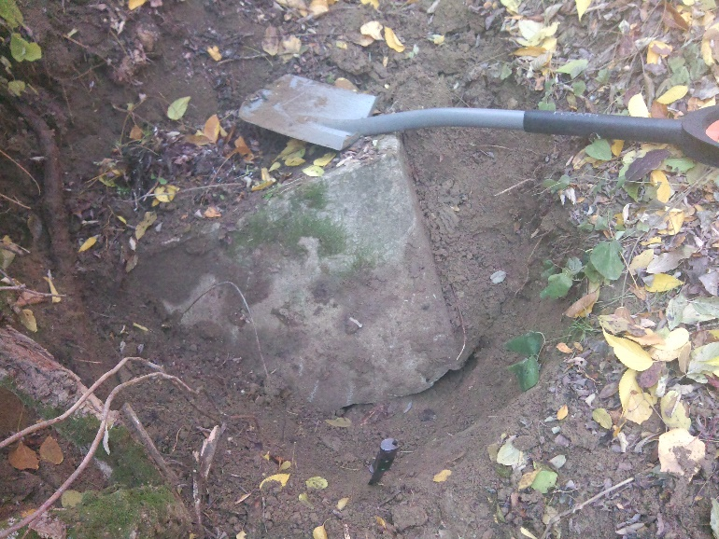
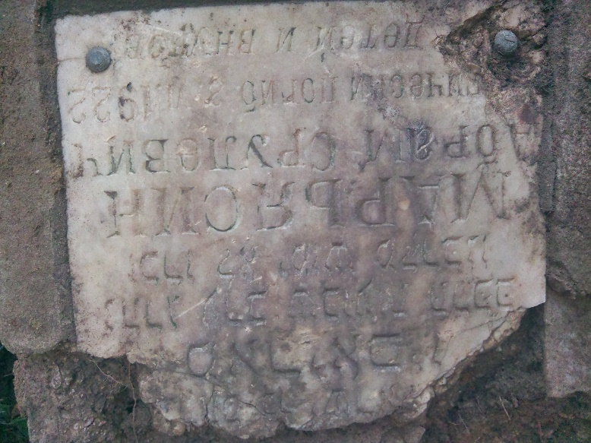
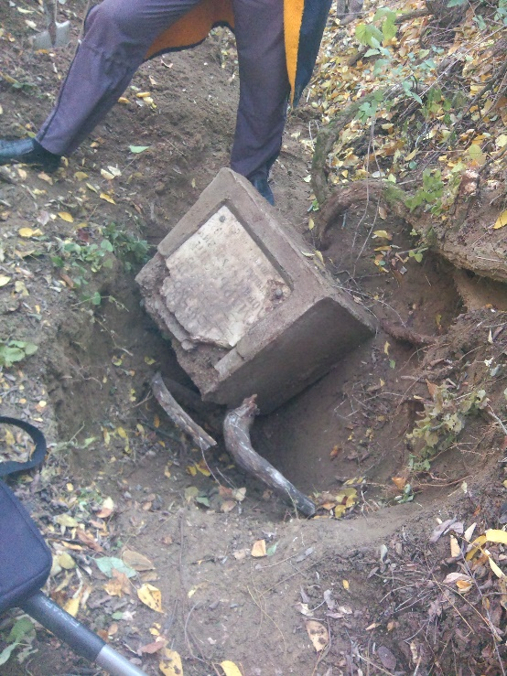
Some time later during the investigation of a nearby ravine, a tombstone was discovered. It was found at the bottom of the ravine, buried in the ground.

Slide 11
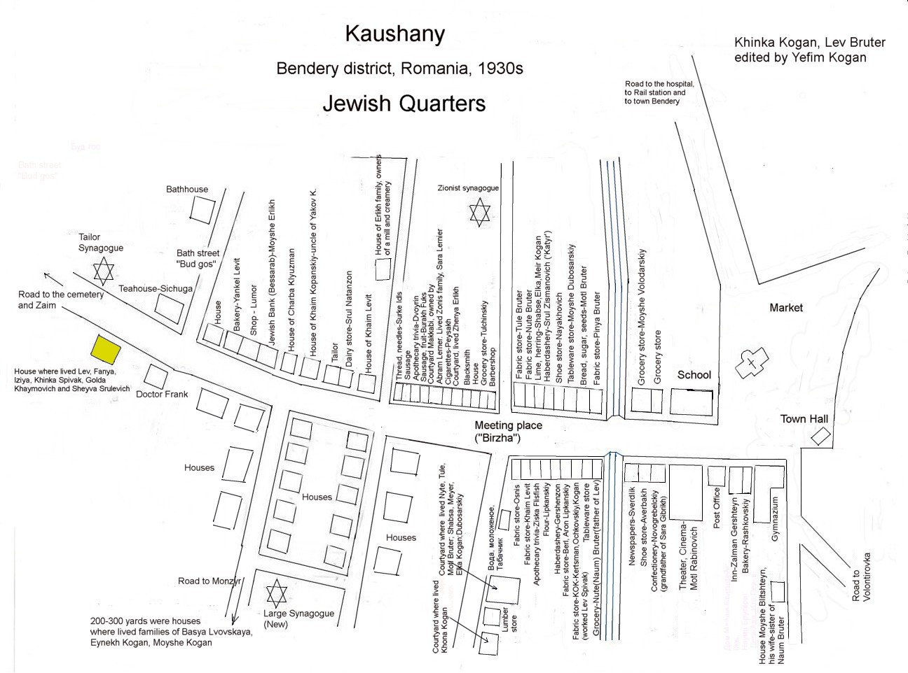
Jewish Life in Kaushany before the war
In 1930s Kaushany was a shteitl (mestechko) with more than 2000 Jewish people, about 400+ families.
The map was created from the memory of Jewish residence of Kaushany, Khinka Kogan (Spivak) with help of her relatives, and children
From “Jewish Life in Bessarabia Through the Lens of the Shtetl Kaushany” at https://www.jewishgen.org/Bessarabia/files/FinalPaper.pdf.

Slide 12
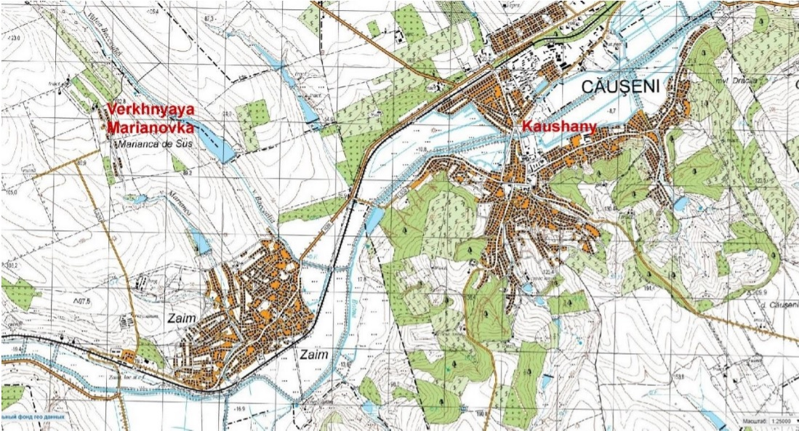
Holocaust
In July of 1941 Romanian Army entered Kaushany, and starting executing Jews. 100+ elderly, sick Jews could not leave town on time, and there are evidence that they were murdered with help or by locals.

Slide 13
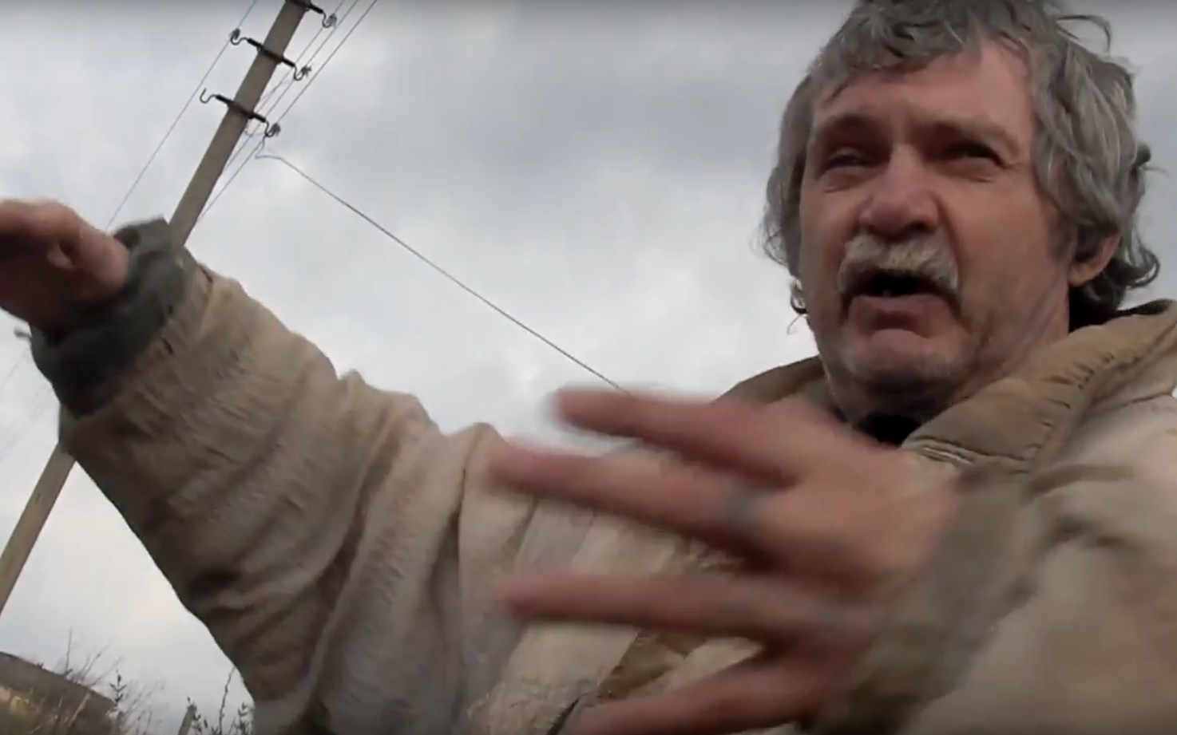
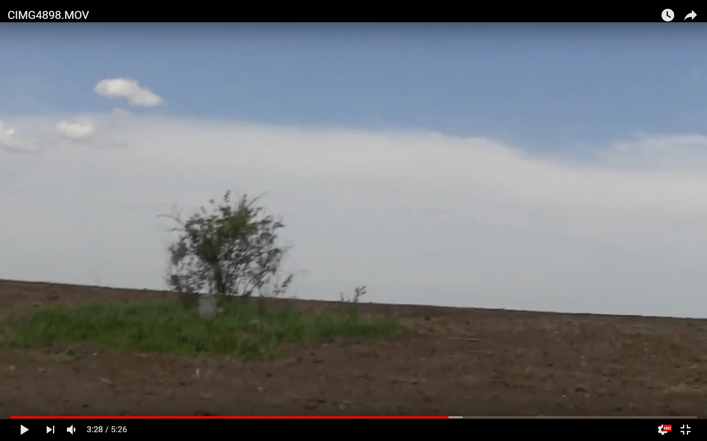
Verkhnyaya Marianovka
Finding the exact place of the mass grave for several years.
The task was complicated by the fact that there were no witnesses of those events. In one of the trips I was able to talk with the locals, who had a guest who knew the exact place.
https://www.youtube.com/watch?v=maN8FH6QH6k&feature=youtu.be

Slide 14
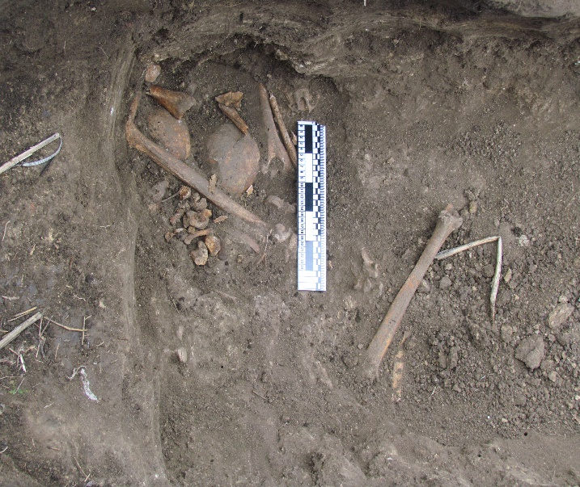
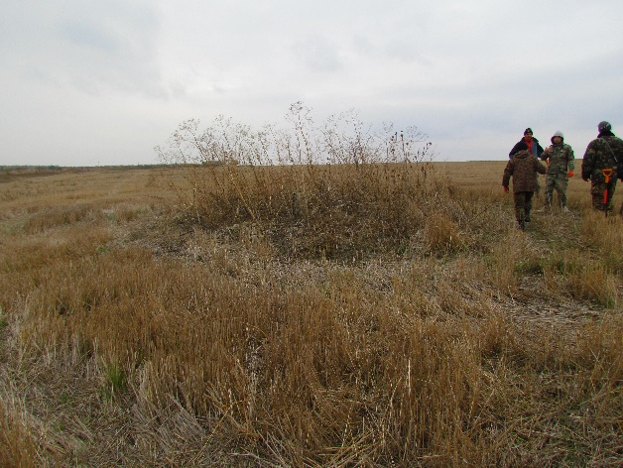
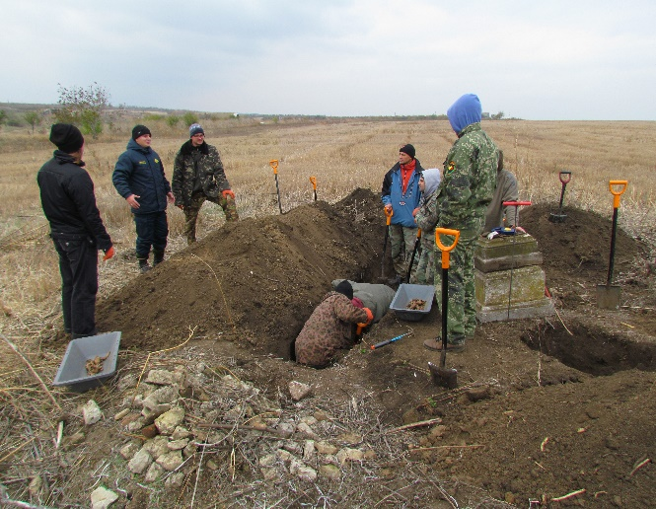
A few years later, with the help of the search group “August”, reconnaissance was conducted and the exact location of the mass grave was established precisely in this place. In the course of intelligence work, there were found the remains of many people and also the remains of lime.

Slide 15
More information on the Holocaust and Jews who were killed and survived in Kaushany, you can find at “Jewish Life in Bessarabia Through the Lens of the Shtetl Kaushany”.
https://www.jewishgen.org/Bessarabia/files/FinalPaper.pdf

Slide 16
How Jewish Past can be remembered ?
There is JewishGen KehilaLink website for Kaushany: https://kehilalinks.jewishgen.org/Causeni/Kaushany.htm. It includes a lot of person information for Jews who used to live there.
There is also an extensive research on Kaushany, references several times already: https://www.jewishgen.org/Bessarabia/files/FinalPaper.pdf. These are all reminders of how our ancestors lived there for many centuries.

Slide 17
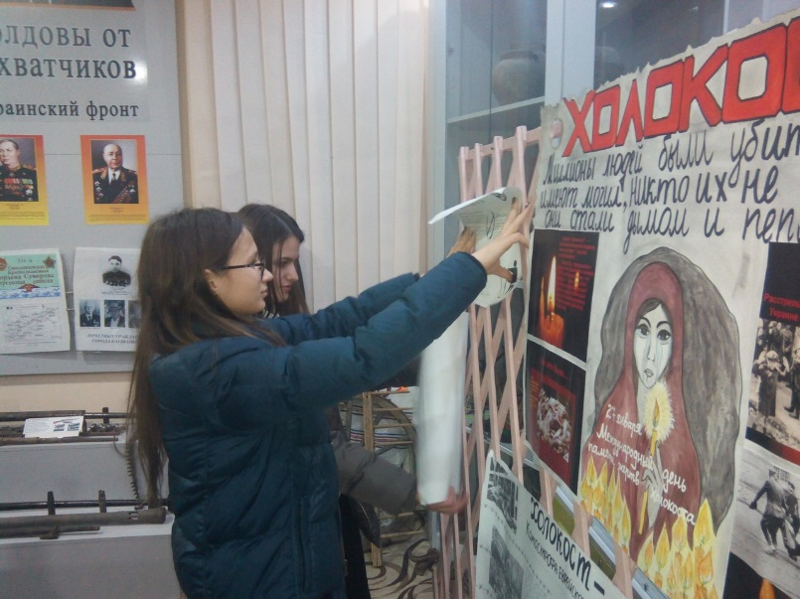
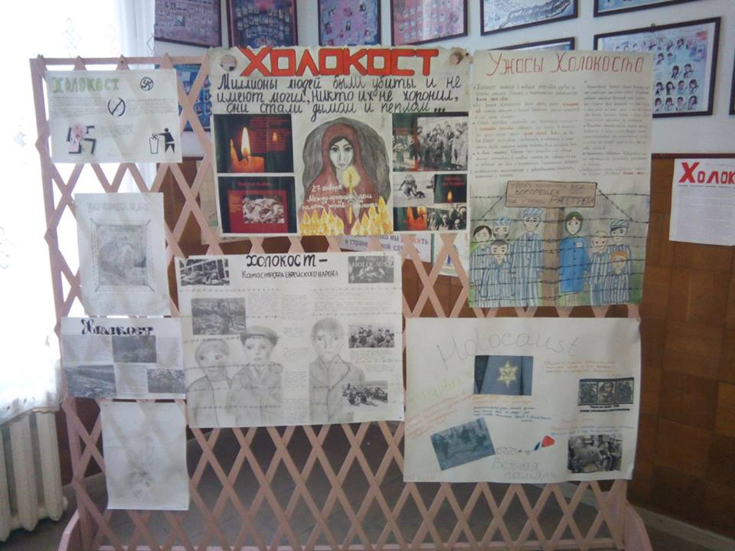
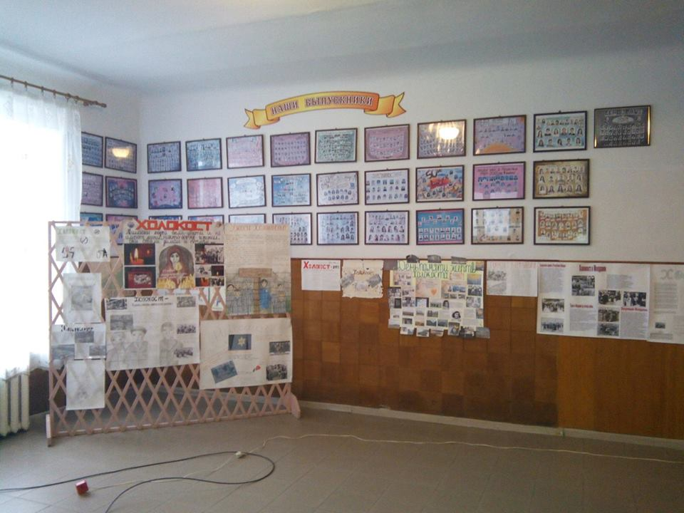
Annually on the Holocaust Remembrance Day, lectures and talks devoted to this topic are held at Pushkin's Lyceum in the city of Kaushany.

Slide 18
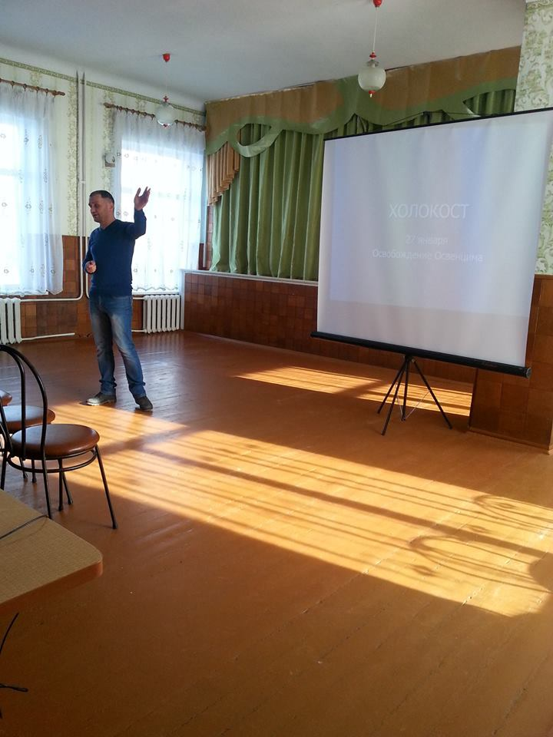
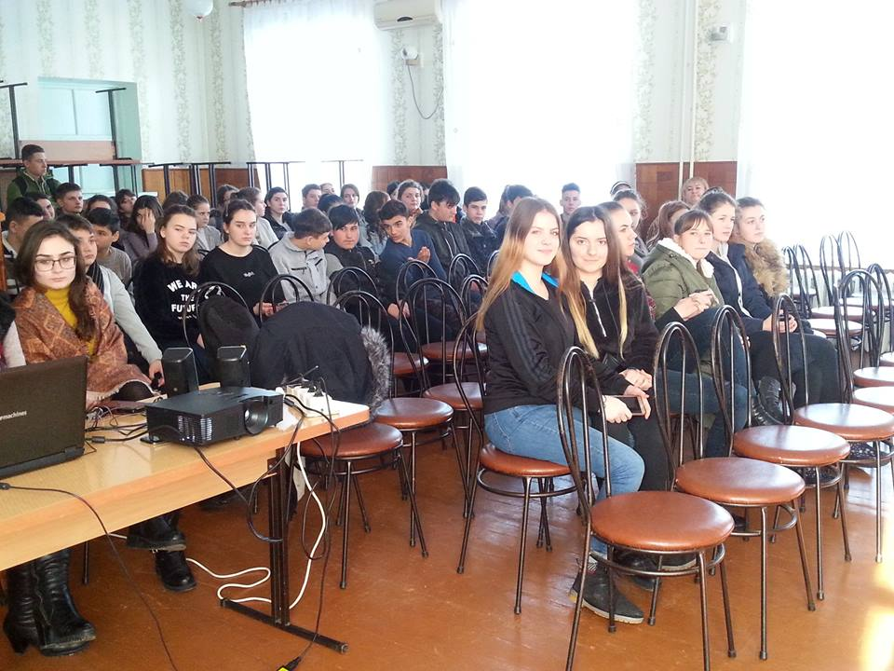
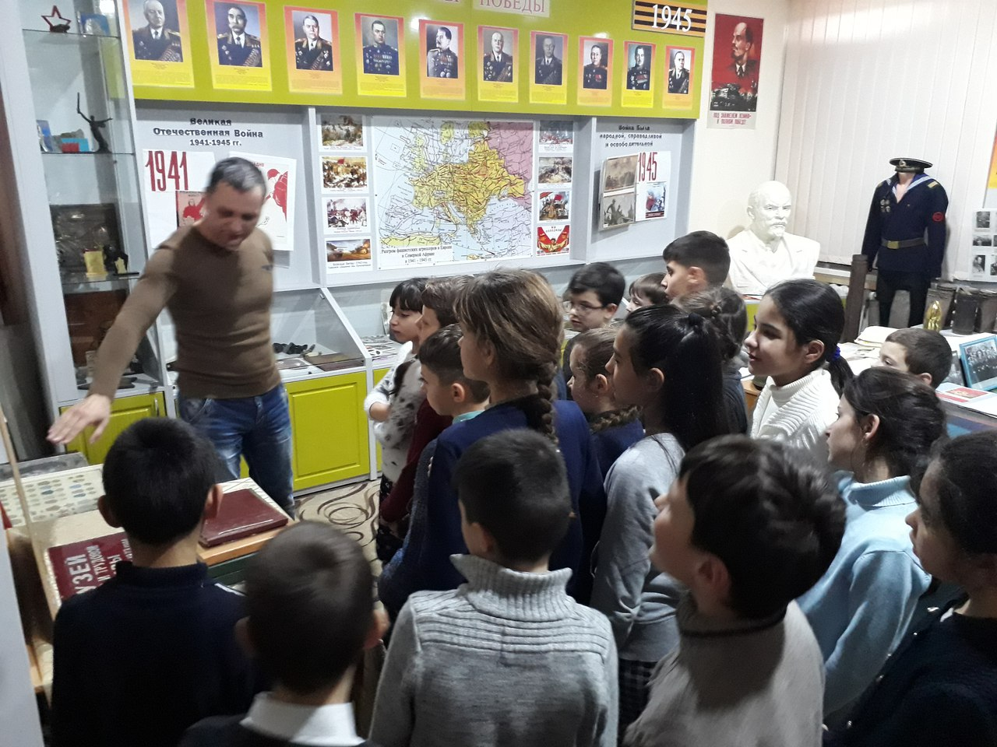
Sessions at High School and Middle School

Slide 19
There is not a single monument, sign, tablet, or reminder of a Jewish past for the Shtetl Kaushany. Who will erect a monument to Jews who used to live in Kaushany? Who will remember all who perished during the Holocaust? Who will put stones and flowers to a monument of the Jewish residents of Kaushany? WE will.

