Slide 1
Jewish Cemeteries in Bessarabia/Moldova:
Current Status and Future Projects
Serghei Daniliuc,
Reseacher, Local Historian, Resident of Kaushany, Moldova
Yefim A. Kogan, MJLS
JewishGen Bessarabia SIG Leader and Coordinator
August 8, 2018

Slide 2
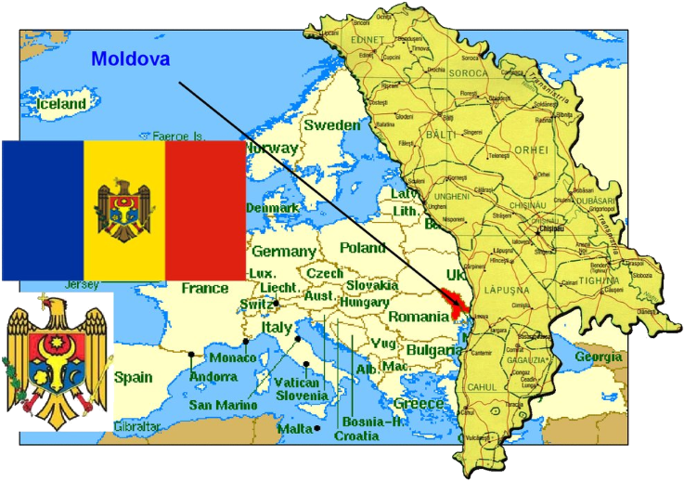
The Republic of Moldova

Slide 3
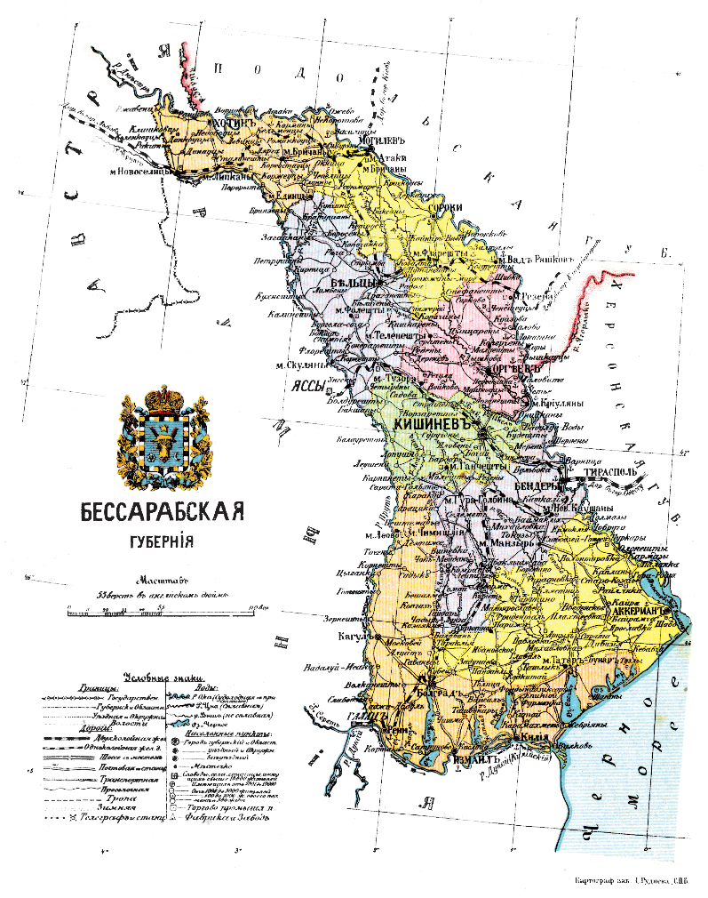
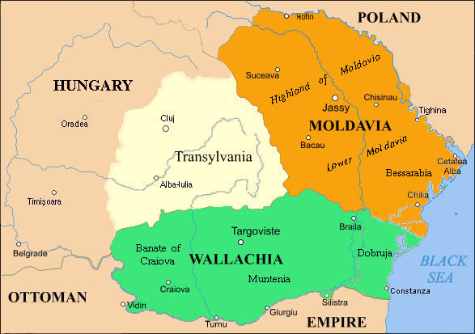
Bessarabia: - being part of Moldovan principality - was part of the Russian Empire as Bessarabia Governorate from 1812 until 1918

Slide 4
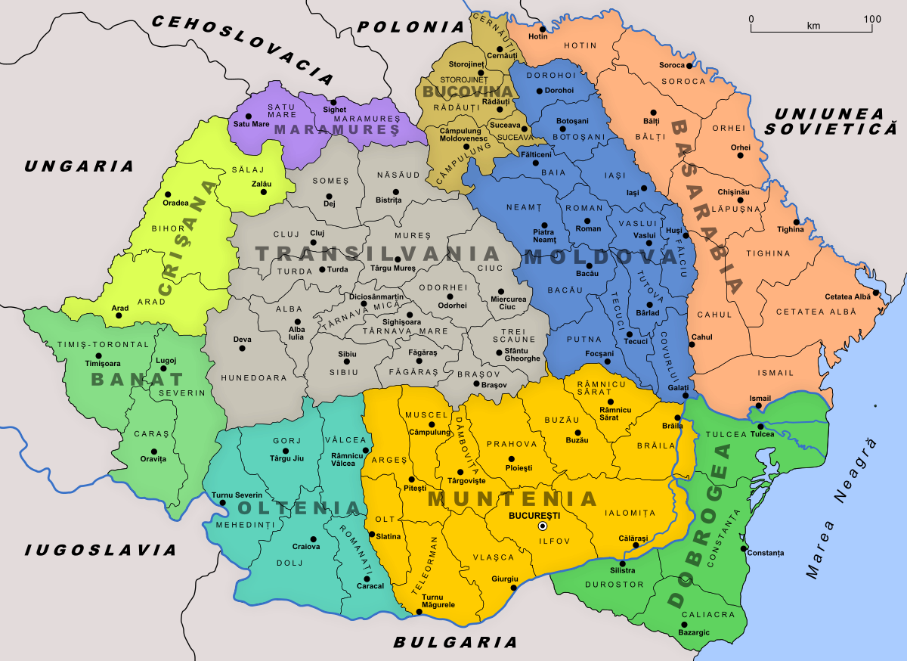
Bessarabia: - later part of The Kingdom of Romania - some territories that are part of Ukraine today, and also in Transnistria

Slide 5
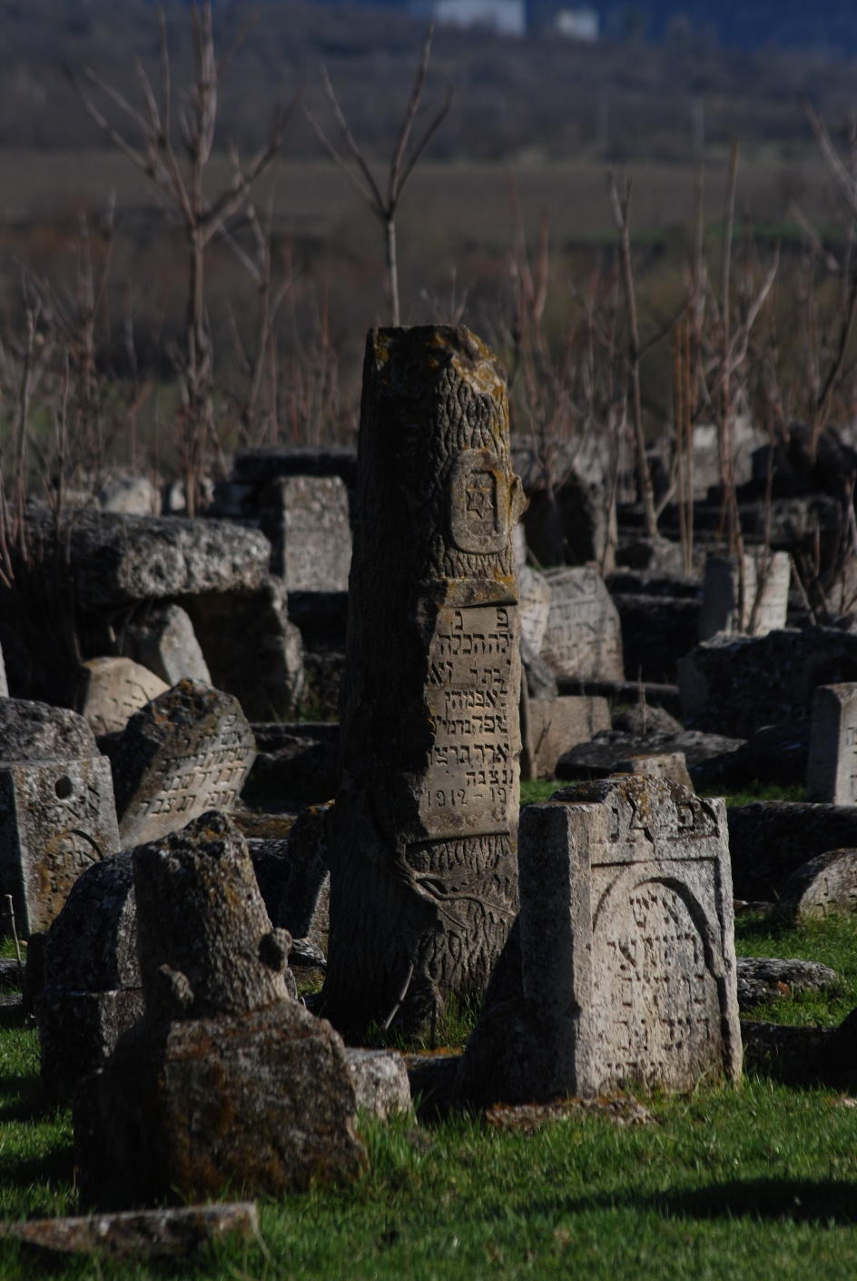
There are more than 70 Jewish cemeteries found in the territory of Bessarabia and Moldova, including Transnistria
Here is the inventory of all cemeteries where Jews were buried (as of March of 2018): https://www.jewishgen.org/bessarabia/files/cemetery/Inventory201803-March.htm

Slide 6
Cemetery conditions
Most of the cemeteries in Bessarabia/ Moldova are in a very poor condition. From all the 77 cemeteries there are only 2, which are in normal condition-- Bendery Jewish Cemetery and Town cemetery “Doyna” with Jewish quarters.

Slide 7
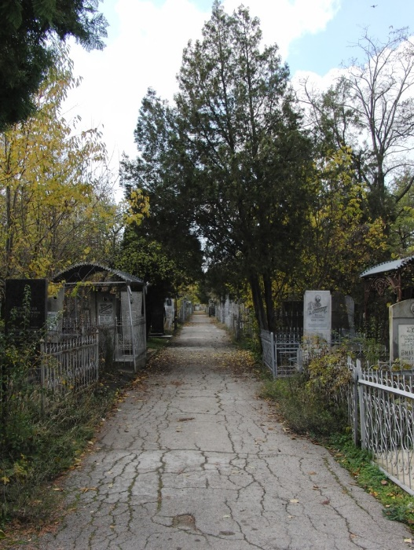
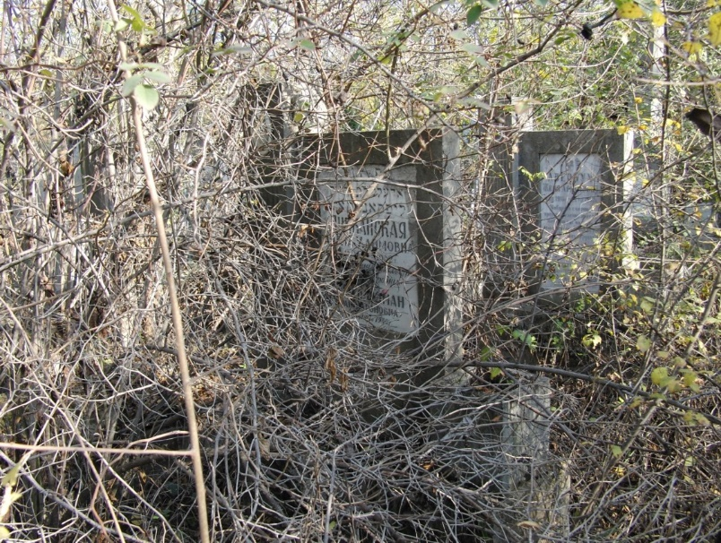
Even in “normal” Bendery cemetery you can find such corners

Slide 8
Cemetery conditions
In most of the cemeteries you find broken or no fences, many tombstones fallen or partially in the ground. Almost all cemeteries do not have any caretakers, and are abandoned.
Time and weather conditions do their job, and cemeteries are gradually being destroyed. Some are deliberately destroyed by local residents or authorities.

Slide 9
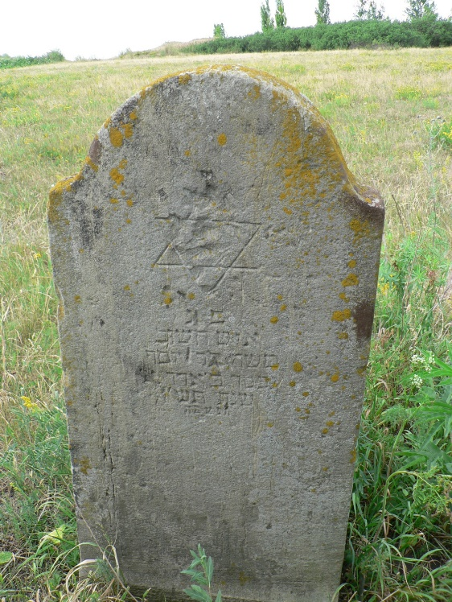
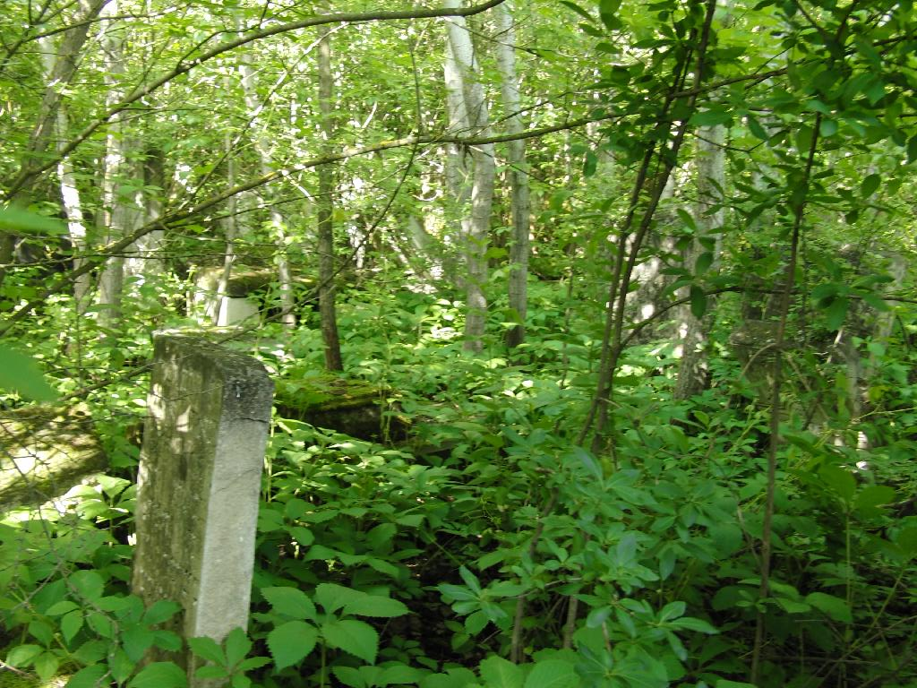
The only remaining tombstone in Dumbroveny Jewish cemetery
Here is a corner of a cemetery in Brichany

Slide 10
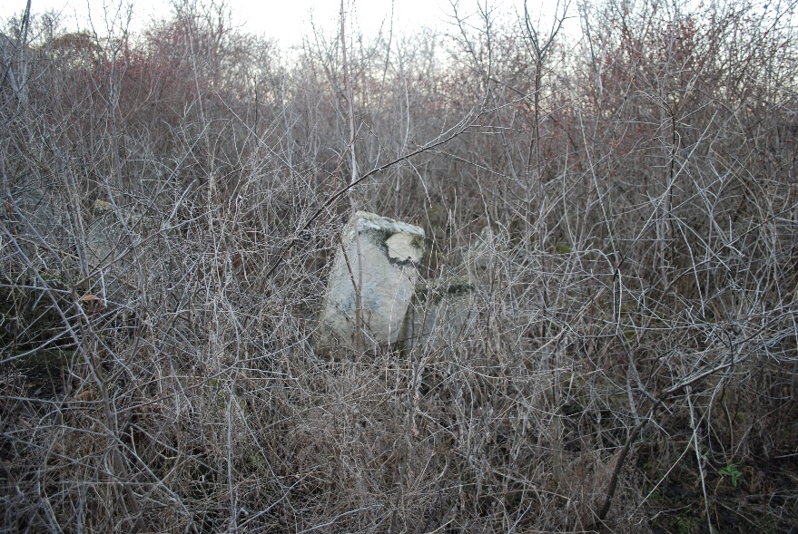
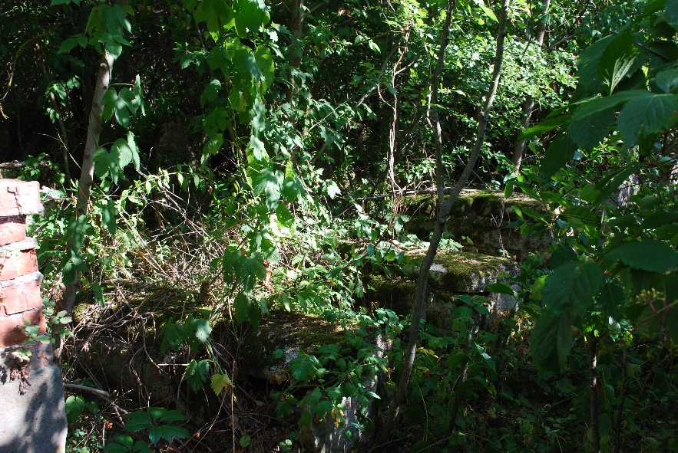
At Rashkov cemetery
Monument at Hincheshty Jewish cemetery

Slide 11
Many cemeteries are completely destroyed!! Here is a list of 10 demolished cemeteries.
We think we should preserve the memory of such cemeteries and put all available information to JewishGen / JOWBR. It may include names of people who were buried there and remembered by their relatives.

Slide 12
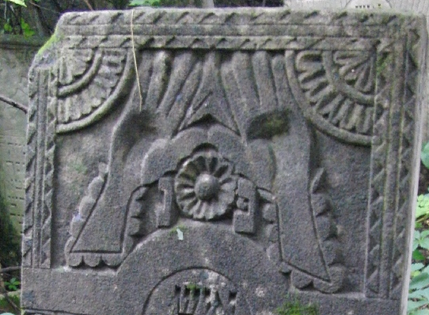
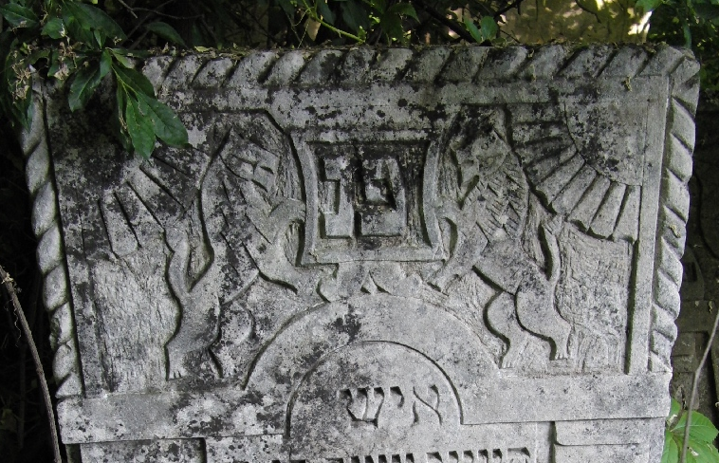
Cemeteries - Museums of Jewish Heritage and Art
Here is a link to Brichany Jewish Cemetery report: https://www.jewishgen.org/Bessarabia/files/cemetery/briceni/BriceniCemetery.pdf
You can find such reports at Bessarabia SIG website / Cemetery section.

Slide 13
The oldest grave we found so far was from the beginning of 18 century (1720s), but we may find even earlier graves. You can find cemetery reports at Bessarabia SIG website / Cemetery section with many details, photographs. Every report also includes a link to list of Unknown graves! Please look at those.
We believe that many of Jewish cemeteries should be protected by the state – the Republic of Moldova as Cultural Heritage sites.

Slide 14
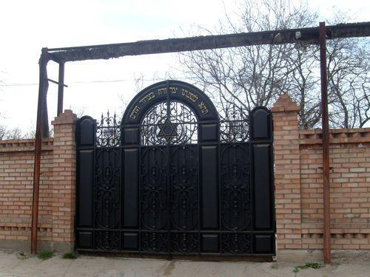
Difficulties working at the cemeteries
The first cemetery we started working was in the city of Bendery. Of the instruments at first was only a camera, but later the reality forced to carry with us a machete or ax. The shooting began in the fall of 2012 and took a huge amount of time.

Slide 15
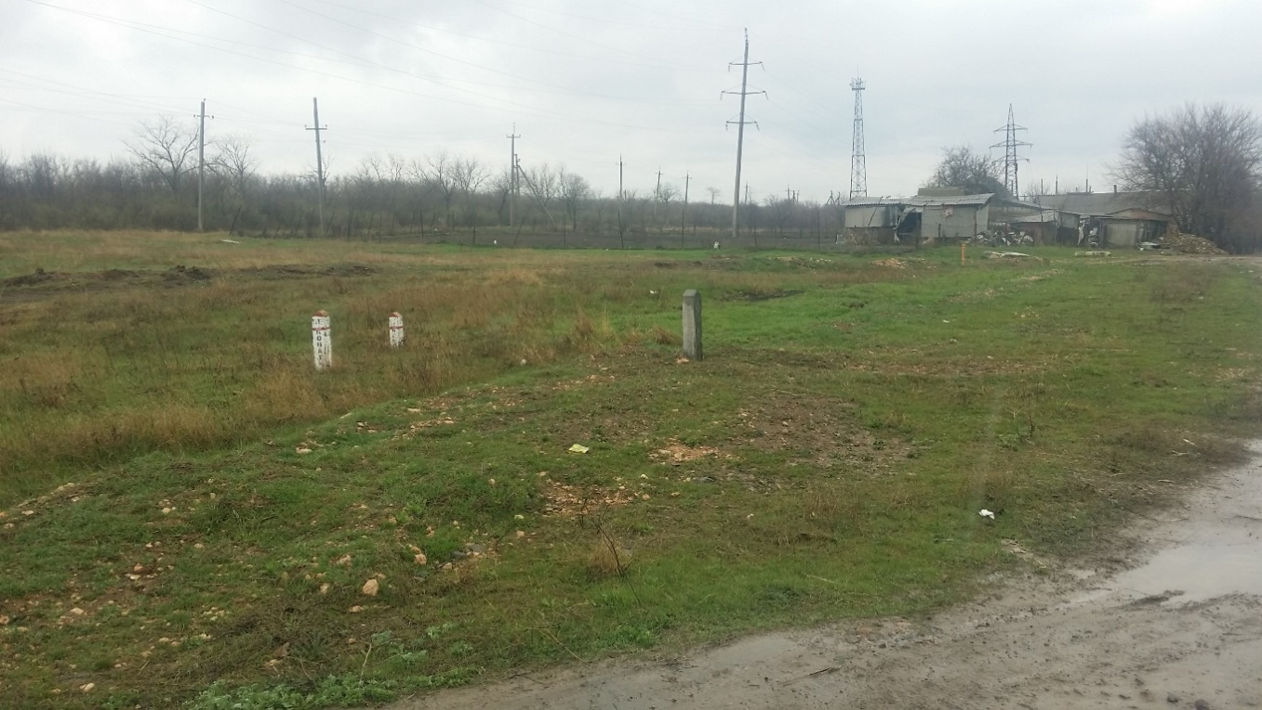
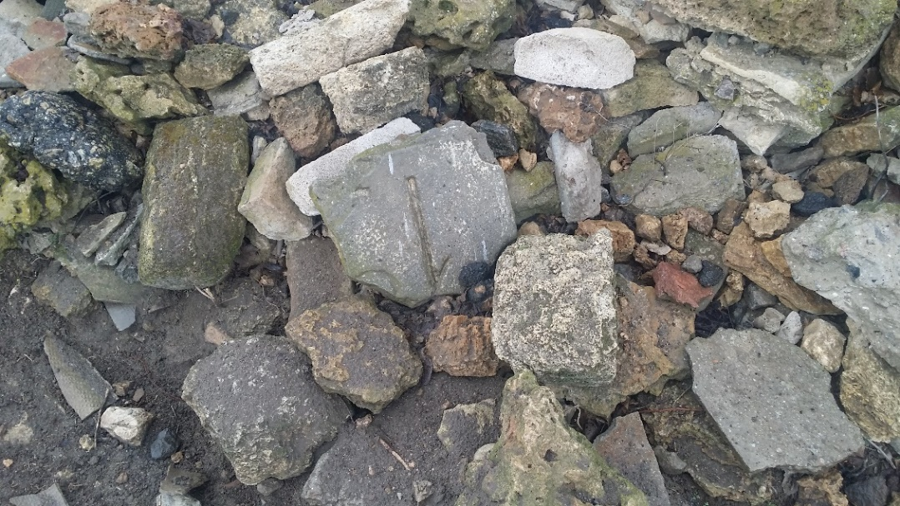
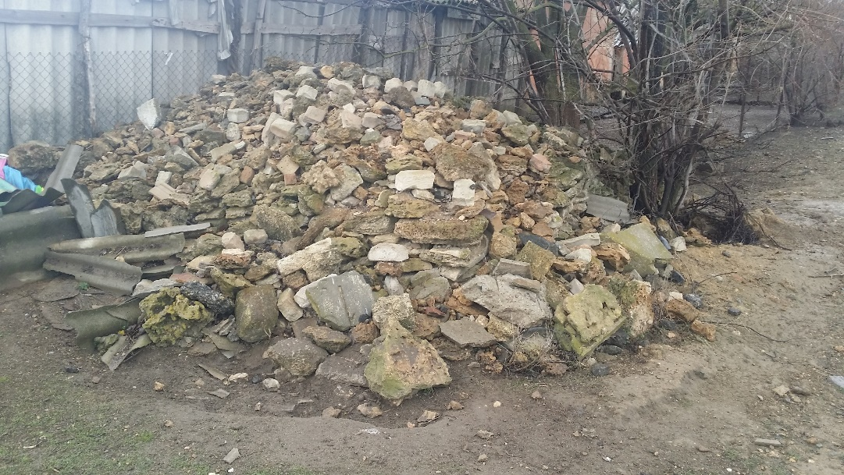
Often cemeteries have to be searched for a long time, including asking the local residents. Sometimes we do not find the cemetery since it was destroyed by plowing, and the stones are dismantled for construction material, as for example, in Sarata, Odessa Oblast.

Slide 16
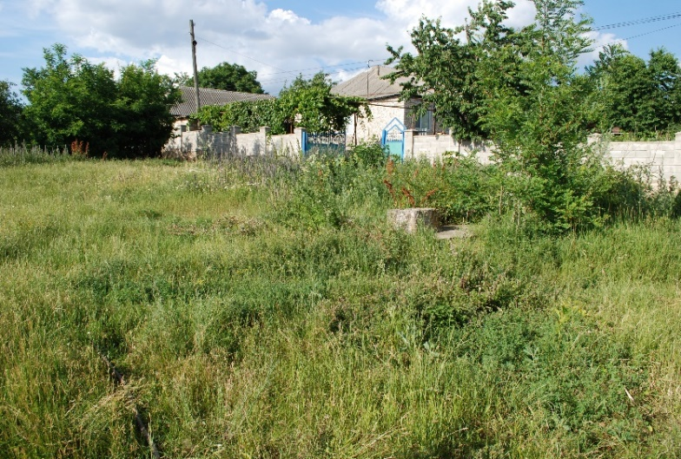
Chinisheutsi Jewish cemetery- a new discovery

Slide 17
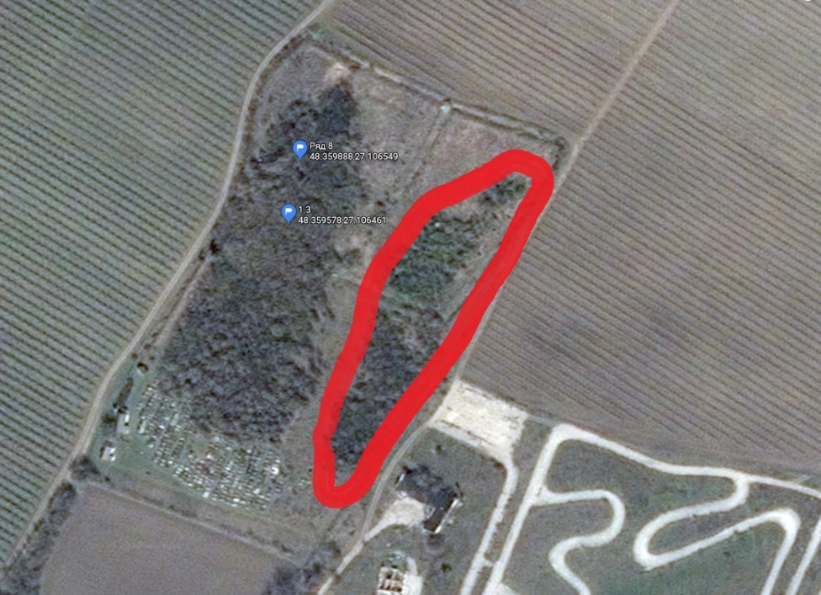
Clearing paths, cleaning cemetery projects
On a map of Brichany cemetery, a red part on the right side, a section there was impossible to get to the stones. We started clearing path project. That required to purchase tools (chainsaw, ax, etc.) for the work, which will be used in many other cemeteries in the future. Half of the work was done in Brichany now, and as a result we estimating that will have images of about 1,500 graves, we could not film before.

Slide 18
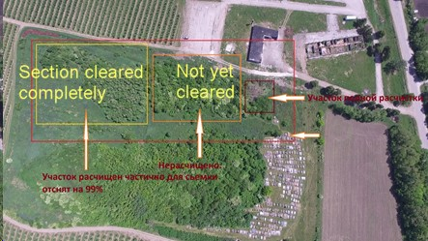

Slide 19
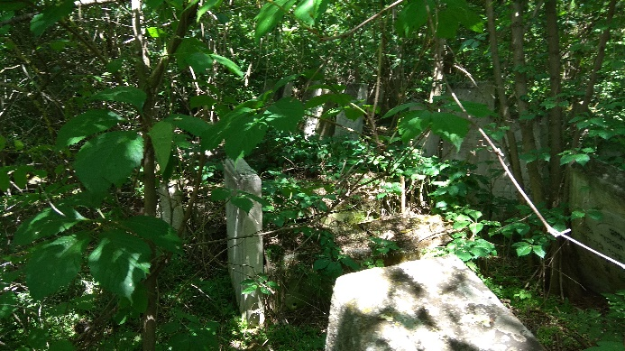
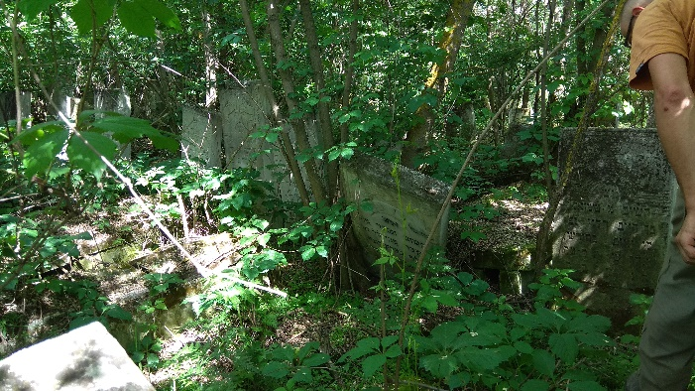
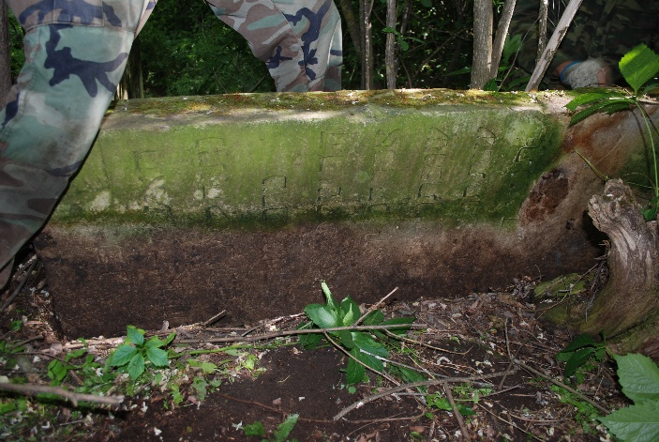
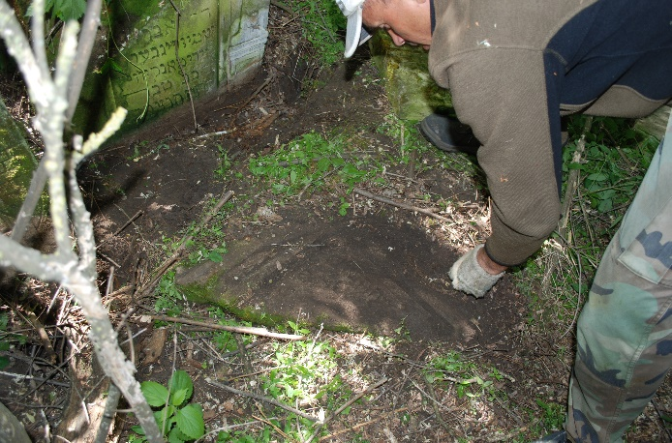
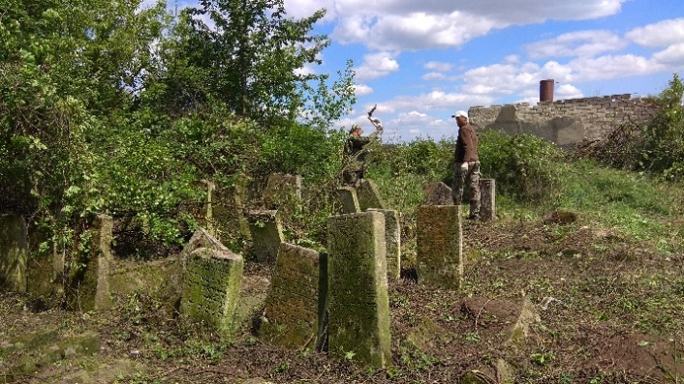
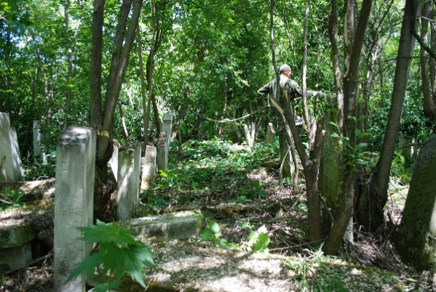
Here are several photos from Brichany project (May of 2018)

Slide 20
Future projects
1. Capture cemeteries that have not been filmed yet. These are such as Zguritsa, Nisporeny, 2 cemeteries in Klishkivtsy, Reni and several others.
2. Cemeteries that were photographed, indexed long time ago, likely only partially - we need to go back to those. There are eight such cemeteries: Calarash, Teleneshty (old), Khotin, Orgeev, Secureny, Tarutino, Yedintsy and Kiliya. Kiliya was already re-visited.
3. Cemeteries are completely destroyed! People still may have some memories of their loved ones buried there. We need this information to for such cemeteries. Information will be submitted to JOWBR. It is also necessary to interview local residents in order to obtain additional information or photos from them. Example: Kaushany. There will be at least 50-60 burial records which soon will go to JOWBR. It will include information from Death records for that town..

Slide 21
Future projects
4. Continue the search for cemeteries that are not indicated anywhere. It can be quite small, such as found in Chinisheutsy, or possible a Jewish sections on Christian cemetery. Jewish cemeteries in Moldova are a kind of open-air museums. Therefore, ideally it is desirable to completely restore the cemeteries. Carry out a full clearance, refurbish with a strong fence, pick up fallen gravestones and annually monitor their cleanliness.
It is necessary to carry out such work as quickly as possible since time does not work for us and does not spare monuments. Some inscriptions on the graves can be read today, and tomorrow it will be too late.
5. Clearing paths, cleaning projects (see above).

Slide 22
How you can help?
There are several volunteering jobs at the cemetery projects: lead a project, manage all aspects of a project, including writing the cemetery report; translate the writings from Russian or/and from Hebrew. Also, we need your donations to make the projects happen, that includes photographing, in some projects cleaning, clearing paths, etc.
If you have information about cemeteries which are not on our inventory list, please let us know. There are some of our members who photographed all the graves from a small cemetery, and we appreciate such gifts very much.

Slide 23
Questions ?

