Slide 1

Bessarabia/Moldova Questions and Answers session
Yefim A. Kogan (yefimk@verizon.net)
Inna Vayner (innanes@gmail.com)
JewishGen Bessarabia SIG Leaders and Coordinators
www.jewishgen.org/Bessarabia
July 26, 2017

Slide 2
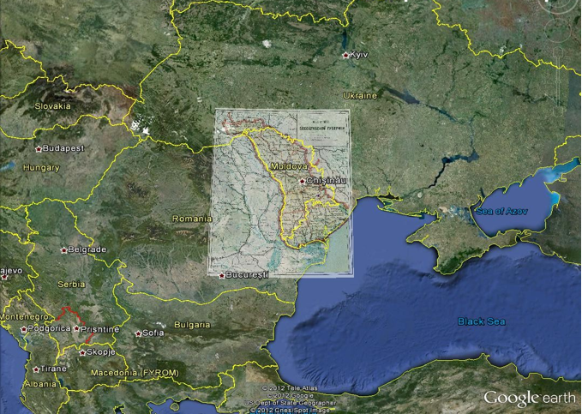
Bessarabia on the map of Europe

Slide 3
Bessarabia/Moldova Q&A Session
1. My great grandmother was born in Belz, but the Yad Vashem entry submitted by her son her place of birth appears to be Bessarabia.
Is Belz in Bessarabia?
My great grandmother was a follower of the Belzer Rebbe, was he from Bessarabia?
This is all very mysterious and I don't have a clear understanding. I thought Belz was in the Ukraine.

Slide 4
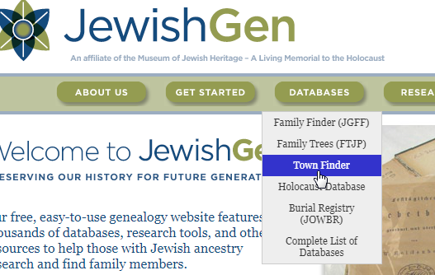
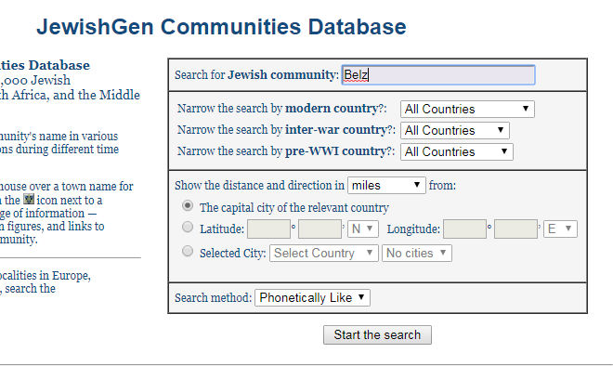
Answer
Locate Town Finder section on the home page
Enter the name of the town you are searching information about

Slide 5
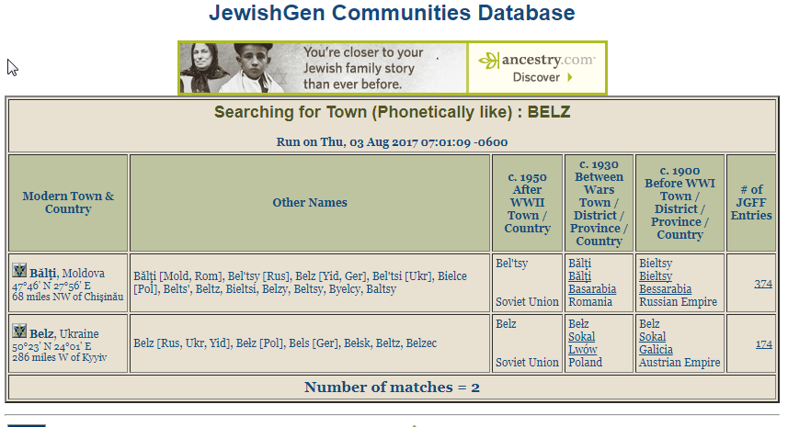
Answer - Continued
The search will return results that are phonetically similar to the town searched

Slide 6
Here are some useful details pertaining to these two towns
Belz is located in Lviv oblast, Galicia, now Ukraine
https://en.wikipedia.org/wiki/Belz
Jews lived here from 17 century
First Belzer Rebbe from 1817 to 1855
There is terrific Yizkor Book for Belz that can be found here http://www.jewishgen.org/Yizkor/belz/belz.html
Beltsy is a district center in Bessarabia, now in Moldova
http://kehilalinks.jewishgen.org/balti/Home.htm
Jews lived here from 18 century
Interesting fact
There is a famous Yiddish song: Main Shteitele Beltz, music Olshanetsy, Alexander, 1892-1946… each town claims that this is about their shteitle… Most likely it is not about Bessarabia Beltz, but in Bessarabia Beltsy website it is as for their town: http://shtetlbelts.ru/
http://shtetlbelts.ru/cemetery/eng_cemet.html

Slide 7
Bessarabia/Moldova Q&A Session
2. Is it possible to find photos of the towns, such as Dumbraveni? My father’s family owned an inn/tavern documented since 1785. The last mention I find after he left is that it was owned by his cousin Peisikh Harast in 1924, in the Bessarabia Business Directory.

Slide 8
Answer
When searching for information about location where your ancestors lived, a good strategy would be to search in multiple languages using Google Chrome. Chrome automatically translates webpages to various languages. So if you are looking for information about Dombroveni and you know that Dombroveni residents spoke Russian, Yiddish, and Romanian you may want to google using the following words:
Домбровены
Dombroveni
Dumbrăveni
דומבראַוועני
There are a number of websites with information on Dombroveni (Dumbroveni) (Russian and English):
http://kehilalinks.jewishgen.org/dumbraveni/
http://www.jewishgen.org/Bessarabia/files/cemetery/dombroveni/DombroveniCemetery.pdf
http://www.jewage.org/wiki/en/Profile:Dombroveny_Russian_Empire
http://www.soroki.com
http://www.soroki.com/photo2/main.php?g2_itemId=73

Slide 9
Bessarabia/Moldova Q&A Session
3. I am curious: I was raised in Brooklyn New York. My parents were both Jewish culturally but not at all religious. I was raised without much religion or cultural identity.
Now that I'm old, I wish I knew more, particularly about my mother's family. My mother came to the US via Canada as a baby. I always understood her to be Romanian. My sister believed her to be Russian. So now I'm thinking maybe it was Bessarabia. She died when we were fairly young and there was little communication with her relatives. And now, anyone who knew anything is dead.

Slide 10
Answer
If a person or family thought to be Romanian and also Russian, it is most likely that the family lived in Bessarabia.
There is no other place which was Russia at one point and also Romania in other… It must be Bessarabia.
What you need to continue your research is to explore Bessarabia SIG website http://www.jewishgen.org/Bessarabia/ and also JewishGen databases http://www.jewishgen.org/databases/Romania/ – Romania (Bessarabia) Database which holds our records. You need to collect names, dates, maiden names, parents names, etc. whatever you know and search – that can bring you to discoveries of your ancestors!

Slide 11
Bessarabia/Moldova Q&A Session
4. Was there a town in Bessarabia called Yedernitz? Was it Romanian, Moldavian or Russian?

Slide 12
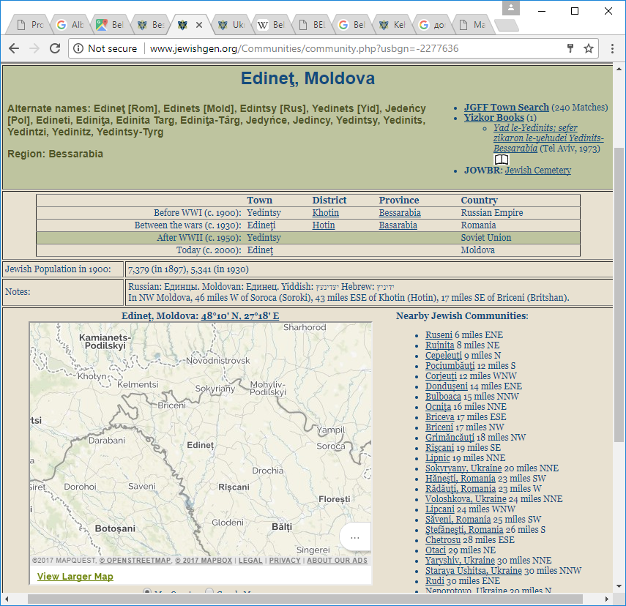
Answer
First, go to JewishGen Town Finder. It will bring you to following page:
http://www.jewishgen.org/Communities/community.php?usbgn=-2277636
As you can see from the Town Finder search results, there are various spellings of the town name - Edinet, Edinets, Yedinets, etc.
The town is now in Republic of Moldova. During the years of
1940-1941 and 1944-1990 it was part of the Soviet Union, in
1941-1944 – occupied by Germany and Romania in the WWII
1918-1940 – part of Kingdom of Romania
1812-1918 – Russian Empire
Before 1812 for about 400 years it was part of Moldova Principality under Ottoman control.
It always helps to read articles on History of Bessarabia, the Governments, etc.

Slide 13
Answer - continued
As you can see from the Town Finder search results, there are various spellings of the town name - Edinet, Edinets, Yedinets, etc
The town is now in Republic of Moldova. During the years of
1940-1941 and 1944-1990 it was part of the Soviet Union, in
1941-1944 – occupied by Germany and Romania in the WWII
1918-1940 – part of Kingdom of Romania
1812-1918 – Russian Empire
Before 1812 for about 400 years it was part of Moldova Principality under Ottoman control.
It always helps to read articles on History of Bessarabia, the Governments, etc.

Slide 14
Bessarabia/Moldova Q&A Session
5. If my relative was born in 1872 through 1892 in Skolan or Sculeni Romania is that also Called Iasi Romania?

Slide 15
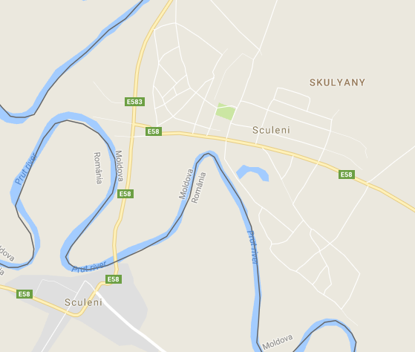
Answer
Skulyani, Skolan, etc. is a town in Moldova that is located on the Prut river.
There is also Skuleni across the river in Romania.
See Sculeni Cemetery report:
http://www.jewishgen.org/Bessarabia/files/cemetery/Sculeni/SculeniCemeteryReport.pdf
The distance between the centers of the two towns is less then 3 miles. The road crosses Moldova – Romania border.

Slide 16
Bessarabia/Moldova Q&A Session
6. Regarding Sukaran, as I found it from a draft card for my great grandmother’s brother. Where is this place?

Slide 17
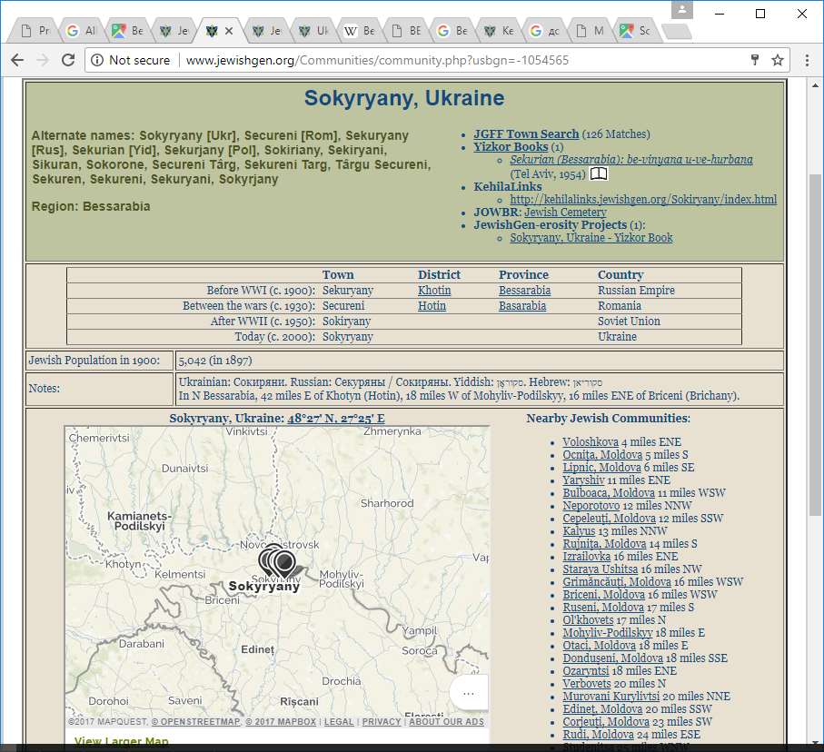
Answer
Sukaran has many different spellings, but as in previous cases, you need to go to JewishGen Town Finder.
The most used names are Sekureni and Securyany.
Now, the town is located in Czernovits oblast of Ukraine, but it used to be part of Bessarabia.
You will be able to find KehilaLinks website, cemetery, yizkor book, etc. if you search Jewishgen.org pages.

Slide 18
Bessarabia/Moldova Q&A Session
7. My grandfather and his family were from Faleshty. I was wondering where I can find or where I can retrieve Faleshty records from.

Slide 19
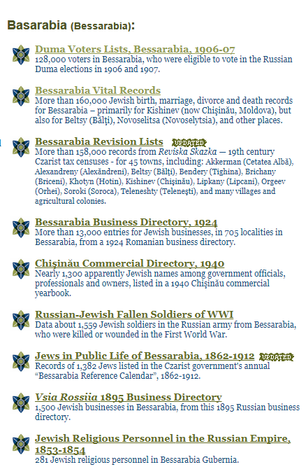
Answer
JewishGen Bessarabia SIG translated many sets of records from Moldovan archives. Records are part of Romania (Bessarabia) database http://www.jewishgen.org/databases/Romania/.
You need to check the Introductory pages in this database (click the link above and scroll down), i.e. Bessarabia Vital Records, Bessarabia Revision List records, and find out if Faleshty is among the town records we have already translated.
Also there are a records in a number of Business directories. They are at JewishGen, as well as at Bessarabia SIG website.
There are two cemeteries in Faleshti where the tombstones photographed and indexed, find the cemetery reports at http://www.jewishgen.org/Bessarabia/Cemetery.html
You may find Family stories, family trees related to your place.
http://www.jewishgen.org/Bessarabia/FamilyMemoirs.html
http://www.jewishgen.org/Bessarabia/FamilyTrees.html

Slide 20
Bessarabia/Moldova Q&A Session
Several questions were about how our ancestors traveled from Bessarabia to Odessa and Bessarabia to the West.

Slide 21
Answer
The railway Chișinău (Kishinev)-Iași was opened on June 1, 1875 in preparation for the Russo-Turkish War (1877–1878) . From Iasi there were railways to Western Europe.
Also Kishinev was connected to Reni and Galati from 1877. You can see information about Railroads in Bessarabia and Transnistria at
https://en.wikipedia.org/wiki/Transnistrian_Railway
Here is another article about Odessa – Kishinev Railroad:
http://encyclopedia2.thefreedictionary.com/Odessa-Kishinev+Railroad

Slide 22
Internet resources on Jewish Bessarabia
Bessarabia SIG website: www.jewishgen.org/bessarabia
Aaron Shneer Gallery: http://picasaweb.google.com/106995678358404531836
Jewish News portal : www.dorledor.info (Russian)
My town Kishinev: http://oldchisinau.com/ (Russian)
Centrul Istoric al Chisinaului: http://www.monument.sit.md/ (Romanian)
Jewish Memory: http://www.jewishmemory.md/eng/ (English, Russian)
All about Bessarabia: http://www.bessarabia.ru/ (English, Russian)
Jewish Encyclopedia: http://www.jewishencyclopedia.com/articles/3185-bessarabia
Historical Maps of Moldova: http://commons.wikimedia.org/wiki/Category:Maps_of_the_history_of_Moldova
Jewish Cemeteries of Kishinev and Orgeev: http://www.pavetex.md/
Bessarabian Jews: http://en.wikipedia.org/wiki/Category:Bessarabian_Jews
Preserving Jewish memory Centropa: http://www.centropa.org/
Bessarabian Maps: http://www.wwii-photos-maps.com/bessarabianmaps/index.html
Memorial: http://www.obd-memorial.ru/html/index.html (Russian)
Memory Book: http://www.nekropol.com/Holokost.htm (Russian)

Slide 23

Bessarabia/Moldova Q&A Session
More Questions?
Find us at
http://www.jewishgen.org/Bessarabia

