Slide 1
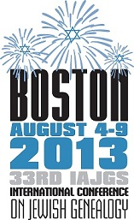
Kishinev – my native town: History of Jews and Genealogy
Yefim A. Kogan
Masters of Jewish Liberal Studies
Augsut 7, 2013
yefimk@verizon.net
JewishGen Bessarabia SIG Coordinator and webmaster - www.jewishgen.org/Bessarabia

Slide 2
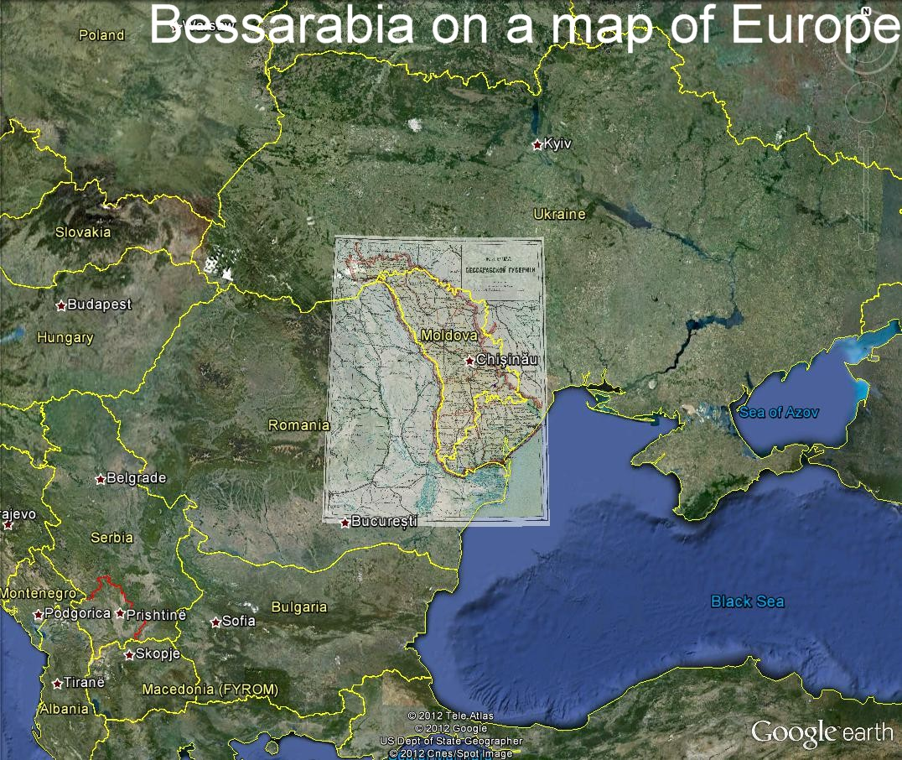

Slide 3
Kishinev – my native town: History of Jews and Genealogy
Brief history of Jews in Kishinev, Bessarabia, Moldavia
History of Jews in Kishinev in Moldavia/Ottoman period, until 1812
History of Jews in Kishinev in Russian Empire period, from 1812-1918
History of Jews in Kishinev in Romanian period from 1918-1940
Jews in Kishinev during the war and after the war
Statistical information on Jews in Kishinev
Archival holdings on Kishinev Jews
Records available at the Moldovan State Archive
Materials in St.Petersburg’s archives
Information collected at JewishGen.org
Other information on Kishinev Jews
Cemetery records
Education records
Material from Bessarabia Annual Books-Calendars
Jewish life in Kishinev today
Internet resources on Kishinev Jews

Slide 4
Brief history of Jews in Kishinev, Bessarabia, Moldavia
History of Jews in Kishinev in Russian Empire period, from 1812-1918
Demetrius Kantemir, Descriptio Moldaviae, 1714
Burial Society, 1774
Census in 1770s
Hayyim ben Solomon Tyrer (1760-1816), Rabbi in Kishinev

Slide 5
Brief history of Jews in Kishinev, Bessarabia, Moldavia
History of Jews in Kishinev in Russian Empire period, from 1812-1918
Kishinev – main town of the Bessarabia oblast, province
Kishinev – part of the pale
At the beginning of 19 c, Zalman ben Mordechay, Shargorodskiy, follower of Baal Shem Tov, became a Rabbi
In 1838 followers of Haskalah movement (enlightenment) opened first Jewish school. In 1859, in addition to two official government Jewish schools and one private women’s school were 46 cheders, and from 1860 a Chasidic Yeshiva was founded.

Slide 6
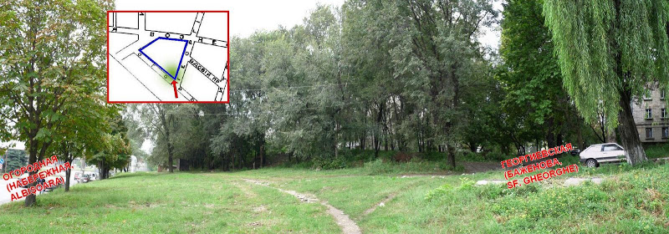
Brief history of Jews in Kishinev, Bessarabia, Moldavia
History of Jews in Kishinev in Russian Empire period, from 1812-1918
The first Big Synagogue was built tentatively in 1812 in the lower part of Kishinev not far from the bank of river Byk. Around it, there also used to be Jewish Cemetery that was called Old in the documents of the 18 century.

Slide 7
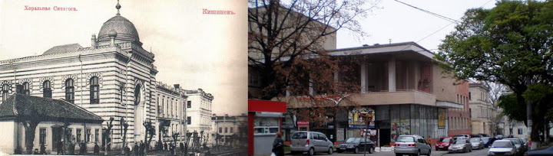
Brief history of Jews in Kishinev, Bessarabia, Moldavia
History of Jews in Kishinev in Russian Empire period, from 1812-1918
At the beginning of 20 c in Kishinev were 77 synagogues and prayer houses. Choral synagogue, erected in 1913 (100!)
From collection of Aaron Shneer

Slide 8
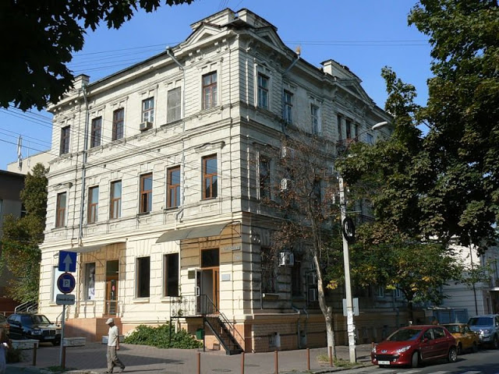
Brief history of Jews in Kishinev, Bessarabia, Moldavia
History of Jews in Kishinev in Russian Empire period, from 1812-1918
Talmud-Torah was an older building (1872) whose construction was financed by Jewish welfare societies.
From collection of Aaron Shneer

Slide 9
Brief history of Jews in Kishinev, Bessarabia, Moldavia
History of Jews in Kishinev in Russian Empire period, from 1812-1918
Zionists of Bessarabia were represented at the First Zionist Congress in 1897 by Jacob Bernstein-Kogan of Kishinev.
Toward the close of the 19th century and the beginning of the 20th, a line of poets and authors emerged on the cultural scene in Bessarabia, many of whom were to play an important role in Yiddish and Hebrew literature, including Eliezer Steinbarg, Judah Steinberg, S. Ben-Zion, Jacob Fichman, Samuel Leib Blank, and Hayyim Greenberg.
The chief rabbi of Bessarabia in the beginning of 20 century was Leyb Moiseevich Tsirelson, who wrote many halakhic works. Since 1908 Leyb Tsirelson was the spiritual and the official rabbi of Chisinau (Bessarabia). In 1910 he was elected chairman of the All-Russian rabbinical committee (Vaad harabonim) and held this position until 1917, when the commission was disbanded. As the authorized representative of the leadership of Jewish Religious Communities in Russia he appeal to the authorities on various matters relating to the Jewish population of the country.

Slide 10
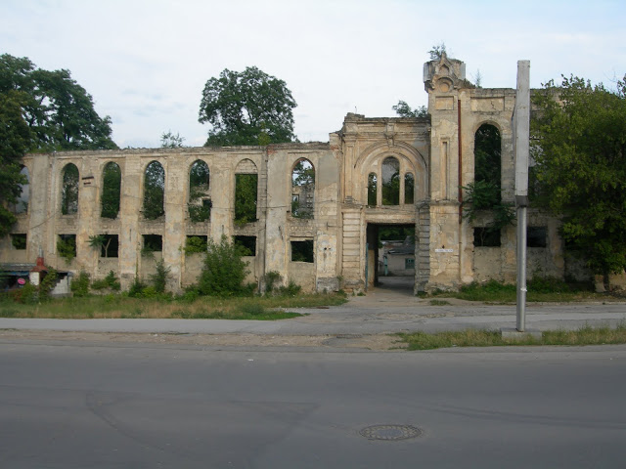
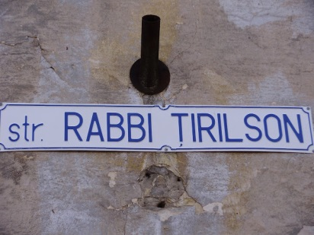
Brief history of Jews in Kishinev, Bessarabia, Moldavia
History of Jews in Kishinev in Russian Empire period, from 1812-1918
Monument to Tsirelson at the Jewish cemetery in Kishinev.
The remains of Yeshiva

Slide 11
Brief history of Jews in Kishinev, Bessarabia, Moldavia
History of Jews in Kishinev in Romanian period from 1918-1940
During this period the Jews of Kishinev suffered from anti-Semitism, but their numbers increased at the expense of the Jews who had escaped from the Ukrainian pogroms during the Civil War.
Romanian Citizenship (1924). Depriving many of the Jews of Kishinev (as in the whole of Bessarabia) Citizenship (1924), the authorities are dooming them to poverty.
Zionist organizations - He-Halutz, helps a lot halutzim from the Soviet Union to immigrate to Eretz Yisrael
Cultural organizations – Makkabi, Hatarbut, "Unser Zeit“ – Yiddish newspaper

Slide 12
Brief history of Jews in Kishinev, Bessarabia, Moldavia
Jews in Kishinev during the war and after the war
After the transfer of Bessarabia under the authority of the Soviet Union (1940), the majority of Jewish institutions were closed in Kishinev and Zionist activity is prohibited. Among the many inhabitants of Kishinev, arrested and deported at that time, there were thousands of Jews.
July 16, 1941 German-Romanian troops occupied Kishinev. Part of the Jewish population was able to evacuate. July 17 eynzatsgruppen unit "D" and a part of the Romanian Gendarmerie killed about fourteen thousand Jewish men. On August 1 were selected for allegedly sent to work 450 young men and women, 411 of them were shot in a few days, once again under the pretext of sending to work was gathered 500 people, 300 of them were shot.

Slide 13
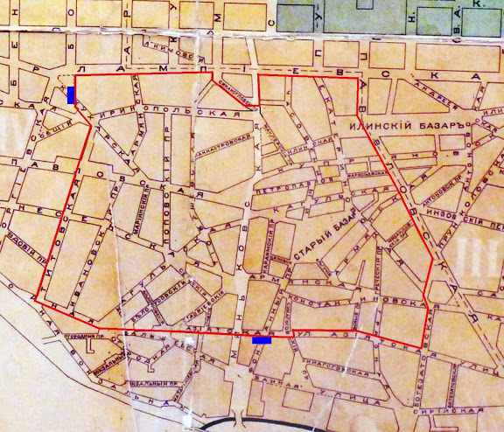
Brief history of Jews in Kishinev, Bessarabia, Moldavia
Jews in Kishinev during the war and after the war
On July 25 Romanian commander of Kishinev ordered the creation of ghettos. According to the Romanian documents, on August 11 in the ghetto lived 10,578 people. By the middle of September 1941 the number of prisoners of the ghetto increased. In the ghetto were sent the Jews from the surrounding villages. From August 5, the Jews of Kishinev were required to wear a distinctive sign - a six-pointed star.

Slide 14
Brief history of Jews in Kishinev, Bessarabia, Moldavia
Statistical information on Jews in Kishinev
In 1867 in Kishinev lived 18,000 Jews, and in addition to a synagogue were 28 prayer houses
1897 All Russian Census. Number of Jewish farmers, middle class, merchants
50,000 Jews lived in Kishinev in 1900, which was 46% of the total population. Kishinev was the 5th largest city by Jewish Population in the Russian Empire after Warsaw, Odessa, Lodz and Vilna.
Estates population of Kishinev according to the census was divided into the following groups: hereditary and private honorary citizens – 173; farmers – 190; merchants – 1208; middle class - 47,446.
Merchants in Kishinev from Revision Lists of 1848, 1854 and 1859:
Merchants of 1st Gild – 8 Jews / 1 family
Merchants of 3rd Gild – 425 Jews / 111 families
Middle Class lived on owned land – 195 Jews / 111 families
Middle Class lived on the town land – 4244 Jews / 1957 families
Farmers on 10 years privileges – 374 Jews / 137 families

Slide 15
Brief history of Jews in Kishinev, Bessarabia, Moldavia
Statistical information on Jews in Kishinev
In 1898 according to the Jewish Colonial Society from 38 factories and plants in Kishinev 29 were owned by Jews, from 7 mills, 6 were in Jewish hands, 5 Publishing companies, 4 were owned by Jews
In 1898 in Kishinev were 16 Jewish schools, more than 2000 people, among them 4 Talmid-Torahs.
From 1886 in Kishinev was organized a group ןצִיּוֹ חוֹבְבֵי (Chovevei Tsion) with a leader M. Dizengoff (first mayor of the Tel Aviv from 1921-25, 1928-1936)
From 1897 – Zionists with leader Bernshteyn-Kogan, and in the beginning of 20th century – organization of Bund and Aguddat Israel.

Slide 16
Brief history of Jews in Kishinev, Bessarabia, Moldavia
Statistical information on Jews in Kishinev
Honorary Citizens (hereditary or private) –
173 hereditary and private honorary citizens in Kishinev in 1897, among them
Leyb Moiseevich Tsirelson, rabbi and spiritual leader of Kishinev and Bessarabia Jews, see http://www.answers.com/topic/yehuda-leib-tsirelson
Abraham son of Naum Katlovker (1844-1907, Kishinev), a Jew from Soroca, a teacher, a secular member of the fifth session of the Rabbinical Commission under the Ministry of Internal Affairs of the Russian Empire in 1893-1894 years, the official government rabbi and an hereditary honorary citizen.

Slide 17
Brief history of Jews in Kishinev, Bessarabia, Moldavia
From Birth Records
Name | Father, Grandfather Mother, Grandfather Mother Maiden Surname | Date of Birth Hebrew Date | Town Uyezd Gubernia | Comments | Place Registered Year Record | Microfilm / Item # Image # Archive / Fond
GALPERIN, David | Shmuel Yosef / Shmul-Yosif / Shulim-Yosif, Mordekhai / Mordko Pesya | 17/10/1910 27 Tishri | Kishinev Kishinev Bessarabia | Mohel Moshe / Moshko GOLDENBERG. Father - a Hereditary Honorary Citizen. Father's name changed from 'Shmul-Yosif' to 'Shulim-Yosif' by a decision of the Bessarabian Gubernian Government on October 14, 1911. | Kishinev 1910 M552 | 2292605 / 1 209 NARM/211/11/376
From death records:
KATLOVKUR, Abram / Avraham | Naum / Nakhum - - - - | Kishinev Government appointed Rabbi of City of Kishinev, honorary citizen by birth | 24/2/1907 23 Adar 62 Chronic pneumonia | Kishinev Kishinev Bessarabia | Kishinev 1907 M109 | 2292609 2 42 NARM 211/11/394
From marriage records:
Kishinev / Kishinev / Bessarabia | 18/10/1895 12 Kheshvan | KAUSHANSKY, Moshko SHEYNBERG, Idis Ratsa | Ruvin Kishinev Leyb | 23/20 22 | Groom was Kishinev 2nd guild merchant's son, witnessed by Kishinev City court 15-Dec-1894 #2030, bride was daughter of honorary citizen by birth, Dowry of 48 Rubles | Shlema KHASILEV Shmul AVERBUKH | Kishinev 1895 | Marriage 323 | 2255903 6 00889 95 NARM 211/11/238

Slide 18
Brief history of Jews in Kishinev, Bessarabia, Moldavia
Archival holdings on Jews in Kishinev
Records available at the Moldovan State Archive:
  Birth, death, marriage records. Many translated and available at JewishGen
  Revision Lists, Jews residents of Kishinev, merchants, middle class. Some records translated and available at JewishGen
  Alphabetical books and lists of petty-bourgeois or Middle Class, (1910)
  Educational records, some translated at JewishGen
  Voters list 1918-1941, Lists of Jewish residents of the region who became Romanian citizens as well as the lists of those who were refused in the citizenship.
  Records related to 1918-1944 period, during which Bessarabia was part of Kingdom of Romania. Among them lists Jewish residents who became Romanian citizens as well as the lists of those who were refused in the citizenship. Also among these documents are very commonly found voters' lists from many cities and villages of Bessarabia.

Slide 19
Brief history of Jews in Kishinev, Bessarabia, Moldavia
Archival holdings on Jews in Kishinev
Records available at the Moldovan State Archive:
  7. Records of nationalized properties owned by Jews, compiled by Romanian authorities in 1941-1944 and also compiled by the Soviet Union in 1945
  Pogrom-related information can be found in the Bessarabian numerous newspapers - Bessarabskie Oblastnye i Gubernskie Vedomosti, Bessarabija, Bessarabskaja pochta, Bessarabskoe Slovo, Drug, published mainly by prominent Jewish people.
  Materials of Archive commission “History of anti-Jewish pogroms in Russia”(1919), which include documents on Kishinev and Dubossary pogroms of 1903. Edited by S.M. Dubnov and G. Ya. Kranshiy-Admoni. (p.21)
  Podolia census of 1875, where some Jewish residents were assigned to various towns, including Kishinev.
  11. Personal files and documents of various kinds from previously classified records of the Bessarabian Police, including records from all of the local police departments.

Slide 20
Brief history of Jews in Kishinev, Bessarabia, Moldavia
Archival holdings on Jews in Kishinev
Materials in St. Petersburg’s archives:
From “Jewish documentary sources in Saint Petersburg Arhives”, S.P., 2011. Most of holdings on Jews in Bessarabia and Kishinev are in Russian State Historical Archive.
Materials of Archive commission “History of anti-Jewish pogroms in Russia”(1919), which include documents on Kishinev and Dubossary pogroms of 1903 (p. 21)
F.1263 Committee of Ministers (p. 119) The enhanced protection of Chisinau and declaring it an exceptional situation due to existing between Christians and Jews, extreme aggravation of relations. 1902
F.1330. General Assembley of the Senate Departments. On the taxation of residents of Chisinau with candle tax.
Many documents on Kishinev pogrom of 1903, including documents on compensations on destroyed property, arrest the instigators of pogroms, etc.
F. 744, Supreme Decrees, p. 381 To restrict or prohibit admission of Jews in male and female gymnasium

Slide 21
Brief history of Jews in Kishinev, Bessarabia, Moldavia
Archival holdings on Jews in Kishinev
Materials in St. Petersburg’s archives:
Personal files and documents of various kinds from previously classified records of
the Bessarabian Police, including records from all of the local police departments,
including Kishinev
Of misconduct of members of Jewish communities, including the case of Kishinev
residents on trial for noise during vote in kahal in a general meeting and police
official present.
h. Many other material on Kishinev

Slide 22
Brief history of Jews in Kishinev, Bessarabia, Moldavia
Material collected at the JewishGen and at Bessarabia SIG: www.jewishgen.org/bessarabia
Maps and schemas of Kishinev and surrounding area, including a map with photos of survived buildings
Duma Voter’s list, 1906, 1907
Business directory of 1924
Yizkor Books, Religious personnel
Photo Gallery
Bessarabian Landsmanshaften: First Kishinever Progressive Society of New York;
Kishinev Sick Benevolent Society
Kishinev historical museum, article
Family Trees, Memoirs, Stories, Travel, Theater
Bessarabia Annual Books, show the page
http://www.jewishgen.org/Bessarabia/files/projects/30AnnualBooks/BessarabiaCalendarAsOfMay2013.htm
Find Search for people from Kishinev in Lithuania, Belorussia, other databases!

Slide 23
Brief history of Jews in Kishinev, Bessarabia, Moldavia
Other information
Russian Jewish Organizations, catalogue of Jewish Organizations
Jewish Memorial websites of died or missing in the war
Dor le Dor – non-commercial fund, Kishinev
Russian Jewish websites
Holocaust on the territory of USSR, Encyclopedia, Moscow, 2011
“Stalin” lists – people killed in 1930s, 1940s
Movies on Jewish Kishinev
See great collections of Jewish Kishinev photos at http://picasaweb.google.com/106995678358404531836 Aaron Shneer Gallery

Slide 24
Jewish life in Kishinev in 2013
15 thousand Jews live today, from presentation of Natalia Alhazov, Chicago, 2008
(from Natalia Alhazov. Where Kishinev Pogrom of 1903 Was: Past and Present of Jewish Moldova. Presented at the International Jewish Genealogical conference in Chicago in 2008)
Cemetery records in the book: “House of Eternity”, Kishinev, “Dor le Dor”, 2004, in Russian, published by charity foundation “Dor le Dor” www.dorledor.info There is a second book published (in Russian) with Names of the buried at the cemetery (not full yet).
Jewish cemetery, containing 40.000 burials on the territory of 11 hectares. The cemetery is one of the oldest in Kishinev; the older gravestones have stela or sarcophagus shape, some combining both. The inscriptions are in Hebrew, Yiddish, Russian and Romanian; among graphical signs predominant are menorah, shofar, palm branch, lion or bird and pitcher. The size of the graveyard was drastically reduced in 1959 when on the decision of the City Council its oldest part was turned into a park. Besides the majority who died their natural death - doctors, lawyers, merchants, manufacturers, craftsmen and common people, here are entombed the victims of 1903 and 1905 pogroms, those killed by bombings during World War II, 400 Jews executed by shooting during the occupation and Jews who died in Kishinev ghetto.

Slide 25
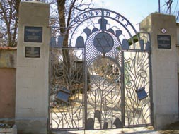
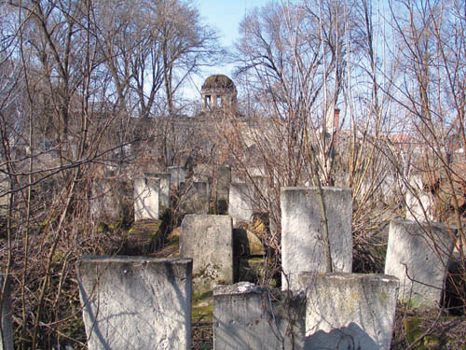
Jewish life in Kishinev in 2013

Slide 26
Jewish life in Kishinev in 2013
Museum of History of Moldovan Jews with its collection started in 1991. It is located in the mikva part of the Jewish Campus and includes authentic materials, exhibits and documents reflecting Jewish life in Moldova with special emphasis on the pogrom of 1903 and the Holocaust of 1941-44.
I. Manger Jewish Library
There is now a Rabbi Tsirelson Street where the ruins – the remains of Yeshiva and Almhouse connected with the names of S. Perelmuter and his son-in-law M. Kligman who financed the construction and maintenance of the buildings.

Slide 27
Internet resources on Kishinev, Bessarabia
Bessarabia SIG website: www.jewishgen.org/bessarabia
Bessarabia Annual Books: http://www.jewishgen.org/Bessarabia/files/projects/30AnnualBooks/BessarabiaCalendarAsOfMay2013.htm
Aaron Shneer Gallery: http://picasaweb.google.com/106995678358404531836
Jewish News portal : www.dorledor.info (Russian)
Graduates from Kishinev pro-gymnazium: http://www.petergen.com/history/kisgim.shtml
Rabbi Yehuda-Leyb Tsirelson: http://www.answers.com/topic/yehuda-leib-tsirelson
My town Kishinev: http://oldchisinau.com/ (Russian)
Centrul Istoric al Chisinaului: http://www.monument.sit.md/ (Romanian)
Jewish Memory: http://www.jewishmemory.md/eng/ (English, Russian)
All about Bessarabia: http://www.bessarabia.ru/ (English, Russian)
Jewish Encyclopedia: http://www.jewishencyclopedia.com/articles/3185-bessarabia
Historical Maps of Moldova: http://commons.wikimedia.org/wiki/Category:Maps_of_the_history_of_Moldova

Slide 28
Internet resources on Kishinev
Jewish theologians of Moldova: http://www.lechaim.ru/ARHIV/162/VZR/k05.htm (Russian)
Jewish Cemeteries of Kishinev and Orgeev: http://www.pavetex.md/
Bessarabian Jews: http://en.wikipedia.org/wiki/Category:Bessarabian_Jews
The Bessarabian Problem, by CHARLES UPSON CLARK: http://www.tkinter.smig.net/romania/FriendsOfRoumania/Ch09/index.htm
Bessarabia by CHARLES UPSON CLARK:
http://depts.washington.edu/cartah/text_archive/clark/mobile.html
Preserving Jewish memory Centropa: http://www.centropa.org/
Jewish Genealogical portal: http://forum.j-roots.info/index.php?sid=4f479bc2a4d784c2e65bbe30e695a8d8 (Russian)
Bessarabian Maps: http://www.wwii-photos-maps.com/bessarabianmaps/index.html
Forum – My town Kishinev http://oldchisinau.com/forum/index.php (Russian)
Memorial: http://www.obd-memorial.ru/html/index.html (Russian)
Memory Book: http://www.nekropol.com/Holokost.htm (Russian)
Stalin’s killing lists: http://stalin.memo.ru/ (Russian)

Slide 29
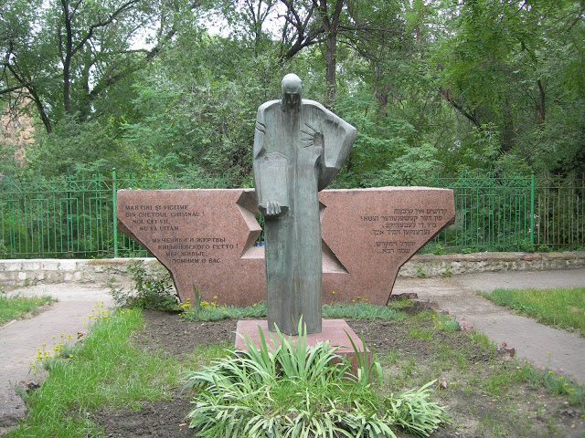
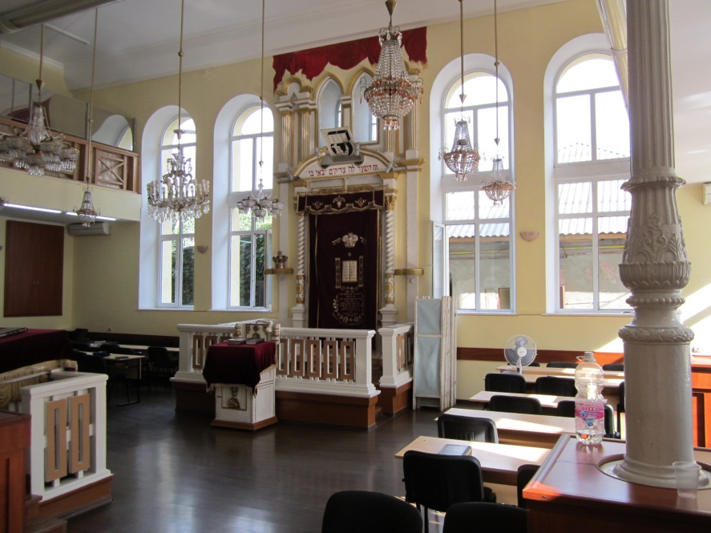
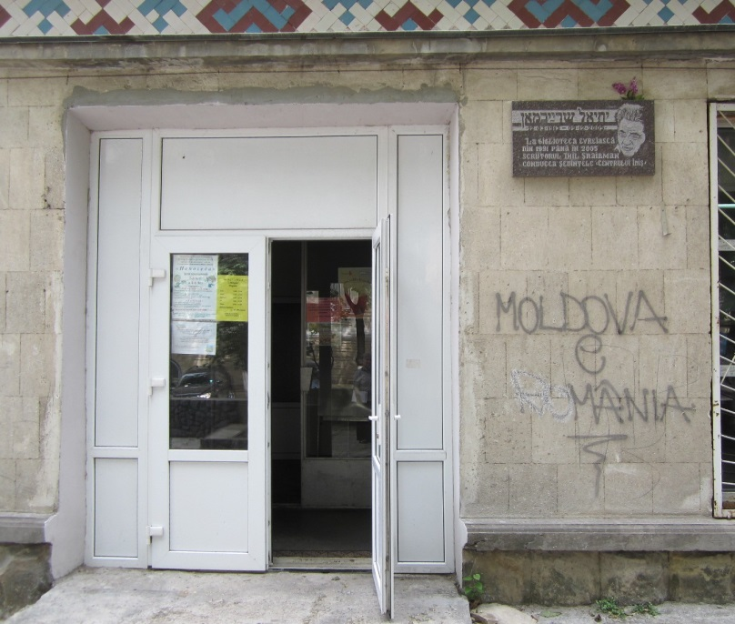
Photo by Jay Sage, 2012
Monument ghetto prisoners
Synagogue,
Jewish center, tablet in memory of Ikhil Shraybman, Jewish writer

Slide 30
Jewish Kishinev
Questions?

