Slide 1


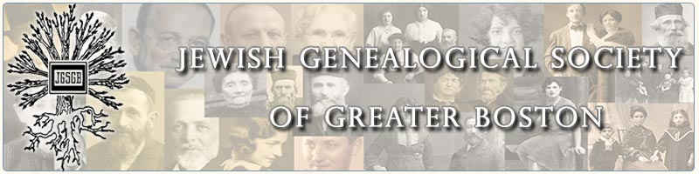
Jewish Life in Bessarabia Through the Lens of the Shtetl Kaushany
Yefim A. Kogan
Masters of Jewish Liberal Studies, Hebrew College, June 2012
August 4, 2013
yefimk@verizon.net
Kaushany website -http://kehilalinks.jewishgen.org/Causeni/Kaushany.htm
JewishGen Bessarabia SIG Coordinator- www.jewishgen.org/Bessarabia

Slide 2
Jewish Life in Bessarabia Through the Lens of
the Shtetl Kaushany
I. Introduction
II. Kaushany before 1918
1918-1940, Jewish life in shtetl Kaushany
Instead of conclusion: the end of the Jewish community in Kaushany
New findings not included in the original research
What else I am looking at?

Slide 3
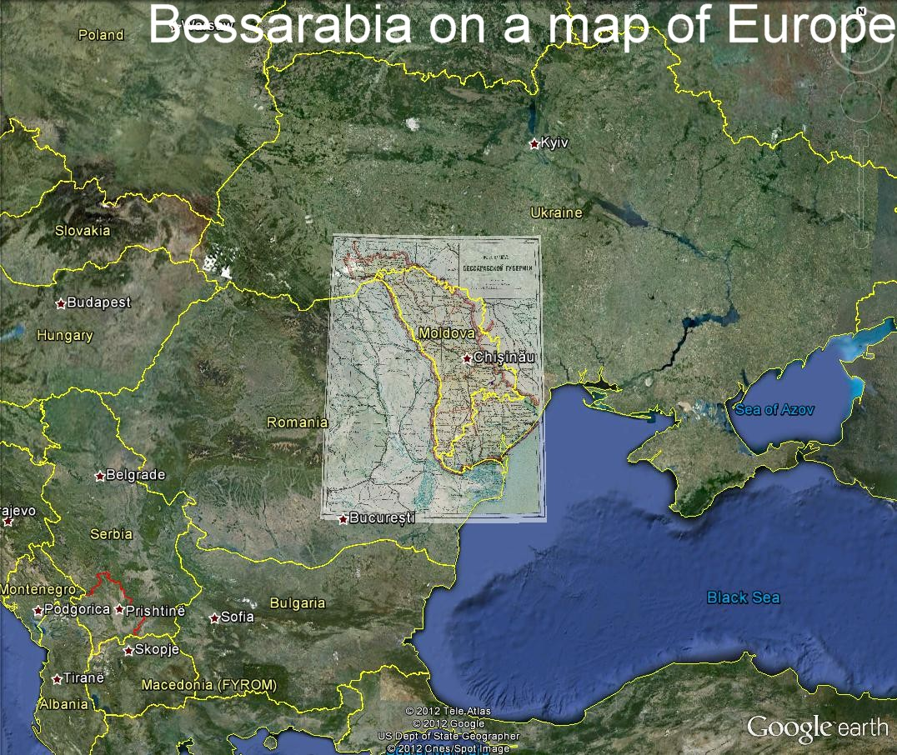

Slide 4
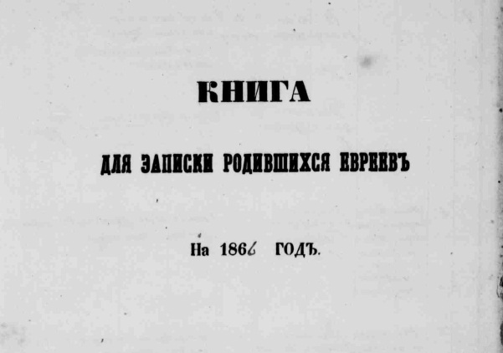
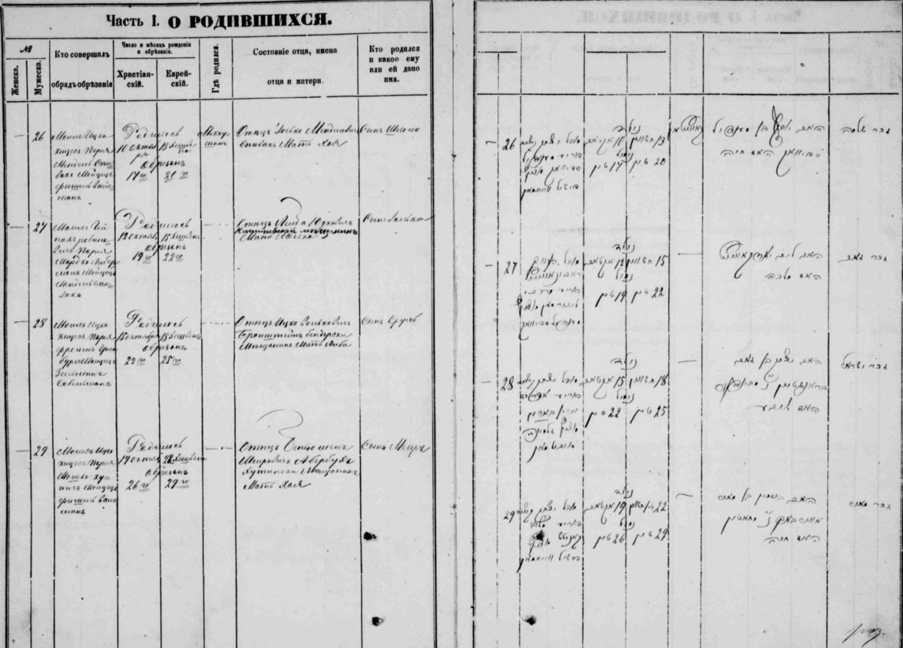
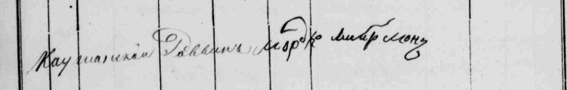
Shloyme Spivak
born October 10, 1866, Kaushany, Bessarabia, Russia
At Shoyme’s Brit Milah the priah was his grandfather Mendel, who was born in 1815.
80 families
80 families 523 Jews reclassified Shloyme
53 Jewish families granted landhold. as petty bourgeois was born
1812 |1817 | 1835 |1853 |1854 |1861 |1864 | 1866
Bessarabia became Agricultural Serfdom
part of Russia colonies started was abolished

Slide 5
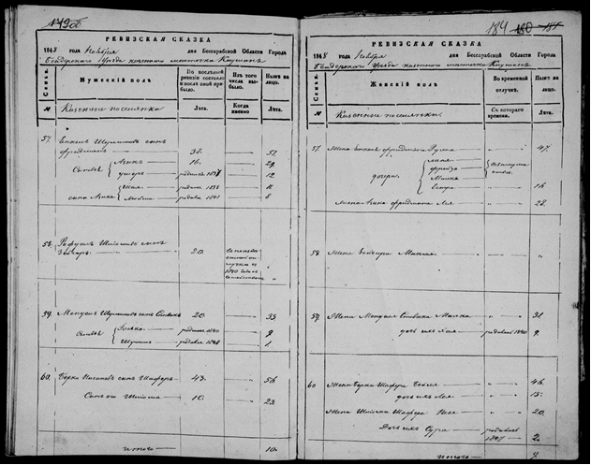
Parents of Shloyme Spivak: Iosko son of Mendel (1840, died before 1921) and Khayka
Parents of Iosko Spivak: Mendel (1815) and Malka (1817)
Parents of Mendel: Shulim (1765 – 1846) and Basya (1770 – died after 1848)
Father of Shulim: Volko (c1730)
Volko was born 641 Jews Shulim was born Mendel was born Iosko was born Shloyme was born
1730 |1760 |1765 |1815 | 1840 | 1866
Ottoman rule, People did not have yet the hereditary surnames
tatars had a Khan palace in Kaushany.

Slide 6
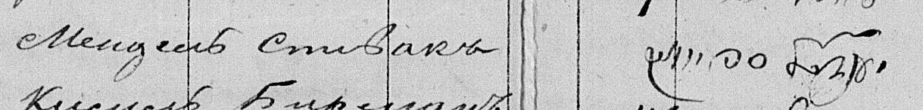
Transcription of Revision Lists from 1848 and 1854. The original documents are in Moldova State Archive, Kishinev. Copied by LDS church, transcribed by JewishGen.org.
1854. Signature of Mendel Spivak among other 5 signatures of prominent Jews in the shtetl who signed the Revision List of 1854.
Mendel is Shloyme’s grandfather.
Shloyme 1675 Jews Shloyme went to Shloyme
born (45% from total) America, but returned registered to vote
 | 1866 |1897 |1904 | 1906-07 | 1918
Russo-Japanese Jews voting Bessarabia became
War in Duma part of Romania

Slide 7
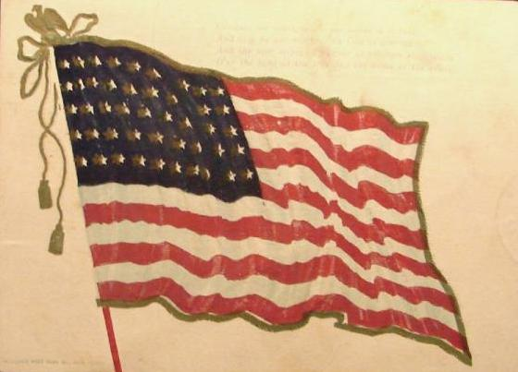
Going to America!
In 1904 Shloyme Spivak with his relative Bronshteyn left to America to get away from Russo-Japanese war. Shloyme wanted to establish himself in America first and come back for the family.
Shloyme came back for ever after half a year. My mother remembers Sloyme well and that the reason of the return was that he didn’t want to work on the Sabbath. Bronshteyn, the relative, was a tailor, worked at the factory apparently on Sabbath as well, got rich, and got his own sewing factory.
Shloyme 1675 Jews Shloyme went to Shloyme
born (45% from total) America, but returned registered to vote
 | 1866 |1897 |1904 | 1906-07 | 1918
Russo-Japanese Jews voting Bessarabia became
War in Duma part of Romania

Slide 8
The Jews in the Russian Empire in 1906 and 1907 were entitled to vote for Duma representatives, the Russian Parliament. For Kaushany in this Russia Voter’s list there were 101 voters in 1906 and 199 voters in 1907.
In order to vote in these elections, a person had to be male, over 24 years old, and for those who lived in small towns, be included in one of the categories: landowner, land manager (managed the land on the behalf of the owner), tenant/lessee (leases the land from the owner), clergyman, owner of immovable property (building, real estate, mills, etc.).
Shloyme was registered to vote in 1907, and the qualification criteria was that he owned a property with value of 95 rubels.

Slide 9
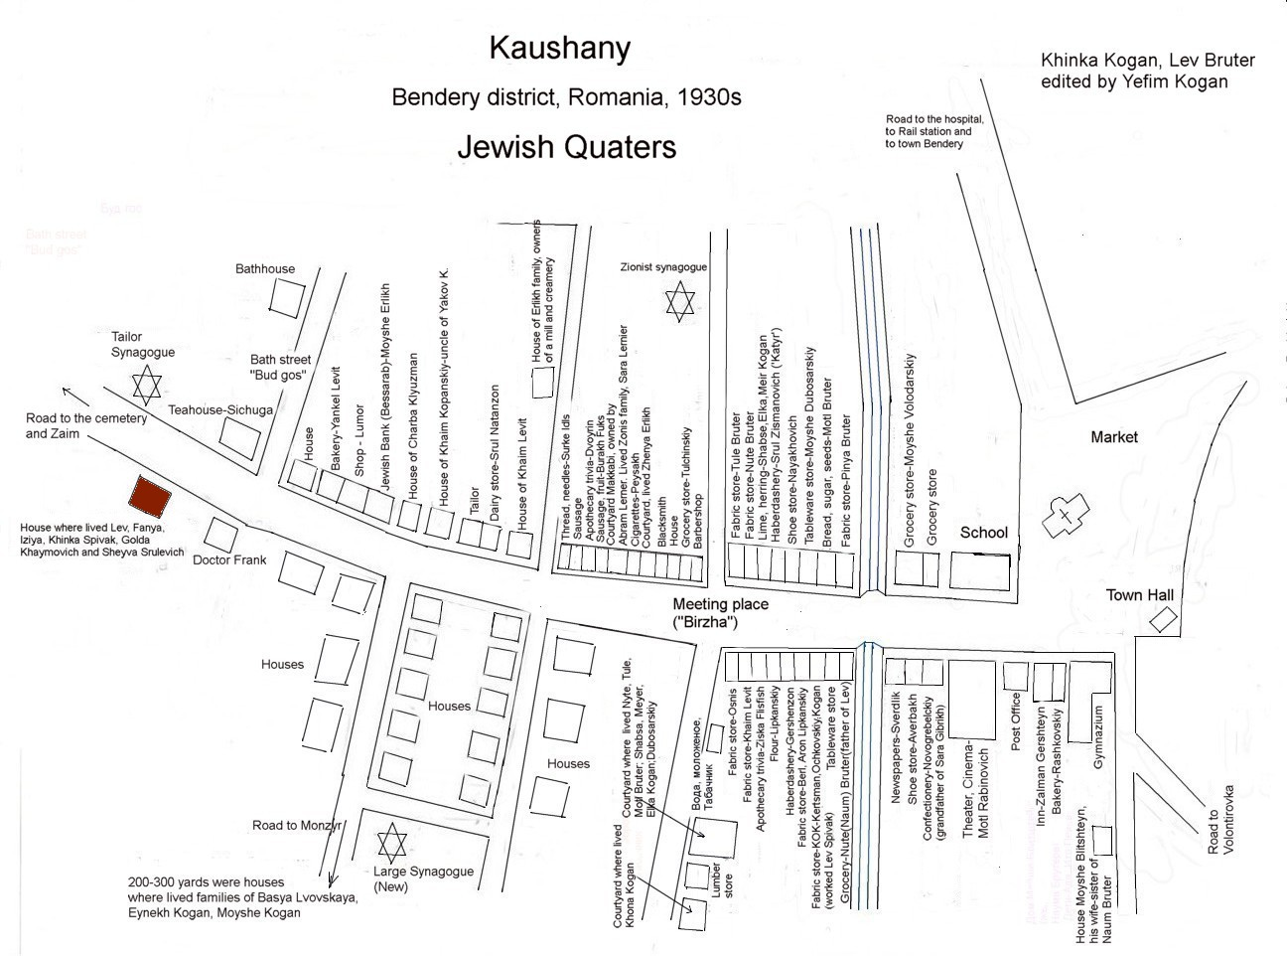

Slide 10
According to the Romanian Business directory of 1924-25, Shloyme owned an inn, tavern or saloon, but later in the 30s, Shloyme did not have that business and he was described in my mother’s memoirs “as a small-time merchant, that is to say, he had no money. In Kaushany, the regional bazaar was on Tuesdays and the local, on Sundays, and to buy grain from peasants you needed money. That money, Shloyme borrowed from the wealthy merchants, banker at a percentage for one day. He bought grain at one price, and sold it at a bit of a profit, thus earning a living”.
Shloyme Shloyme - Shloyme -
born Innkeeper a small merchant
 | 1866 | 1918 |1924 |1936 |1940, June 28 |1941, June 22
Bessarabia became Soviets occupied Beginning of
part of Romania Bessarabia Great Patriotic War

Slide 11
Shloyme’s courtyard.
In 1930s Shloyme owned several houses in a courtyard on the main street in Kaushany.
In front of the courtyard was the house of my great grandfather Shloyme Spivak. They had 3 rooms, a corridor and a kitchen. Near their house grew four beautiful trees, and a large bench stood under them. My mother and uncle loved to sit there with their friends. At the windows of the house were wooden shutters that were closed and locked at night with hooks. Into the courtyard led a small wicket and a gate.
The other house where my grandparents and mother with her brothers lived stood on a dais. They had 2 rooms, a corridor and a kitchen. Grandfather’s brother Yankel lived in a third house and the fourth was for rent. On one side of the courtyard were small sheds, where they kept wood and corncobs for heating flats in the winter. Just to note, that Kaushany did not have electricity until 1939, and they used kerosene lamps for lighting and stoves for cooking. In every Jewish courtyard was a cellar for storing vegetables, fruits, and barrels of good Moldovan wine. My great grandfather sold the grain, so their yard had a large barn, where the grain was dried before shipping to customers.

Slide 12
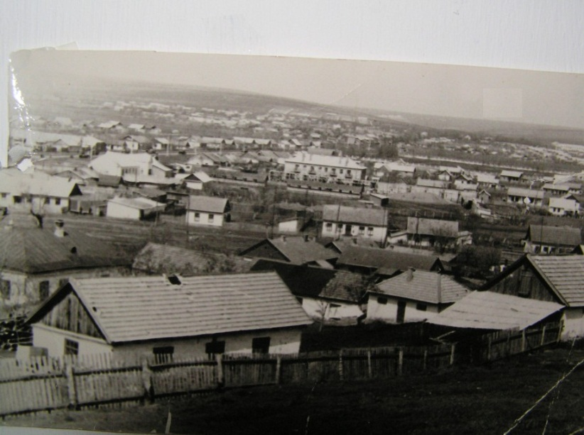
Kaushany in 1950s
Shloyme
born
USSR occupied Beginning of
Bessarabia Great Patriotic War
 | 1866 | |1940, June 28 |1941, June 22

Slide 13
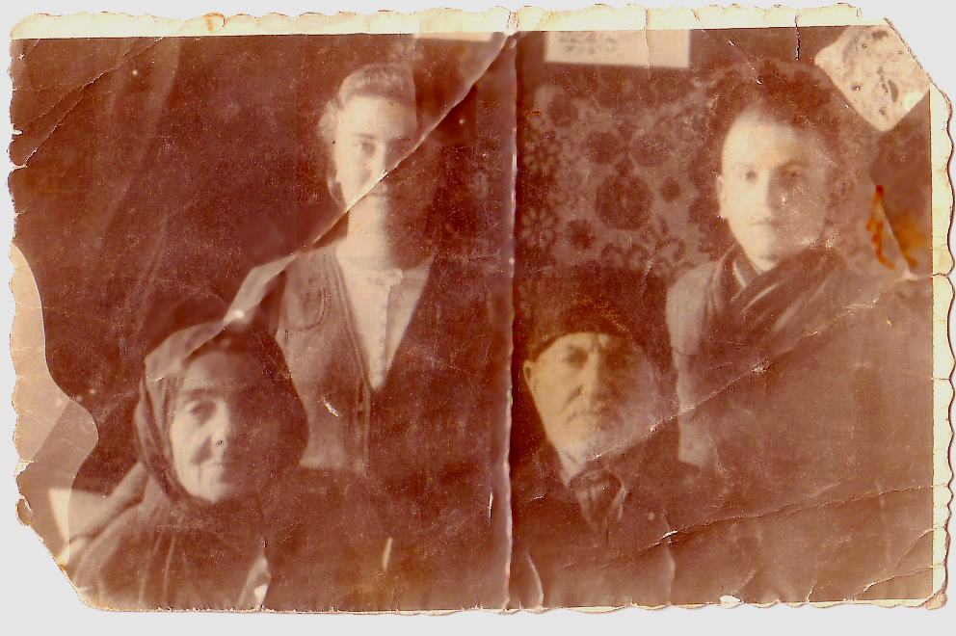
Shloyme Spivak with his wife Sheyva Spivak (Levit) and grandchildren Khinka and Isaac, 1939, Kaushany
Shloyme and Sheiva
Shloyme died from hunger in
born Djezgazgan, Kazakhstan
Soviets occupied Beginning of end of Jewish
Bessarabia Great Patriotic War community in Kaushany
 | 1866 | |1940, June 28 |1941, June 22 |1943 |1950s

Slide 14

Great Patriotic War (1941-1945)
In the beginning of July 1941 Shloyme’s family evacuated to Djezgazgan, Kazakhstan, where Shloyme and Sheiva died from hunger in 1943.
There are 246 records of Jews from Kaushany in the Yad Vashem Central Database of Shoah Victims' Names. Among them are those who were killed in their native town, in their own houses, people who perished during evacuation, and those who were caught and sent to Transnistria Camps.
80-100 Jews who could not evacuate to the East were killed mostly by moldovans living next door.
Shloyme and Sheiva
Shloyme died from hunger in
born Djezgazgan, Kazakhstan
Soviets occupied Beginning of end of Jewish
Bessarabia Great Patriotic War community in Kaushany
 | 1866 | |1940, June 28 |1941, June 22 |1943 |1950s

Slide 15
87 Jews from Kaushany fought in the war and were killed under Stalingrad, Sevastopol, in other major battles of WWII.
My family’s good friend and distant relative Lev Bruter, born in Kaushany was saved by Ukrainians George and Varvara Feodorovna Pelin who were honored as Righteous Among the Nations by Yad Vashem in 1996.
Below is an excerpt from the Final Report of the International Commission on the Holocaust in Romania. (2004). Bucharest, Romania:
Pelin, George
Pelin, Varvara
George and Varvara Pelin were farmers living in the village of Malayeshty in the Tiraspol district. In March 1944, they sheltered Lev Bruter in their home. Bruter was a young Jewish native of the town of Kaushany in Moldova whom they had never met before the war.
File 6853.

Slide 16
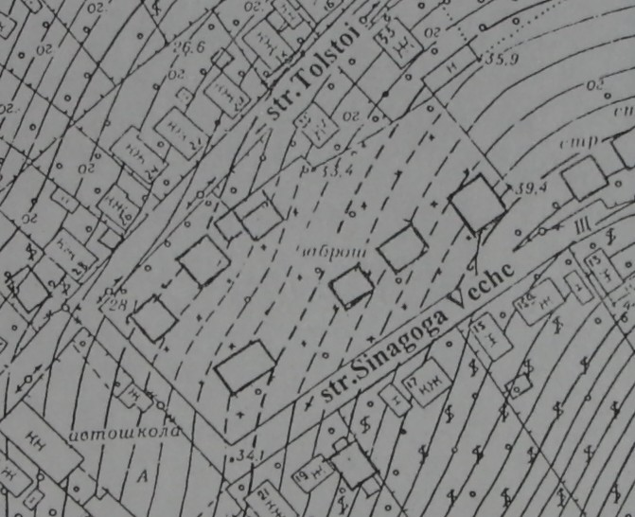
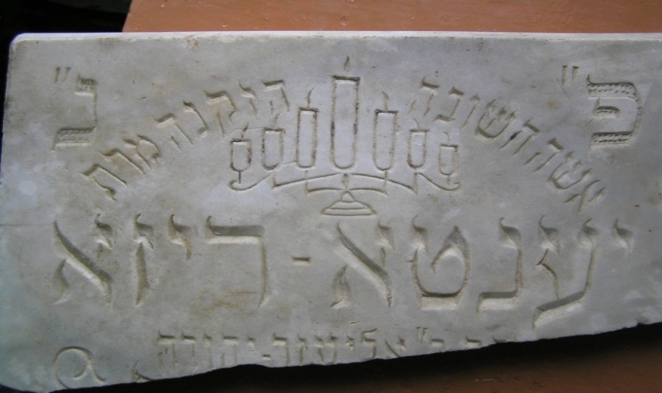
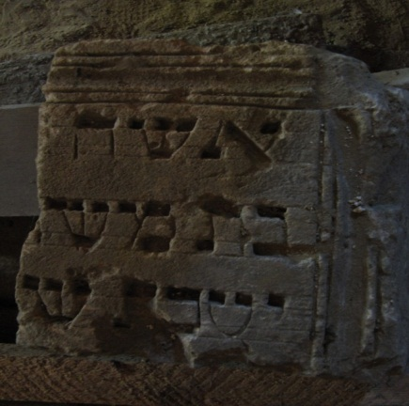
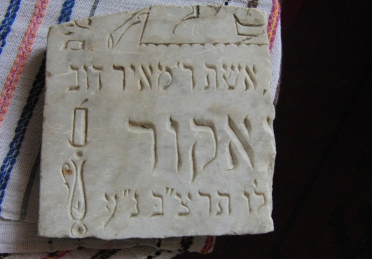
Kaushany, 21 century
According to my parents, relatives and friends from Kaushany, the last Jew left Kaushany in 1970s. At that time the cemetery was destroyed and farmer’s houses build on top. According to statistics from 2000, there are 6 Jews living in Kaushany…

Slide 17
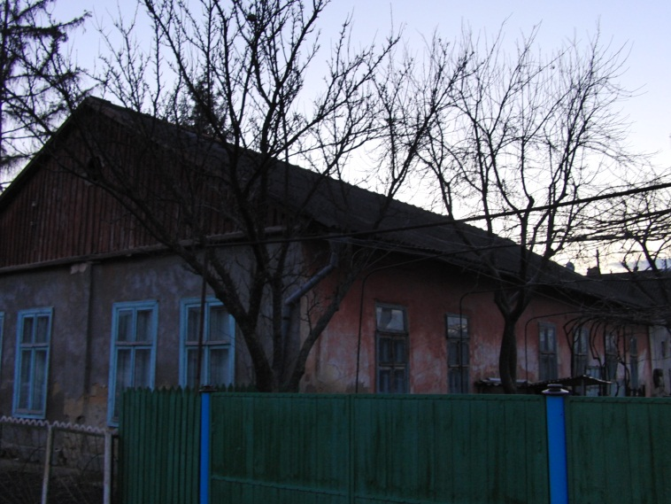
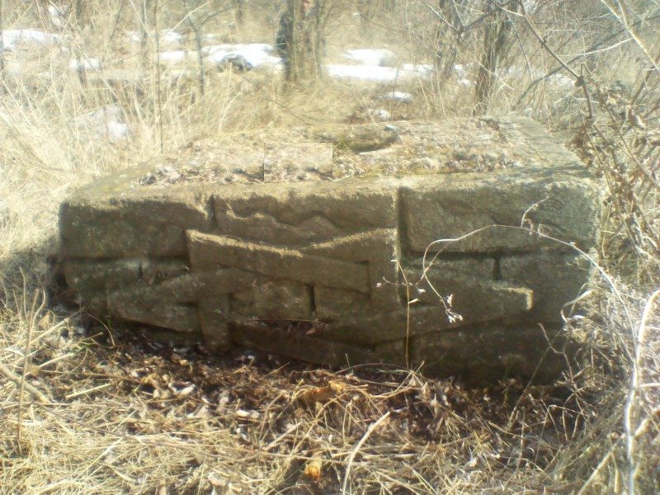
House in Kaushany, which is to this day called “Synagogue”, even though no synagogues have existed in Kaushany at least for 60 years.
ssd
A stone found not far from Kaushany in a wooded area.
Courtesy of Sergey Daniliyck, 2012

Slide 18
New findings not included in the original research
Official documents about division of land between Christians and Jews 1834-1837
School documents from 1936
Land documents from 1941, created by Romanian authorities during Bessarabia occupation in World War II

Slide 19
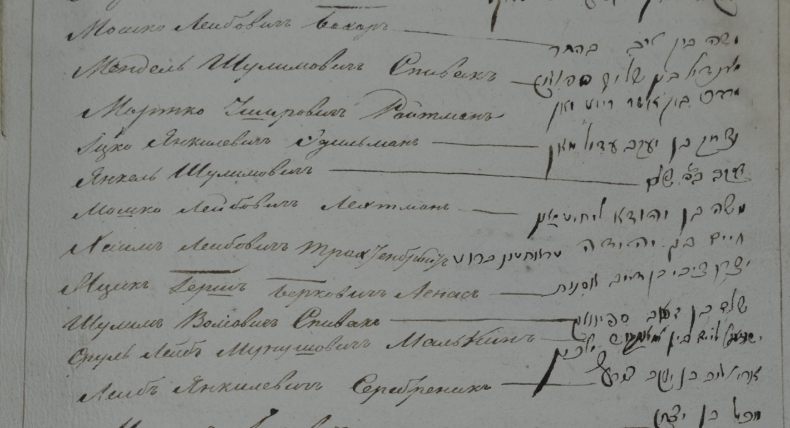
Official documents about division of land between
Christians and Jews, 1834-1837
After 3 years of meetings with officials and writing to authorities, Jewish society of Kaushany was separated with their land! Jews will pay land taxes similar to other population in towns, and 80 existing families (according to last census) would have rights to the land in the future. 80 heads of households signed the sentence. <This long document will be fully translated in the future.>

Slide 20
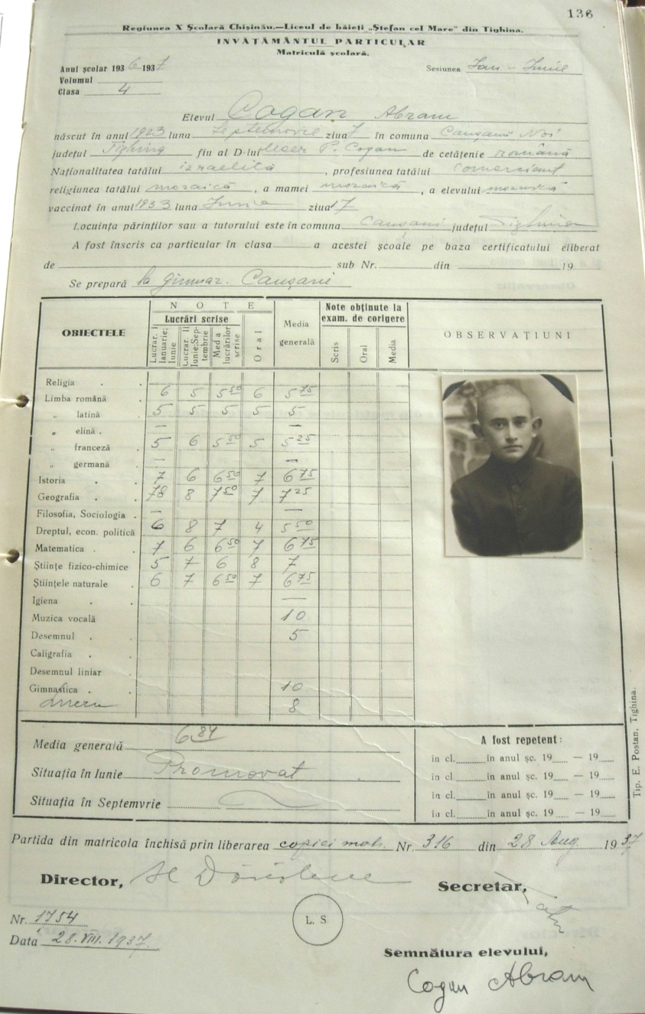
School documents from 1936-37
School report card (in Romanian) for my father (z’’l) Abram Kogan with his photo and signature.
It says in the report that his nationality is Israelita and religion of father, mother and Abram is Mosaic. Also father’s profession – commerce.

Slide 21
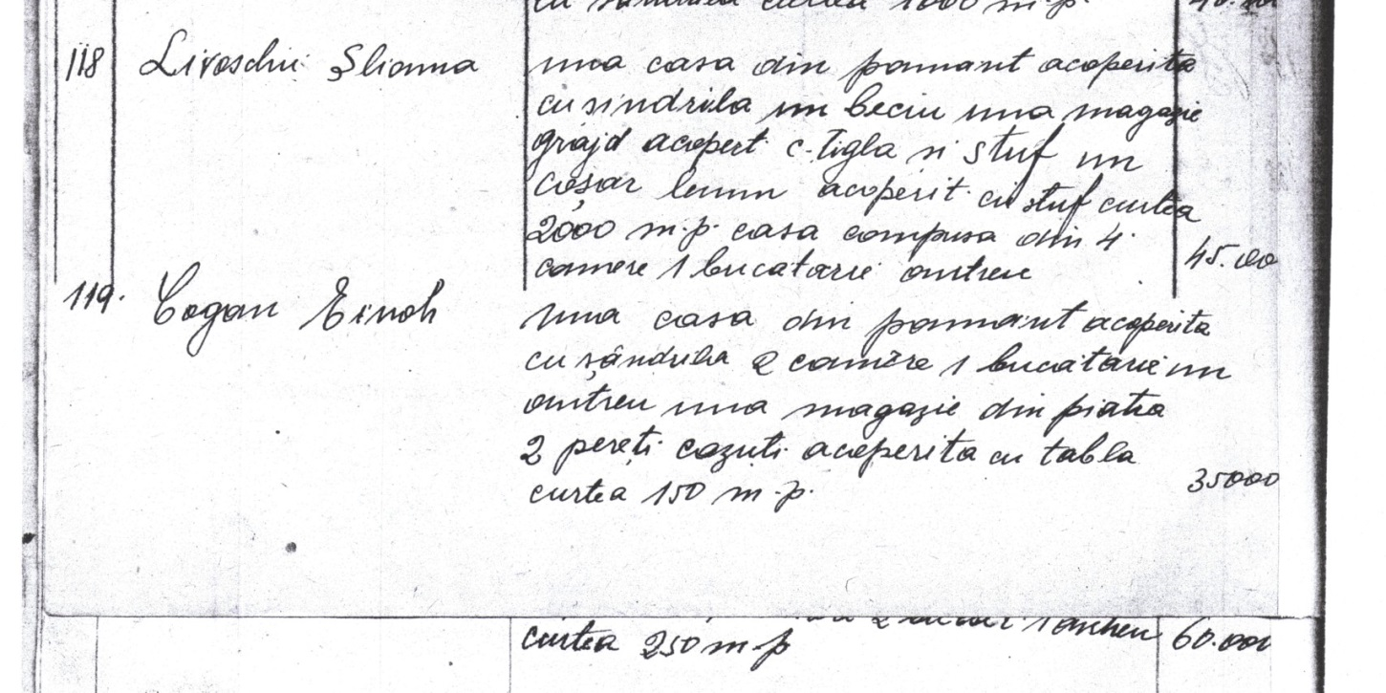
Land documents from 1941, created by Romanian authorities during Bessarabia occupation in World War II
227 families owned houses in Kaushany, from total of about 400-500 families before the war.
Kogan Eynekh
One house on the ground, covered with planks. 2 rooms and 1 kitchen, a store made of stone covered with iron. Yard 150 sq.m., 35,000 (cost).

Slide 22
What else I am looking at?
Find a census of Jews from 18 century, Moldova/Ottoman Empire (it was one in 1770s done by Russian army, who stationed in Bessarabia)
Find out when the first Jews appeared in Kaushany? (I think around 16 century)
Find origin of these Jews in Kaushany.
More…

Slide 23
There is not a single monument,
sign,
tablet, or reminder
of a Jewish past for the Shtetl Kaushany.
Who will remember all who perished during
the Holocaust?
Who will put stones and flowers to a monument of the Jewish residents of Kaushany?
I will.

Slide 24
Jewish Life in Bessarabia Through the Lens of the Shtetl Kaushany
Full text of the research paper is available at: http://www.jewishgen.org/Bessarabia/files/FinalPaper.pdf
Questions ?

